Slide 1
Show and Tell
West Midlands Placement Portal (WMPP)
Sprint 9
8 November 2023

Slide 2
Outcomes for Sprint 9
A Placement Officer can complete the journey to Create a new Referral, including capture of all info, uploading documents, and determining what Providers will receive it.
A Provider can view a summary of a referral (including standard, sibling and parent & child variations)
Development have all the information required to start work on Provider Referral List screens and functionality
All information required to authorise a placement is confirmed so that child can be placed in a timely way
Manage Referral: journeys that trigger a change in referral status by a Placement Officer have designs that can be tested with users
Complete Discovery phase for manage referral - History log, notification requirements

Slide 3
Agenda
Discover
Design
Develop
Test
Create new Referral
View new Referral
Manage referral workstack
Respond & action referrals
11:00 Targeted outcomes for sprint
11.10 View referral (Provider)
11:15 Respond and action referrals (provider)
11.35 Manage referral workstack
11:40 Provider survey findings
11.55 Next steps

Slide 4
View Referral
Discover
Design
Test
Develop

Slide 5
Respond and action referrals - Make an offer
Discover
Design
Develop
Test

Slide 6
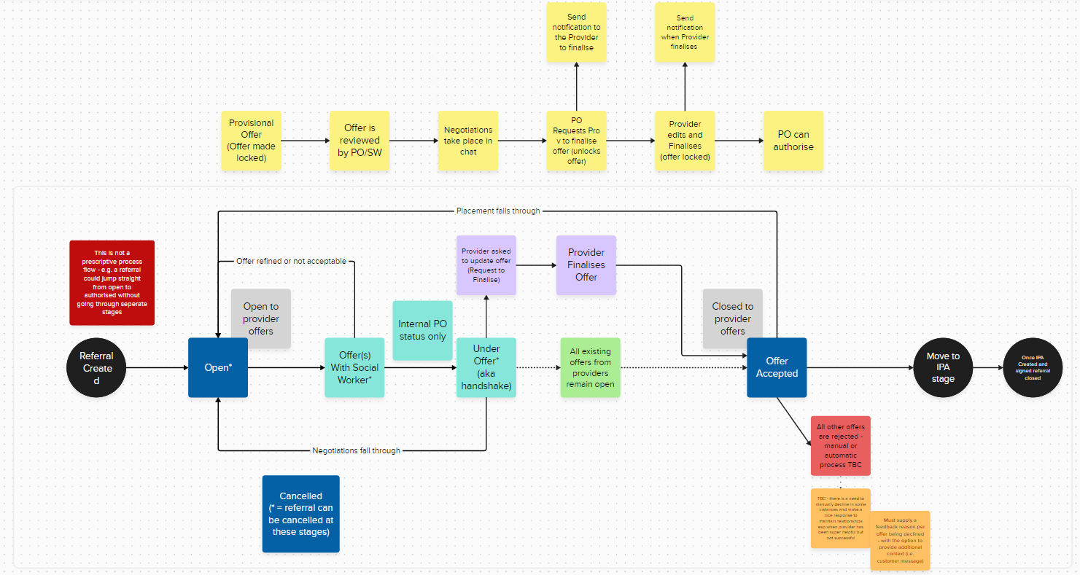
Previous Action Structure

Slide 7
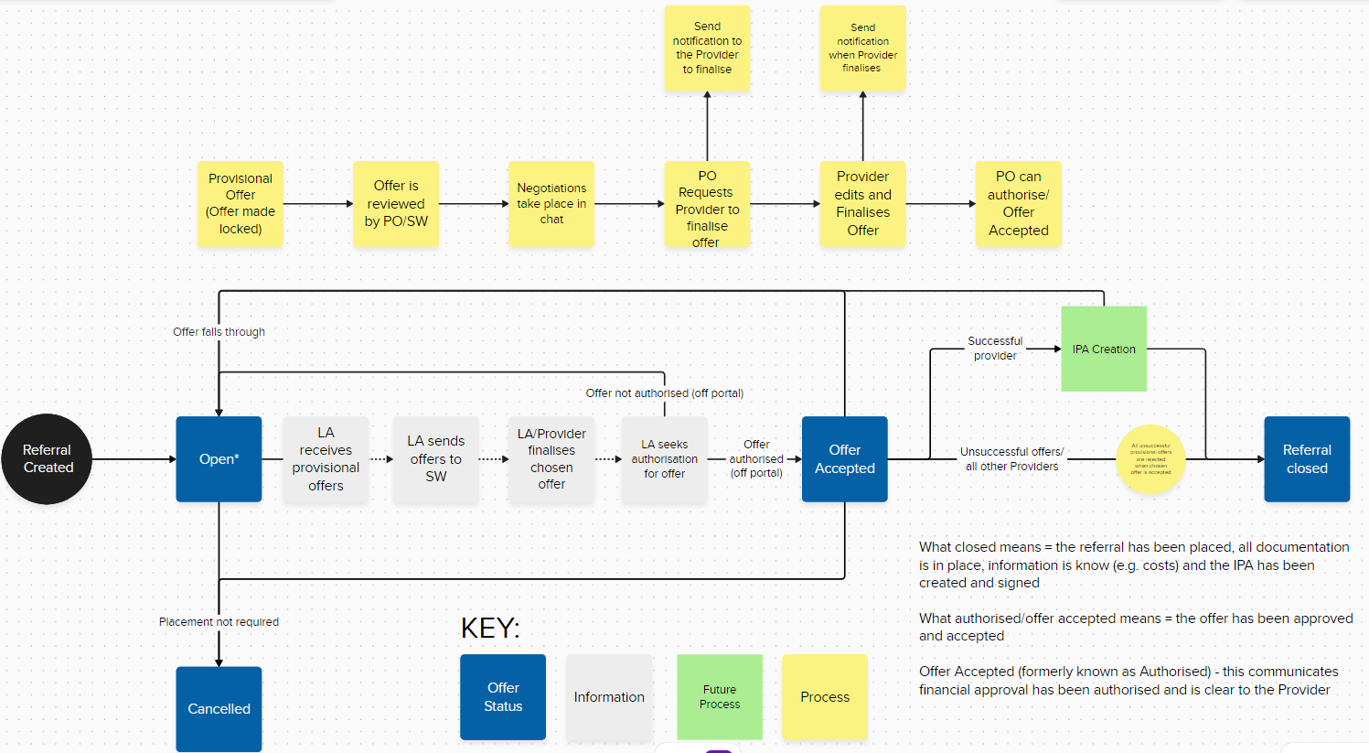
Simplified Action Structure

Slide 8
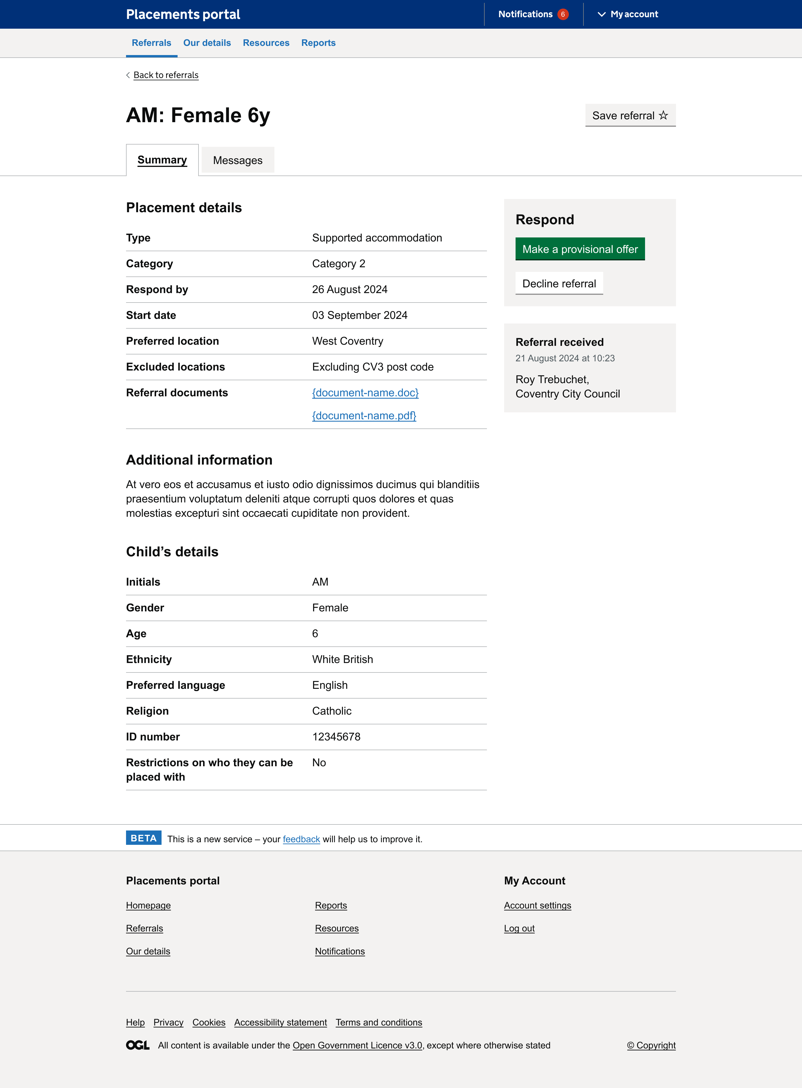
Provider: Make a provisional offer
View prototype​
Notes:
As most participants struggled to locate saved referrals we could consider the placement
of ‘Apply filters’ button, or moving the ‘Saved’ option closer to the ‘apply filters’ button.

Slide 9
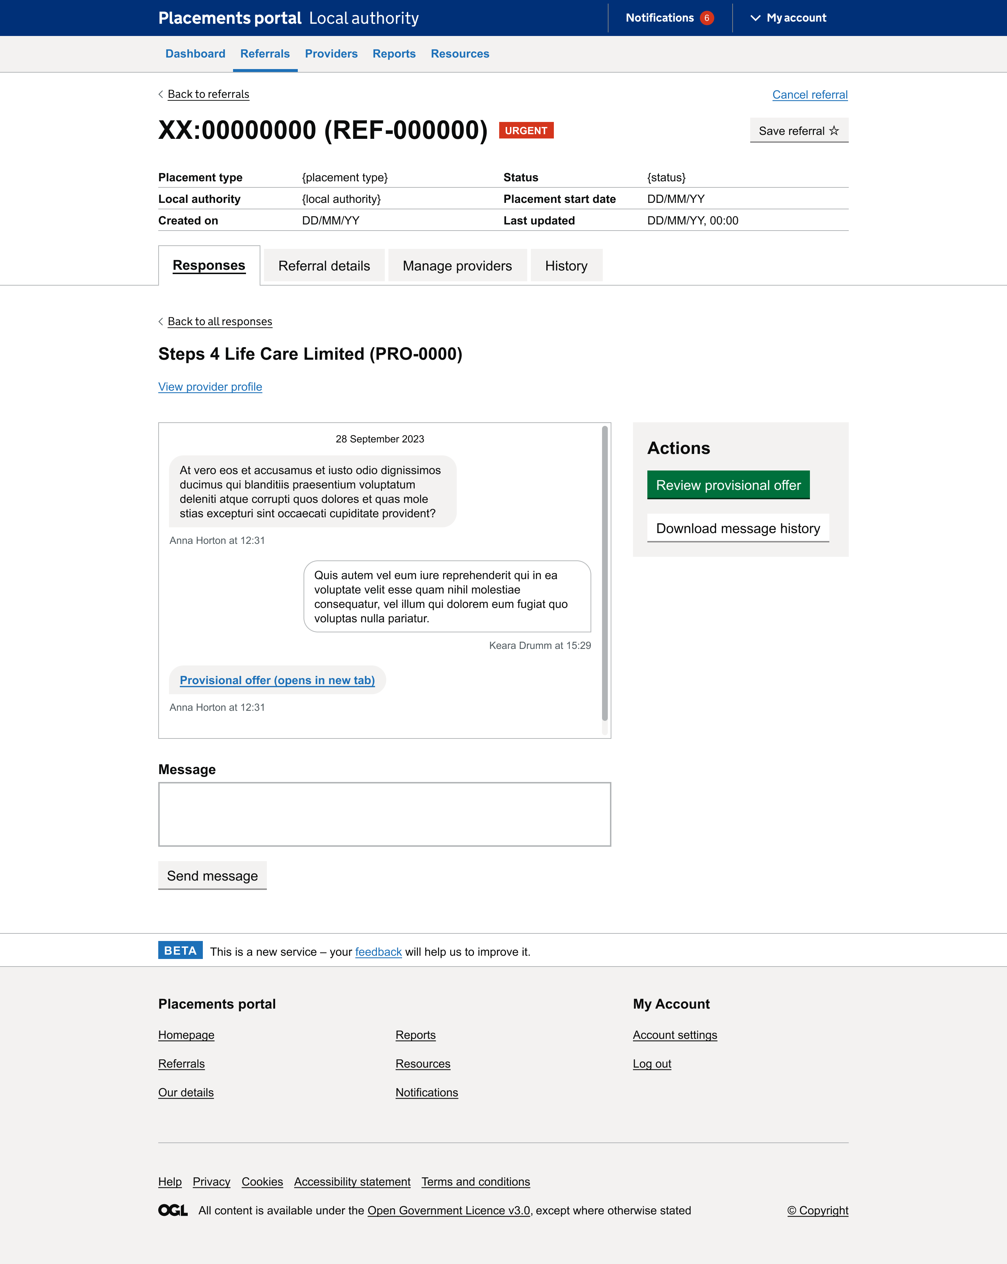
Local authority: Review provisional offer and request final offer
View prototype​
Notes:
As most participants struggled to locate saved referrals we could consider the placement
of ‘Apply filters’ button, or moving the ‘Saved’ option closer to the ‘apply filters’ button.

Slide 10
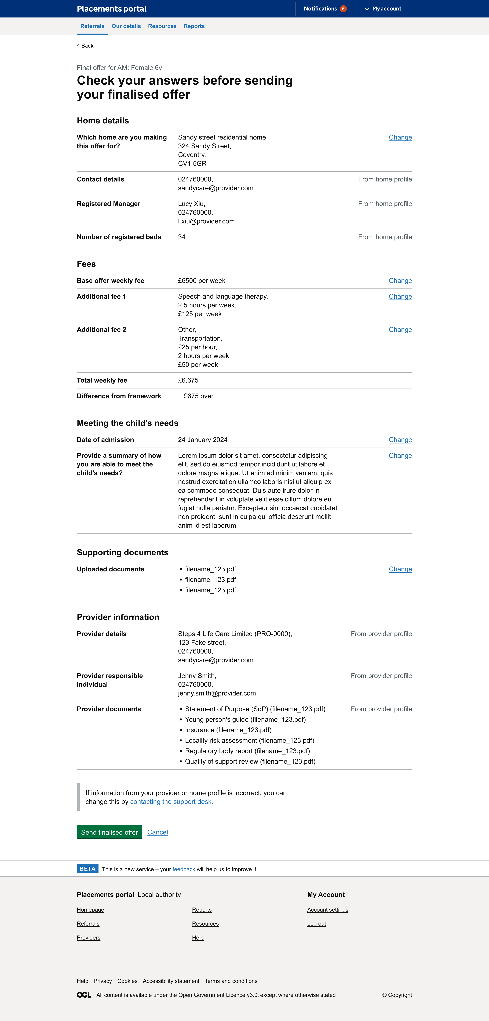
Provider: Finalise offer
View prototype​
Notes:
As most participants struggled to locate saved referrals we could consider the placement
of ‘Apply filters’ button, or moving the ‘Saved’ option closer to the ‘apply filters’ button.

Slide 11
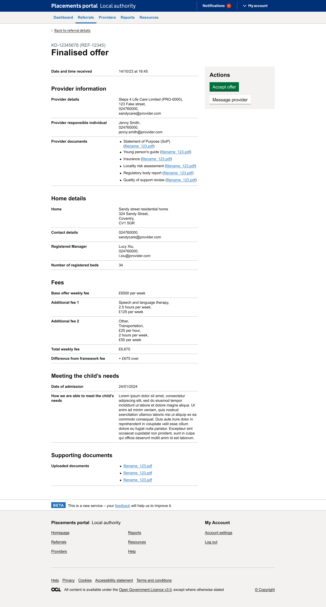
Local authority: Review and accept final offer
View prototype​
Notes:
As most participants struggled to locate saved referrals we could consider the placement
of ‘Apply filters’ button, or moving the ‘Saved’ option closer to the ‘apply filters’ button.

Slide 12
Manage referral workstack Local Authority
Discover
Design
Develop
Test

Slide 13
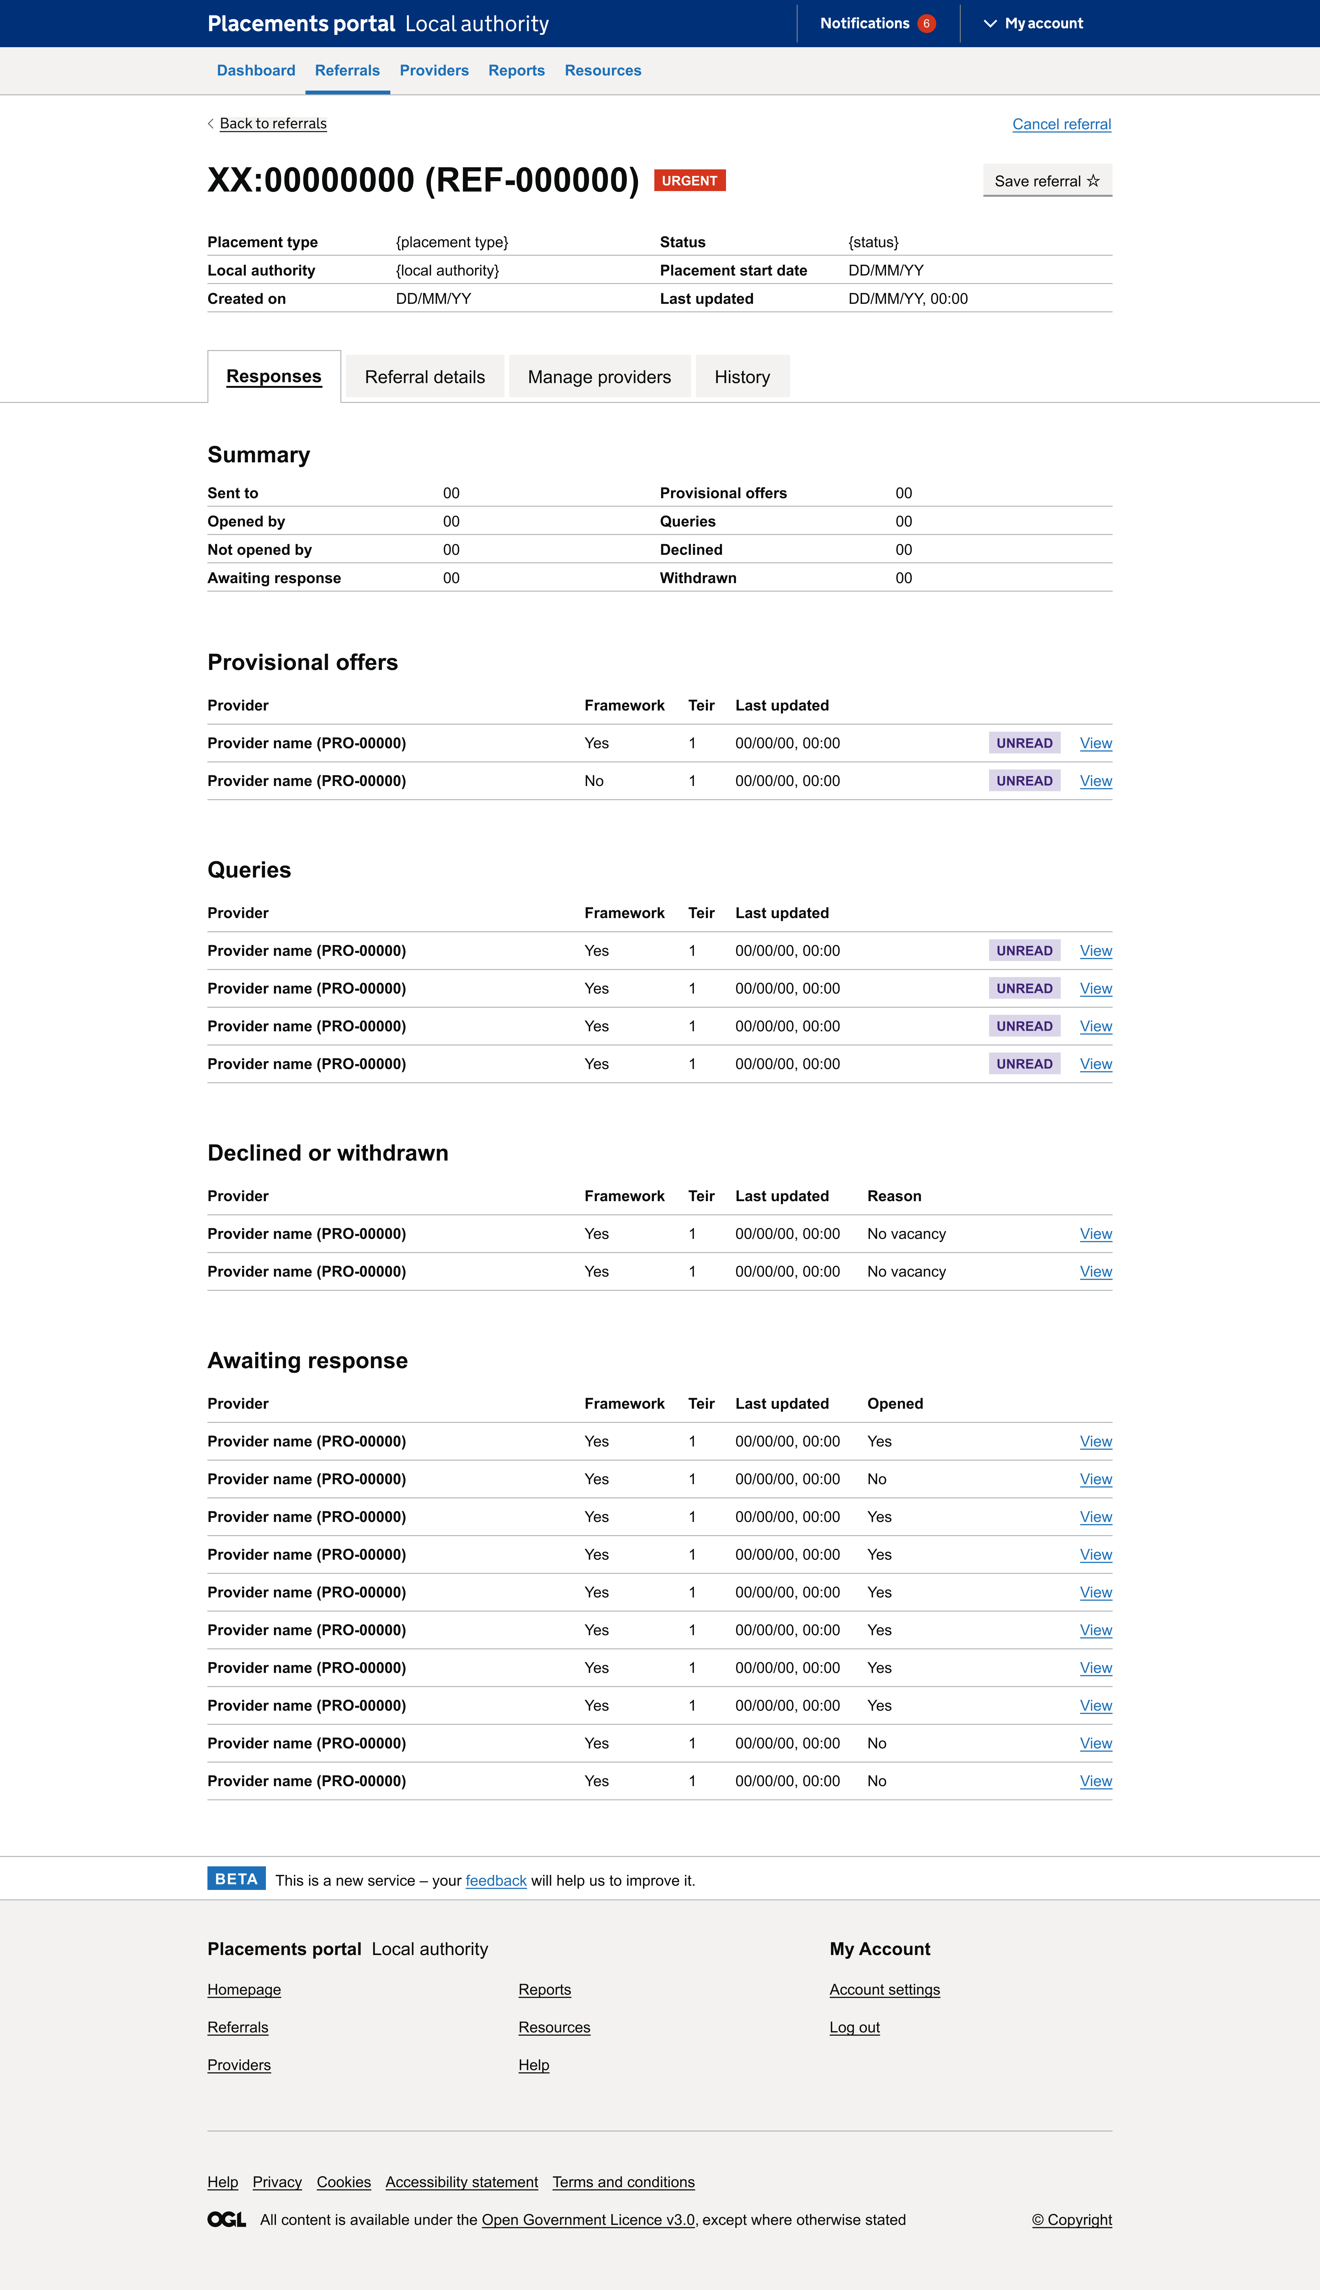
Design updates: Overview
Removed referral ID from referral summary (as it is in the title)
Added 'Last updated' row to the referral summary
Changed the tab name to 'Manage providers' as users were confused with 'Provider search'
Notes:
As most participants struggled to locate saved referrals we could consider the placement
of ‘Apply filters’ button, or moving the ‘Saved’ option closer to the ‘apply filters’ button.

Slide 14
Design updates: Responses
Tiers: Added in a tiers column so that tiers are shown (if applicable)
Opened/Not opened: Added in a column within the 'Awaiting response' section to identify which providers have opened the referral
Contact information: How might we link directly to provider profile in awaiting response or a way to view contact information...
Notes:
As most participants struggled to locate saved referrals we could consider the placement
of ‘Apply filters’ button, or moving the ‘Saved’ option closer to the ‘apply filters’ button.

Slide 15
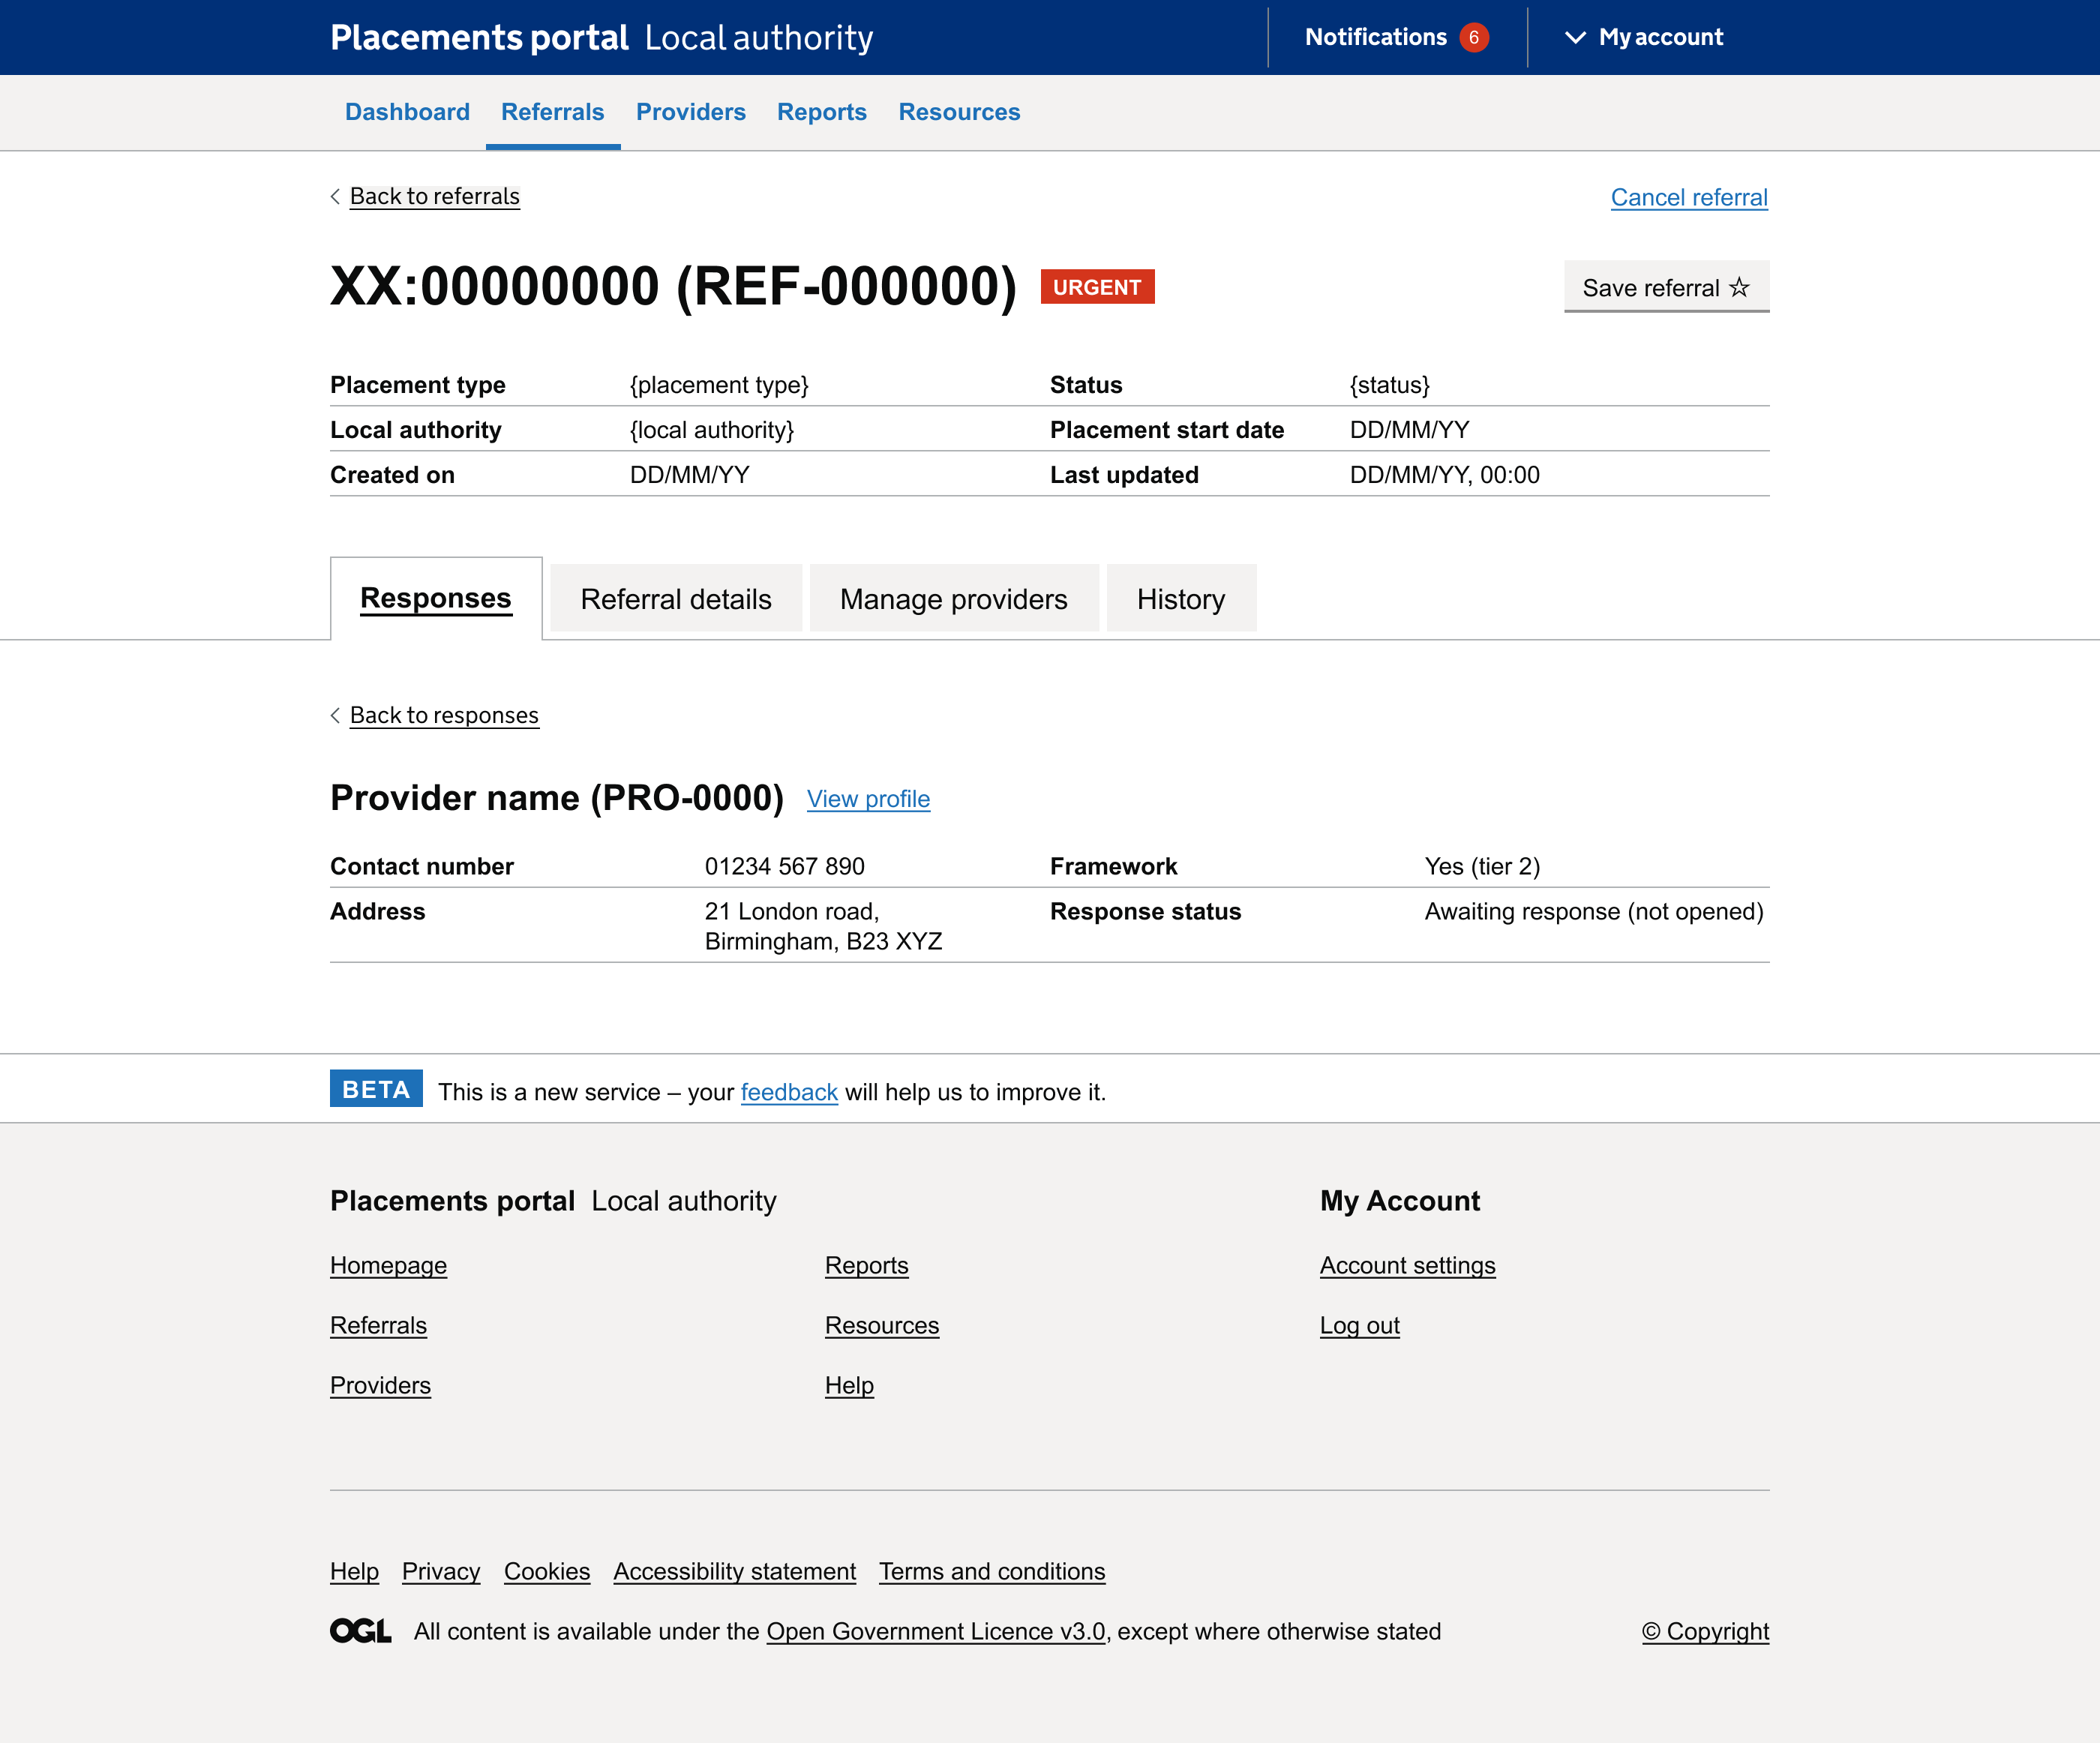
Design updates: Provider details
High-level provider information regardless of the response:
Contact number
Address
Framework/Tiers
Response status
Access to full provider profile via 'view profile' link
Notes:
As most participants struggled to locate saved referrals we could consider the placement
of ‘Apply filters’ button, or moving the ‘Saved’ option closer to the ‘apply filters’ button.

Slide 16
Provider survey - findings
Discover
Design
Develop
Test

Slide 17
Survey Results
The survey was to help us understand providers views and their structure 74 providers answered the survey
Notes:
As most participants struggled to locate saved referrals we could consider the placement
of ‘Apply filters’ button, or moving the ‘Saved’ option closer to the ‘apply filters’ button.

Slide 18
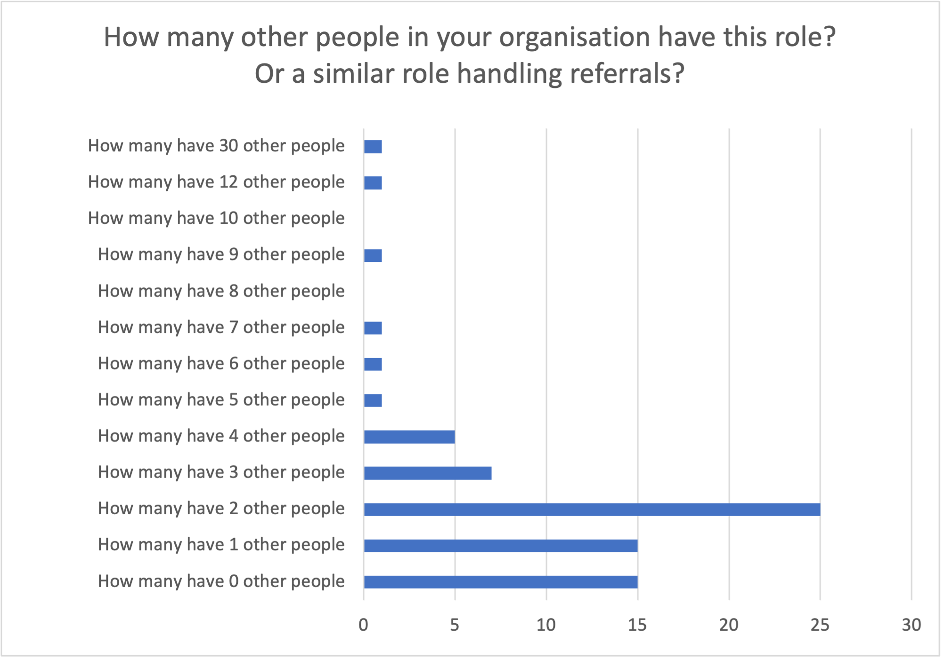
How many people handle referrals and need access to the portal in provider organisations?
34% people have 3 people (2 other people and the person who answered the survey) working on referrals.
58% providers have either three or more people that focused on managing referrals.
The higher the number of people the larger the organisation. The highest number of people in this sample working on referrals in one organisations being 30 this provider manage over 1000 foster carers.
For MVP understanding how multiple access and notifications for multiple users is important
Q.How many other people in your organization have this role? Or similar role handling referral? Understanding providers views survey; Nov 2024; Base = All answering question (74)
Number of providers

Slide 19
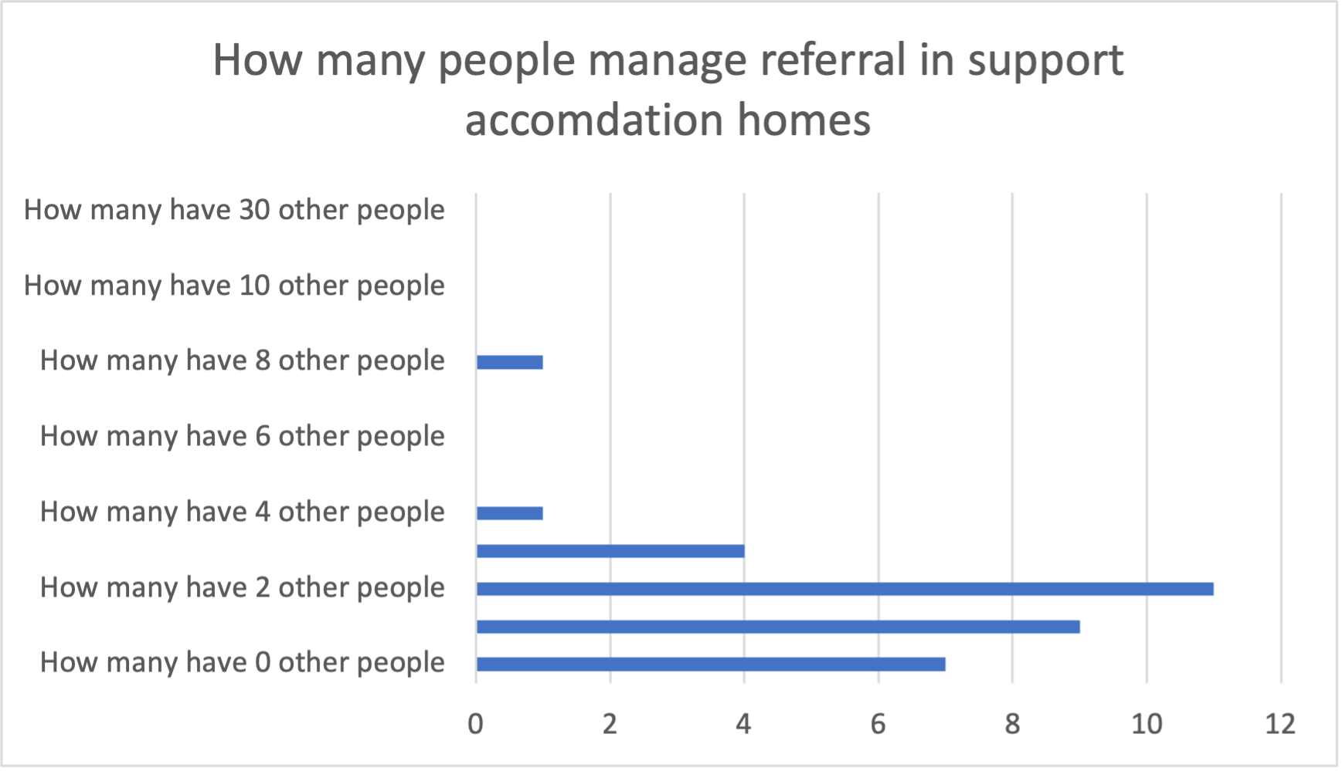
How many people handle referrals for support accommodation homes?
When looking at how many people manage referral for supported accommodation 33% had 3 people working on referrals.
52% of residential providers had 3 or more people working on referral management.
Q How many other people in your organization have this role? Or similar role handling referral? Understanding providers views survey; Nov 2024; Base = Support accommodation providers answering question (33)
Number of providers

Slide 20
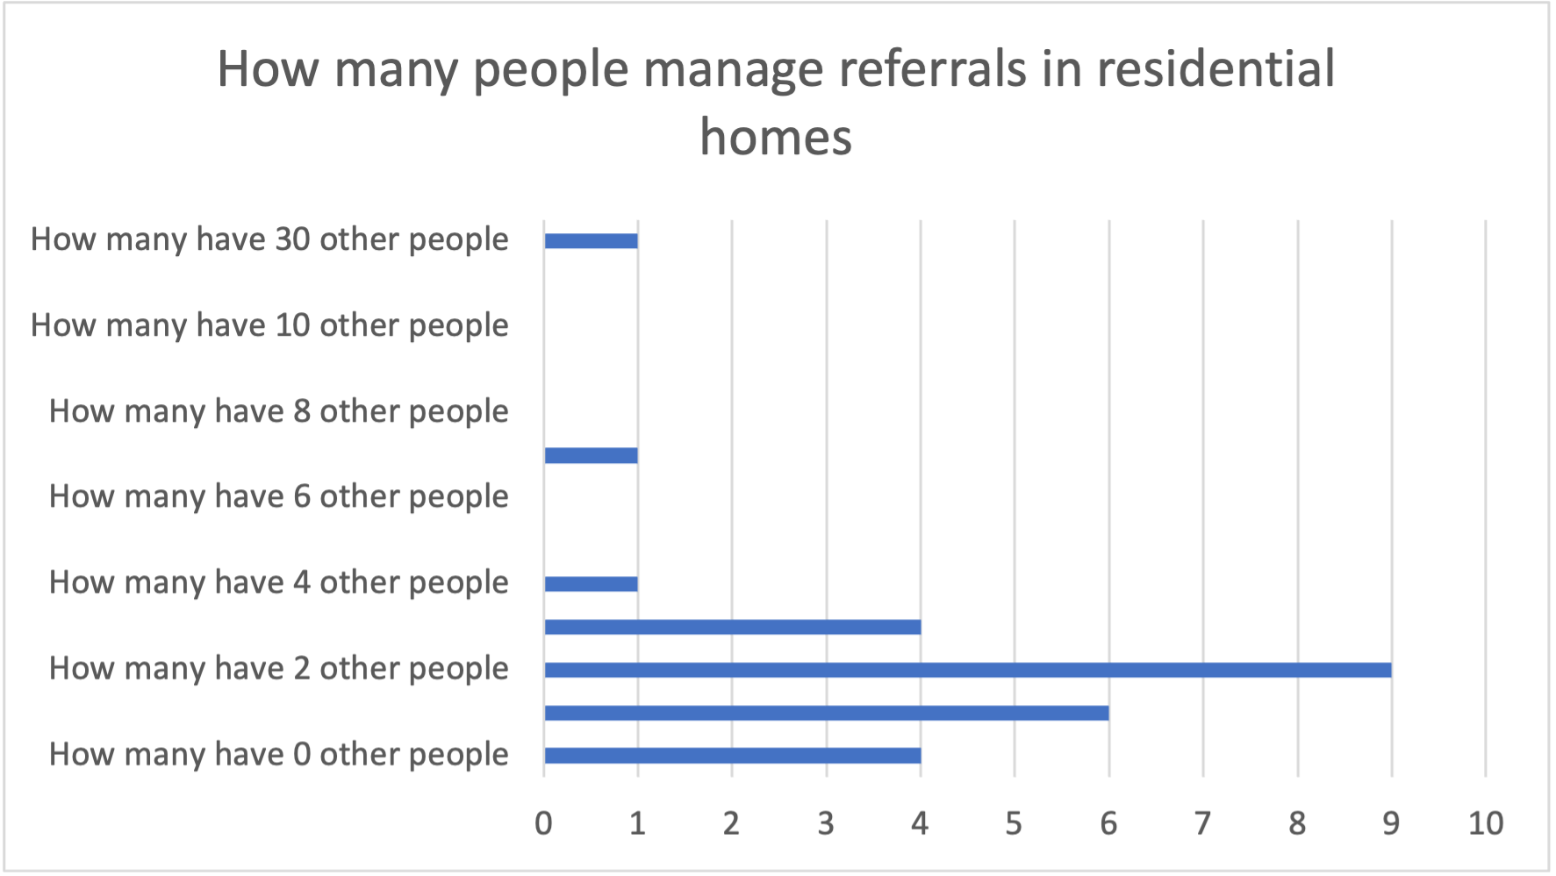
How many people handle referrals for residential homes?
When looking at how many people manage referral for residential homes 35% had 3 people working on referrals.
62% of residential providers had 3 or more people working on referral management.
Number of providers
QX How many other people in your organization have this role? Or similar role handling referral? Understanding providers views survey; Nov 2024; Base = Residential providers answering question (26)

Slide 21
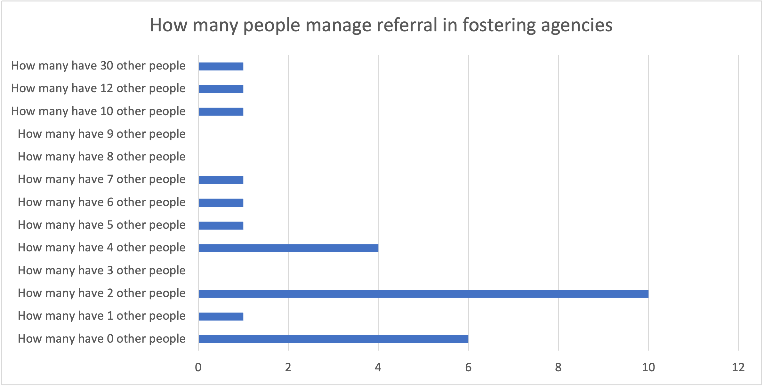
How many people handle referrals in foster agencies?
When looking at how many people manage referrals for foster agencies 37% had 3 people working on referrals.
74% of foster agencies had 3 or more people working on referral management.
Number of providers
Q How many other people in your organization have this role? Or similar role handling referral? Understanding providers views survey; Nov 2024; Base = Residential providers answering question (27)

Slide 22
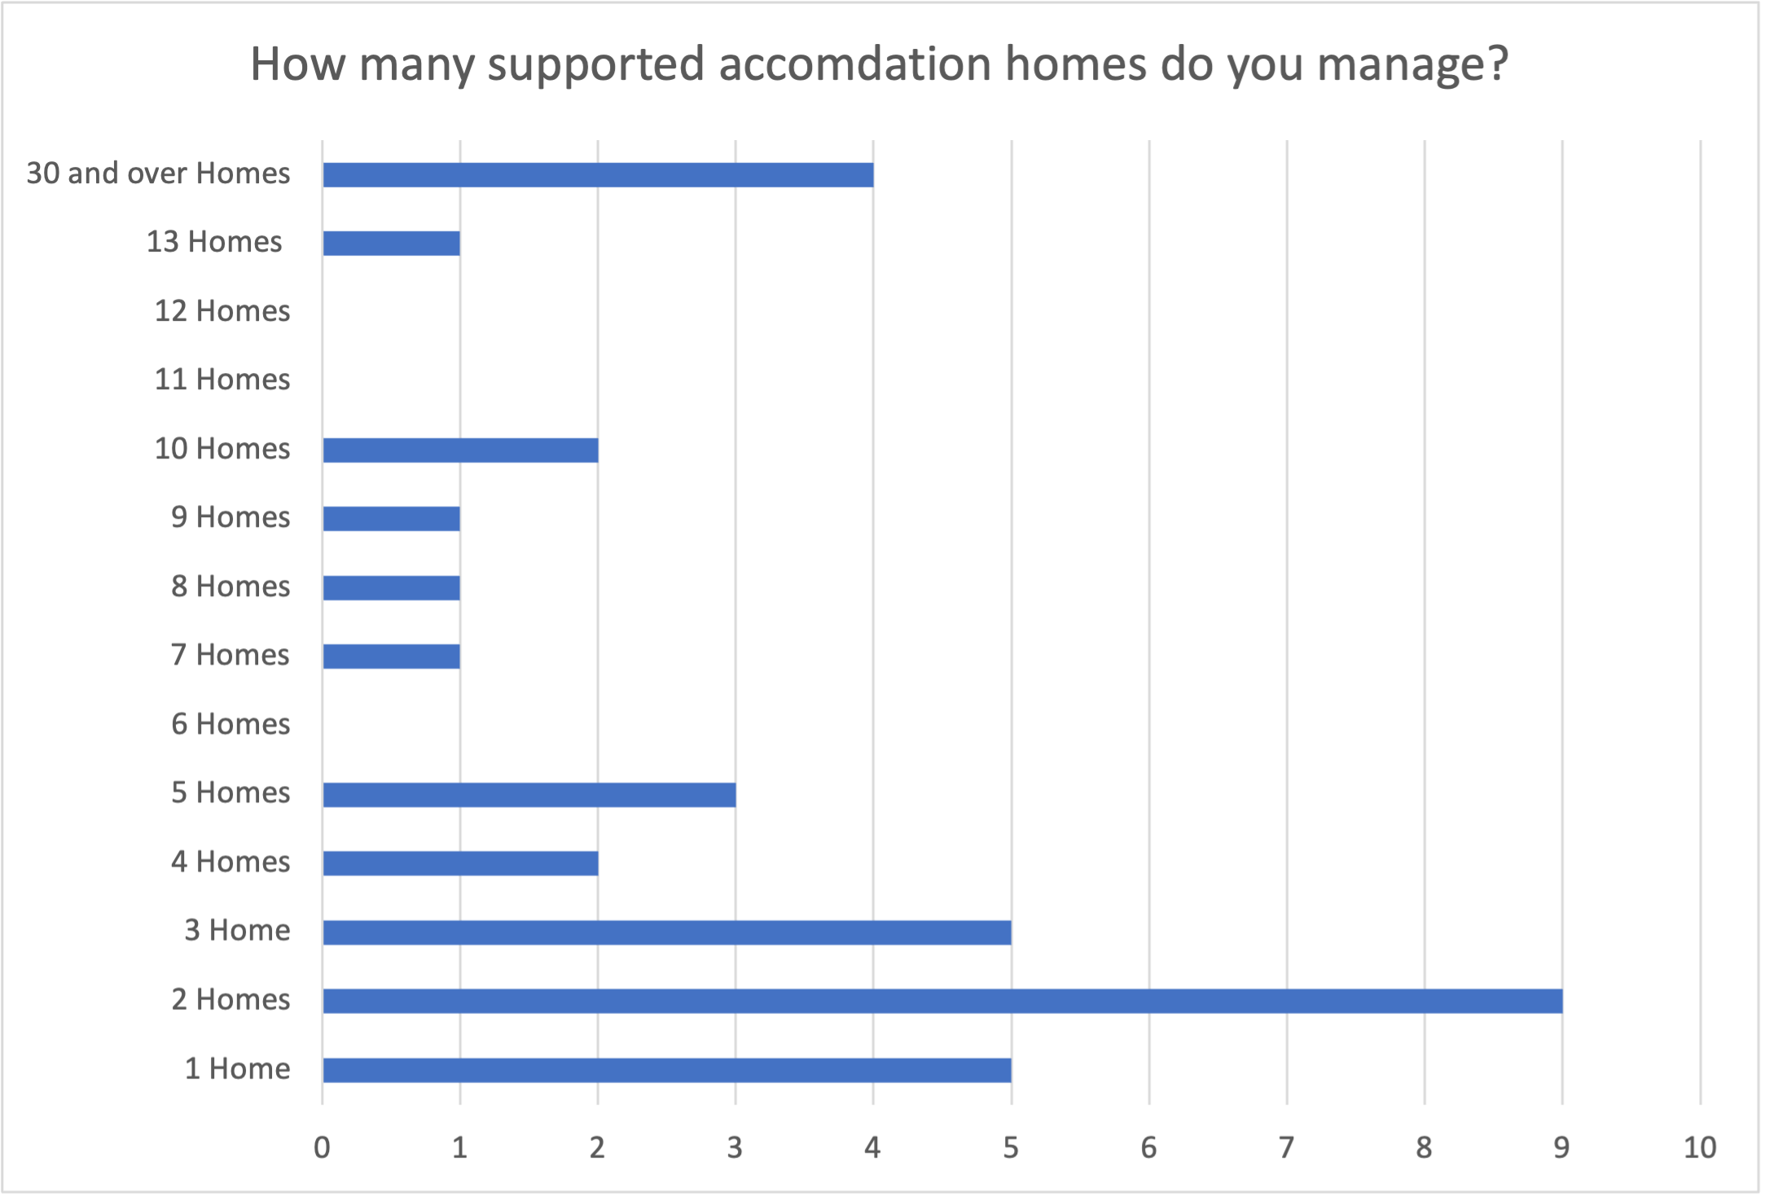
How many homes do support accommodation providers manage?
45% the providers who supply support accommodation manage 4 or more homes.
With the most homes managed by provider was 50 homes managed by one provider. This provider had 90 – 100% of their homes in the west midlands.
Q How many supported accommodation homes do you manage? Understanding providers views survey; Nov 2024; Base = All answering question (33)
Number of providers

Slide 23
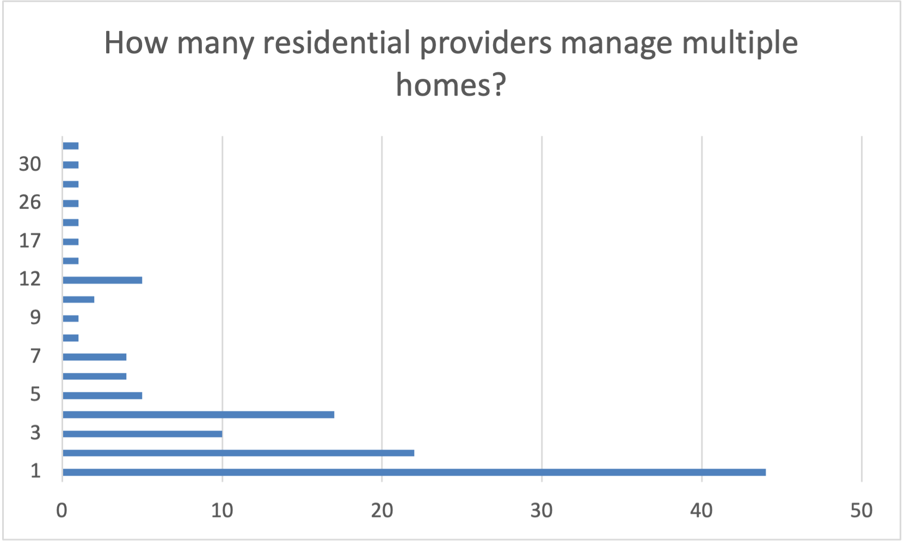
How many homes do residential providers manage?
59% of residential providers manage 1 home
38% of providers manage 4 or more homes
Highest number of homes residential provider on framework managed is 36 homes.
How many homes that a residential provider manages
No. providers
Data taken from FCA residential framework spreadsheet Base = providers (122)

Slide 24
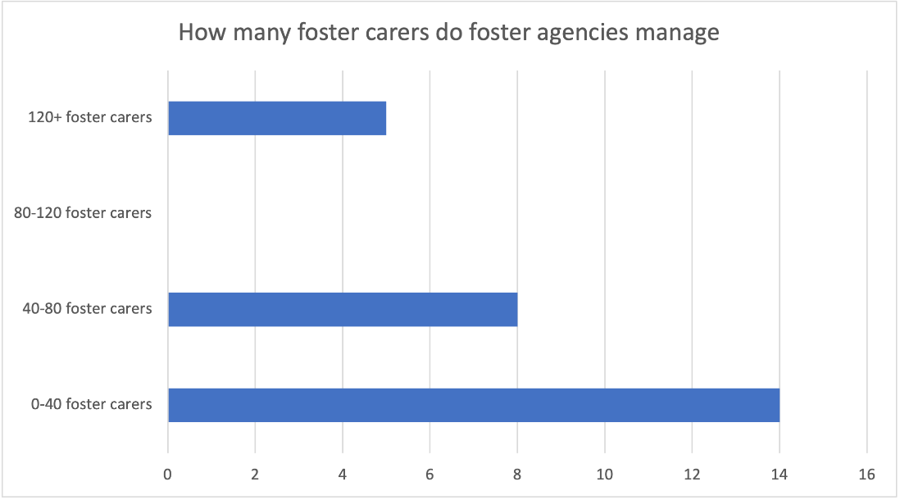
How many foster carers do fostering agencies manage?
52% foster agencies mange 40 or less foster carers. With lowest number of foster carers being 5.
19% foster agencies mange 120 or more. With highest number of foster carers being 1154.
This highlights that in some cases there may be multiple foster carers that are suggested for one child
No. providers
Q How many foster carers do you manage? Understanding providers views survey; Nov 2024; Base = All answering question (27)

Slide 25
Do providers manage more than one type of accommodation?
There are few organisations that offer multiple types.
There were 5 organisations that offer support accommodation and residential.
There were 4 organisations that offer residential and fostering.
There were 0 organisations that offer support accommodation and fostering
There are 2 organisations that offer all 3 types of accommodation.
The organisations that offered all 3 services were not always the largest organisations and often only had 3 members of staff handling referrals.
12% of organisations handle 2 or more types of accommodation.
Q.How many other people in your organization have this role? Or similar role handling referral? Understanding providers views survey; Nov 2024; Base = All answering question (74) + Q How many support accommodation, residential or foster carers do you manage Understanding providers views survey; Nov 2024; Base = All answering question (74)

Slide 26
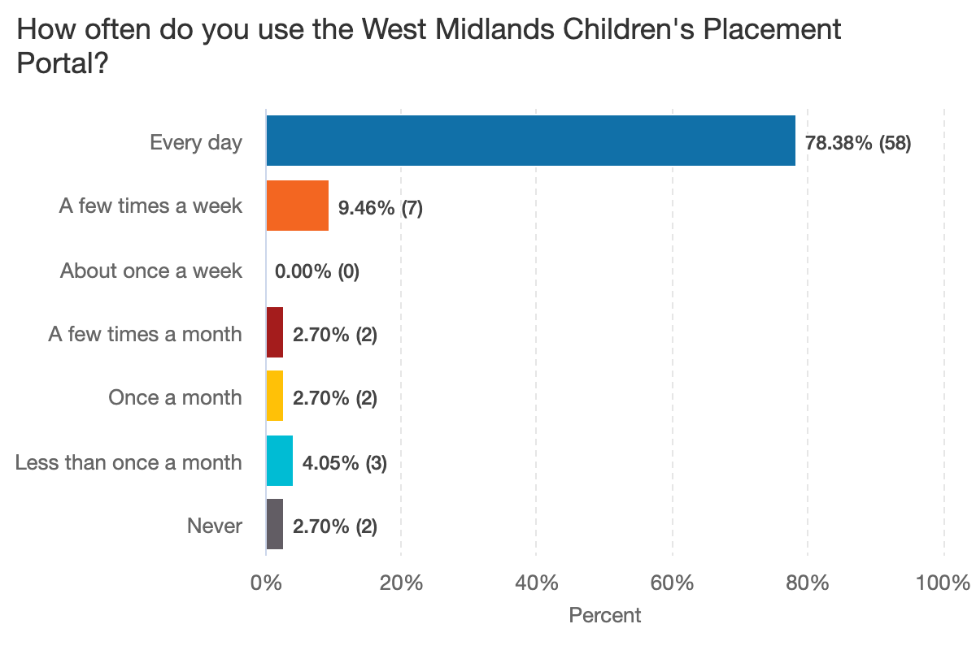
How often is the portal being used?
The portal is being used every day by most providers.
However we have heard in qualitative interviews this is not the case. This finding could be due to the survey being answered by those that are engaged

Slide 27
Do providers work on spot placements and framework placements?
Of the providers that answered the survey most offered spot placements less than once a month.
Most providers offer framework and spot placements
In the portal there will be one list for all people on the framework and one for those not on framework.
52 out 74 (70%) providers offered spot and framework placements.
Out of those that offer both 54% offered them less than once a month
13 out 74 (18%) providers were not on framework but offered spot placement. Of those 8 of 13 (62%) offered framework less than once a month

Slide 28
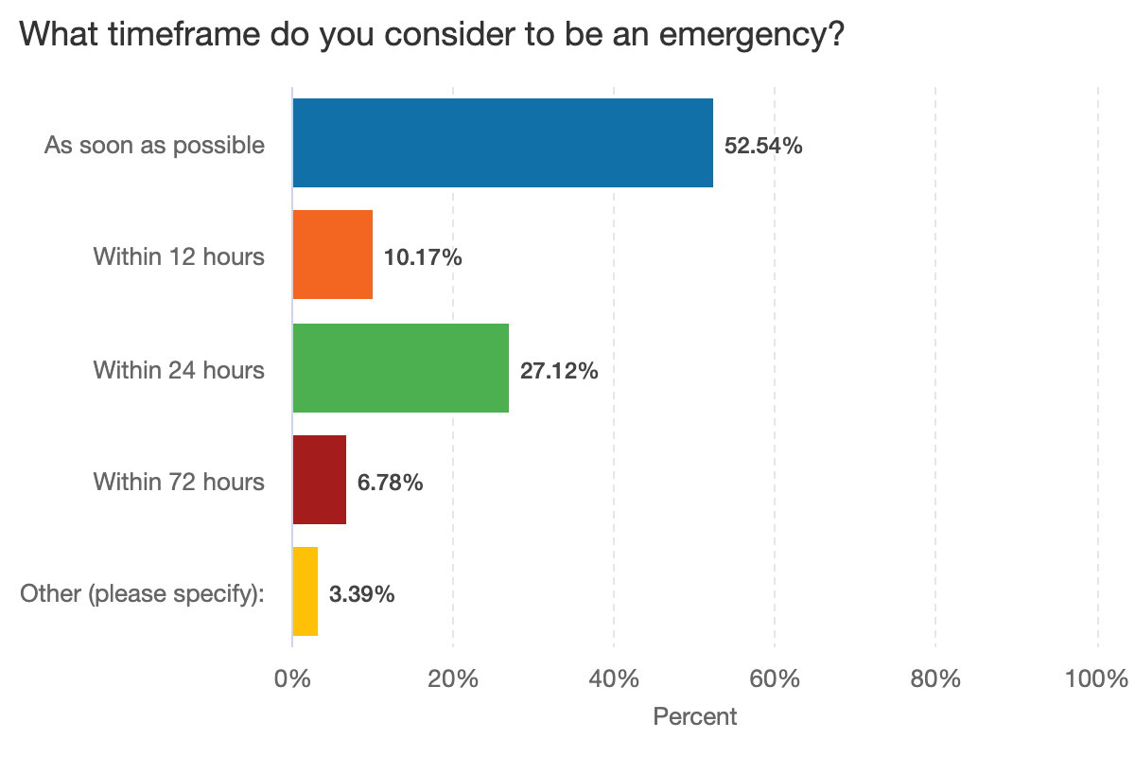
What do providers consider an urgent or emergency placement?
Most people understood emergency placements to mean as soon as possible or within 24hrs.
When training people on the new portal it is important that 'urgent' tag is universally understood as within 72 hours (as this is not currently be the case).

Slide 29
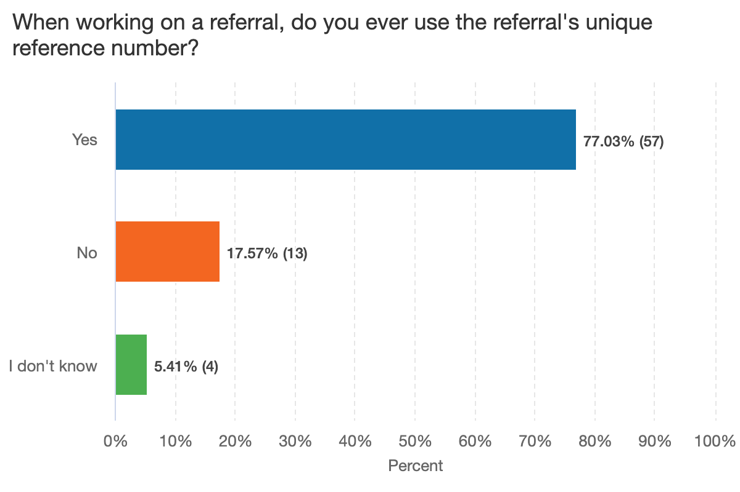
Is the reference number needed on the provider side?
Most providers do use the reference number to help them when managing and finding referrals they are working on.
It would be useful to include this on the provider listing page.

Slide 30
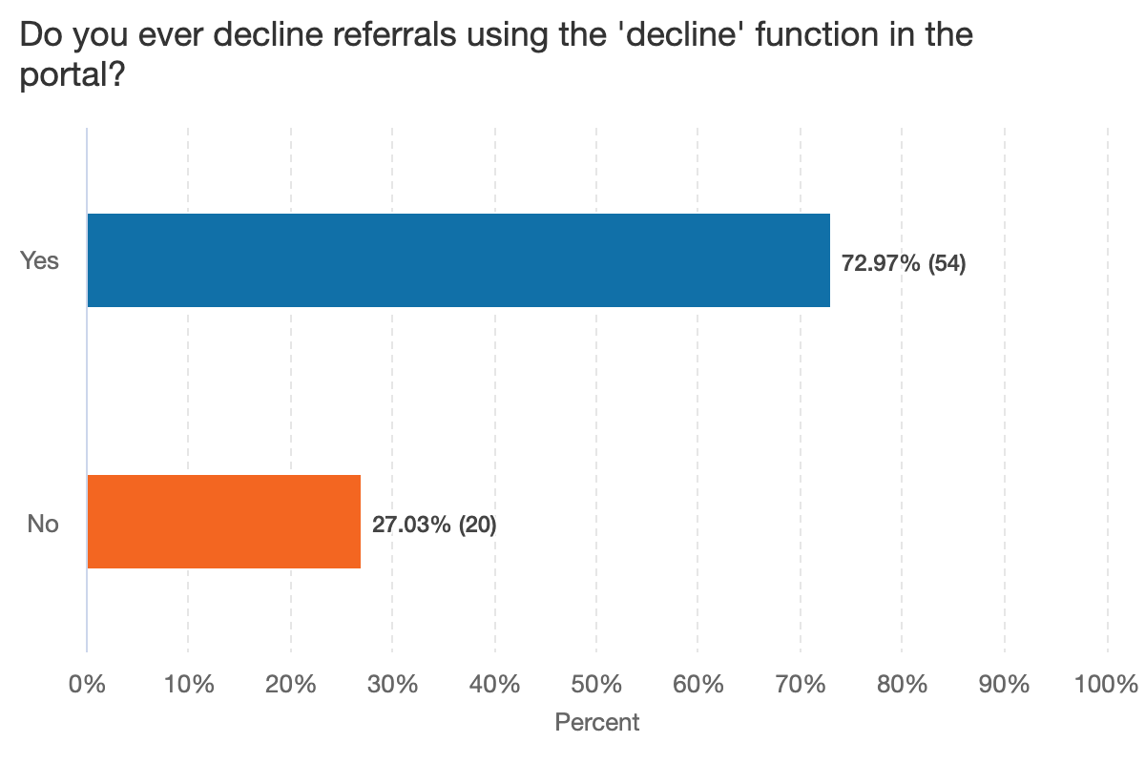
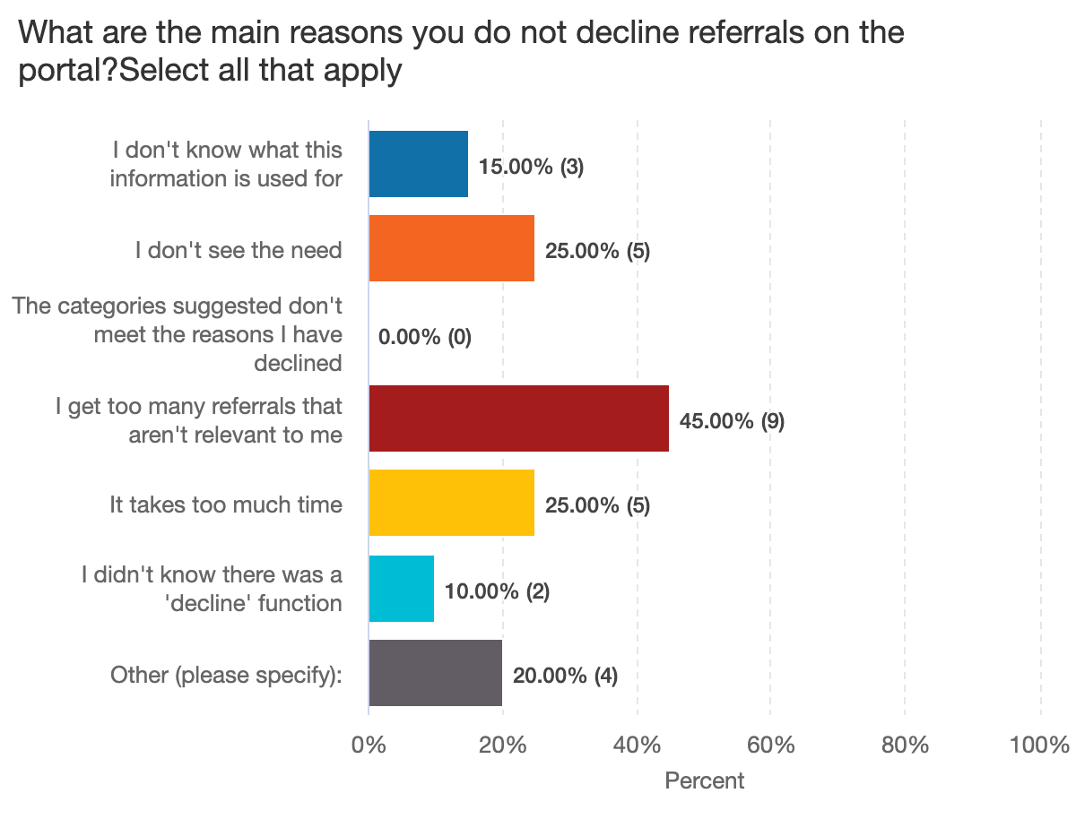
Is the decline function currently used in the portal?
Those that did not use it shared that getting too many referrals that weren't relevant to them as the main reason which may suggest that if the new portal sends relevant information, it may increase the use of this feature.
Most providers do use the decline feature currently so currently.

Slide 31
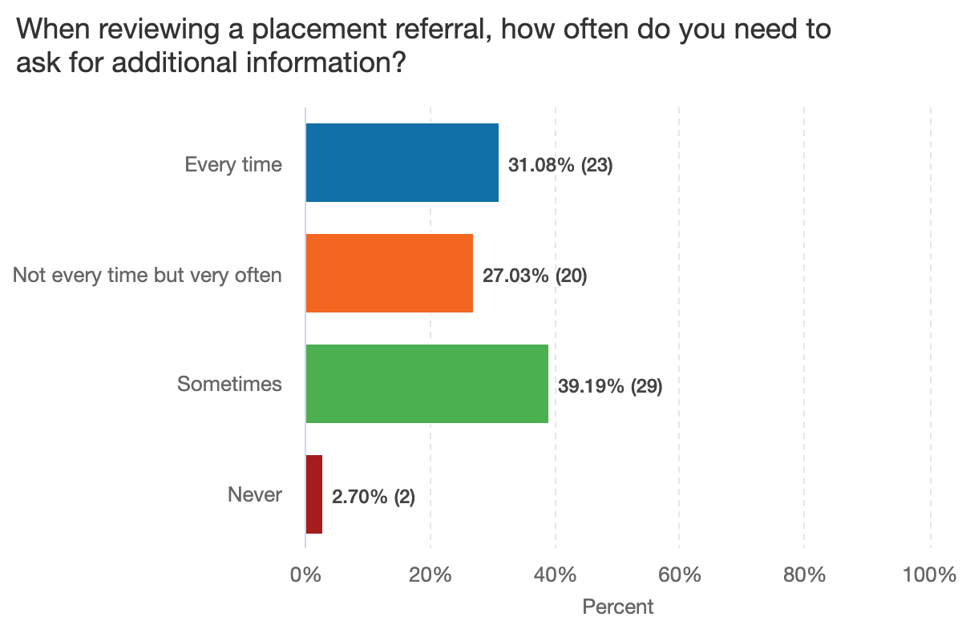
How often will additional information be needed and the query/ message feature be needed?
Most providers will need to use the query / message feature when reviewing a referral.

Slide 32
Next steps
Create new Referral
View new Referral
Manage referral workstack
Respond & action referrals
Start development on a Provider can navigate and organise their workstack of referrals (filter, sort, organise in tabs)
Manually test Create New Referral functionality on Portal
Test prototype designs for making an offer and referral listings view with users
Discovery of Frameworks and how they impact making an offer

