Slide 1
Show & Tell
West Midlands Placement Portal
Sprint 12 – 20th Dec 2023

Slide 2
Agenda
Discover
Design
Develop
Test
11:00 Project Update
11.10 Portal development - Demo
11:15 Approach for email notifications
11.20 Fostering – design changes
11:25 Social Worker research
11:45 Discovery – Provider registration
11.55 Roundup and Next steps

Slide 3
Project Update – Core Placement process
 | Requirements Discovered | Designs Agreed | Development complete | SW Testing Complete
Create New Referral
View referral
Manage Workstack
Respond & Action referrals
Provider
LA
Provider
LA
Provider
Provider

Slide 4
Manage Referral - Provider actions
Discover
Design
Test
Develop

Slide 5
Manage Referral - Email notifications
Discover
Design
Test
Develop

Slide 6
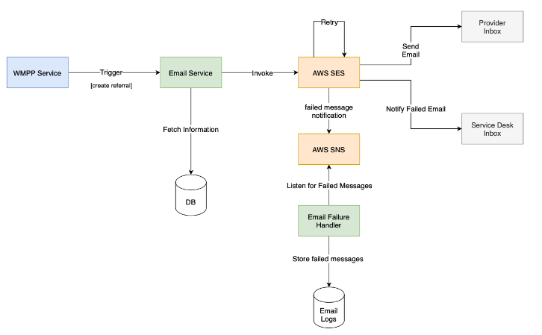
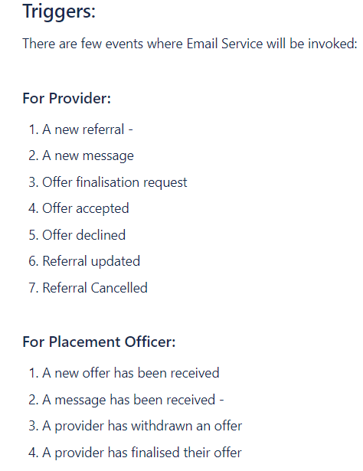
Technical approach
Notes:
It's also about relationships between providers and placement officers – some will call provders they know

Slide 7
Respond and action referrals - Make an offer - Fostering
Discover
Design
Develop
Test

Slide 8
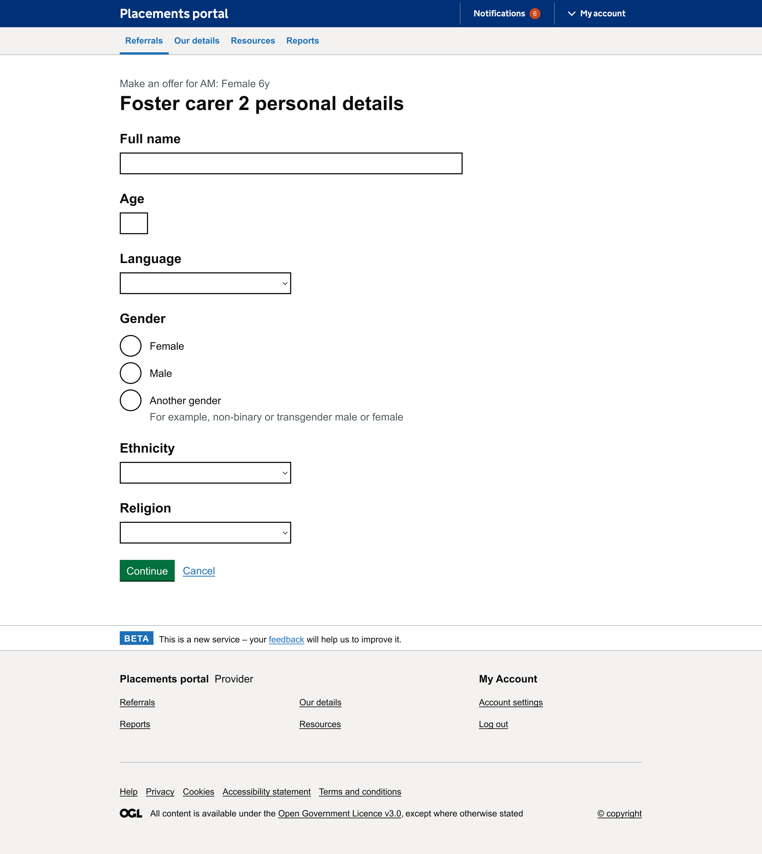
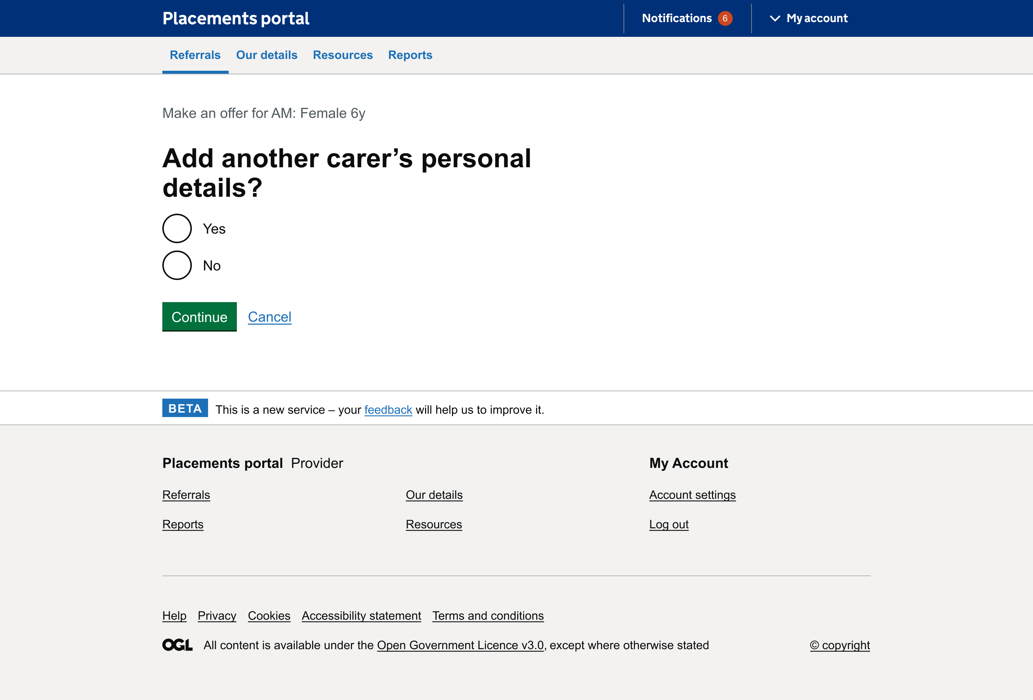
Ability to add details for two foster carers
Last sprint through user research interviews it was discovered that there was a need to add information for a second carer. The fostering journey now allows for provider to add both foster carer details.
Notes:
It's also about relationships between providers and placement officers – some will call provders they know

Slide 9
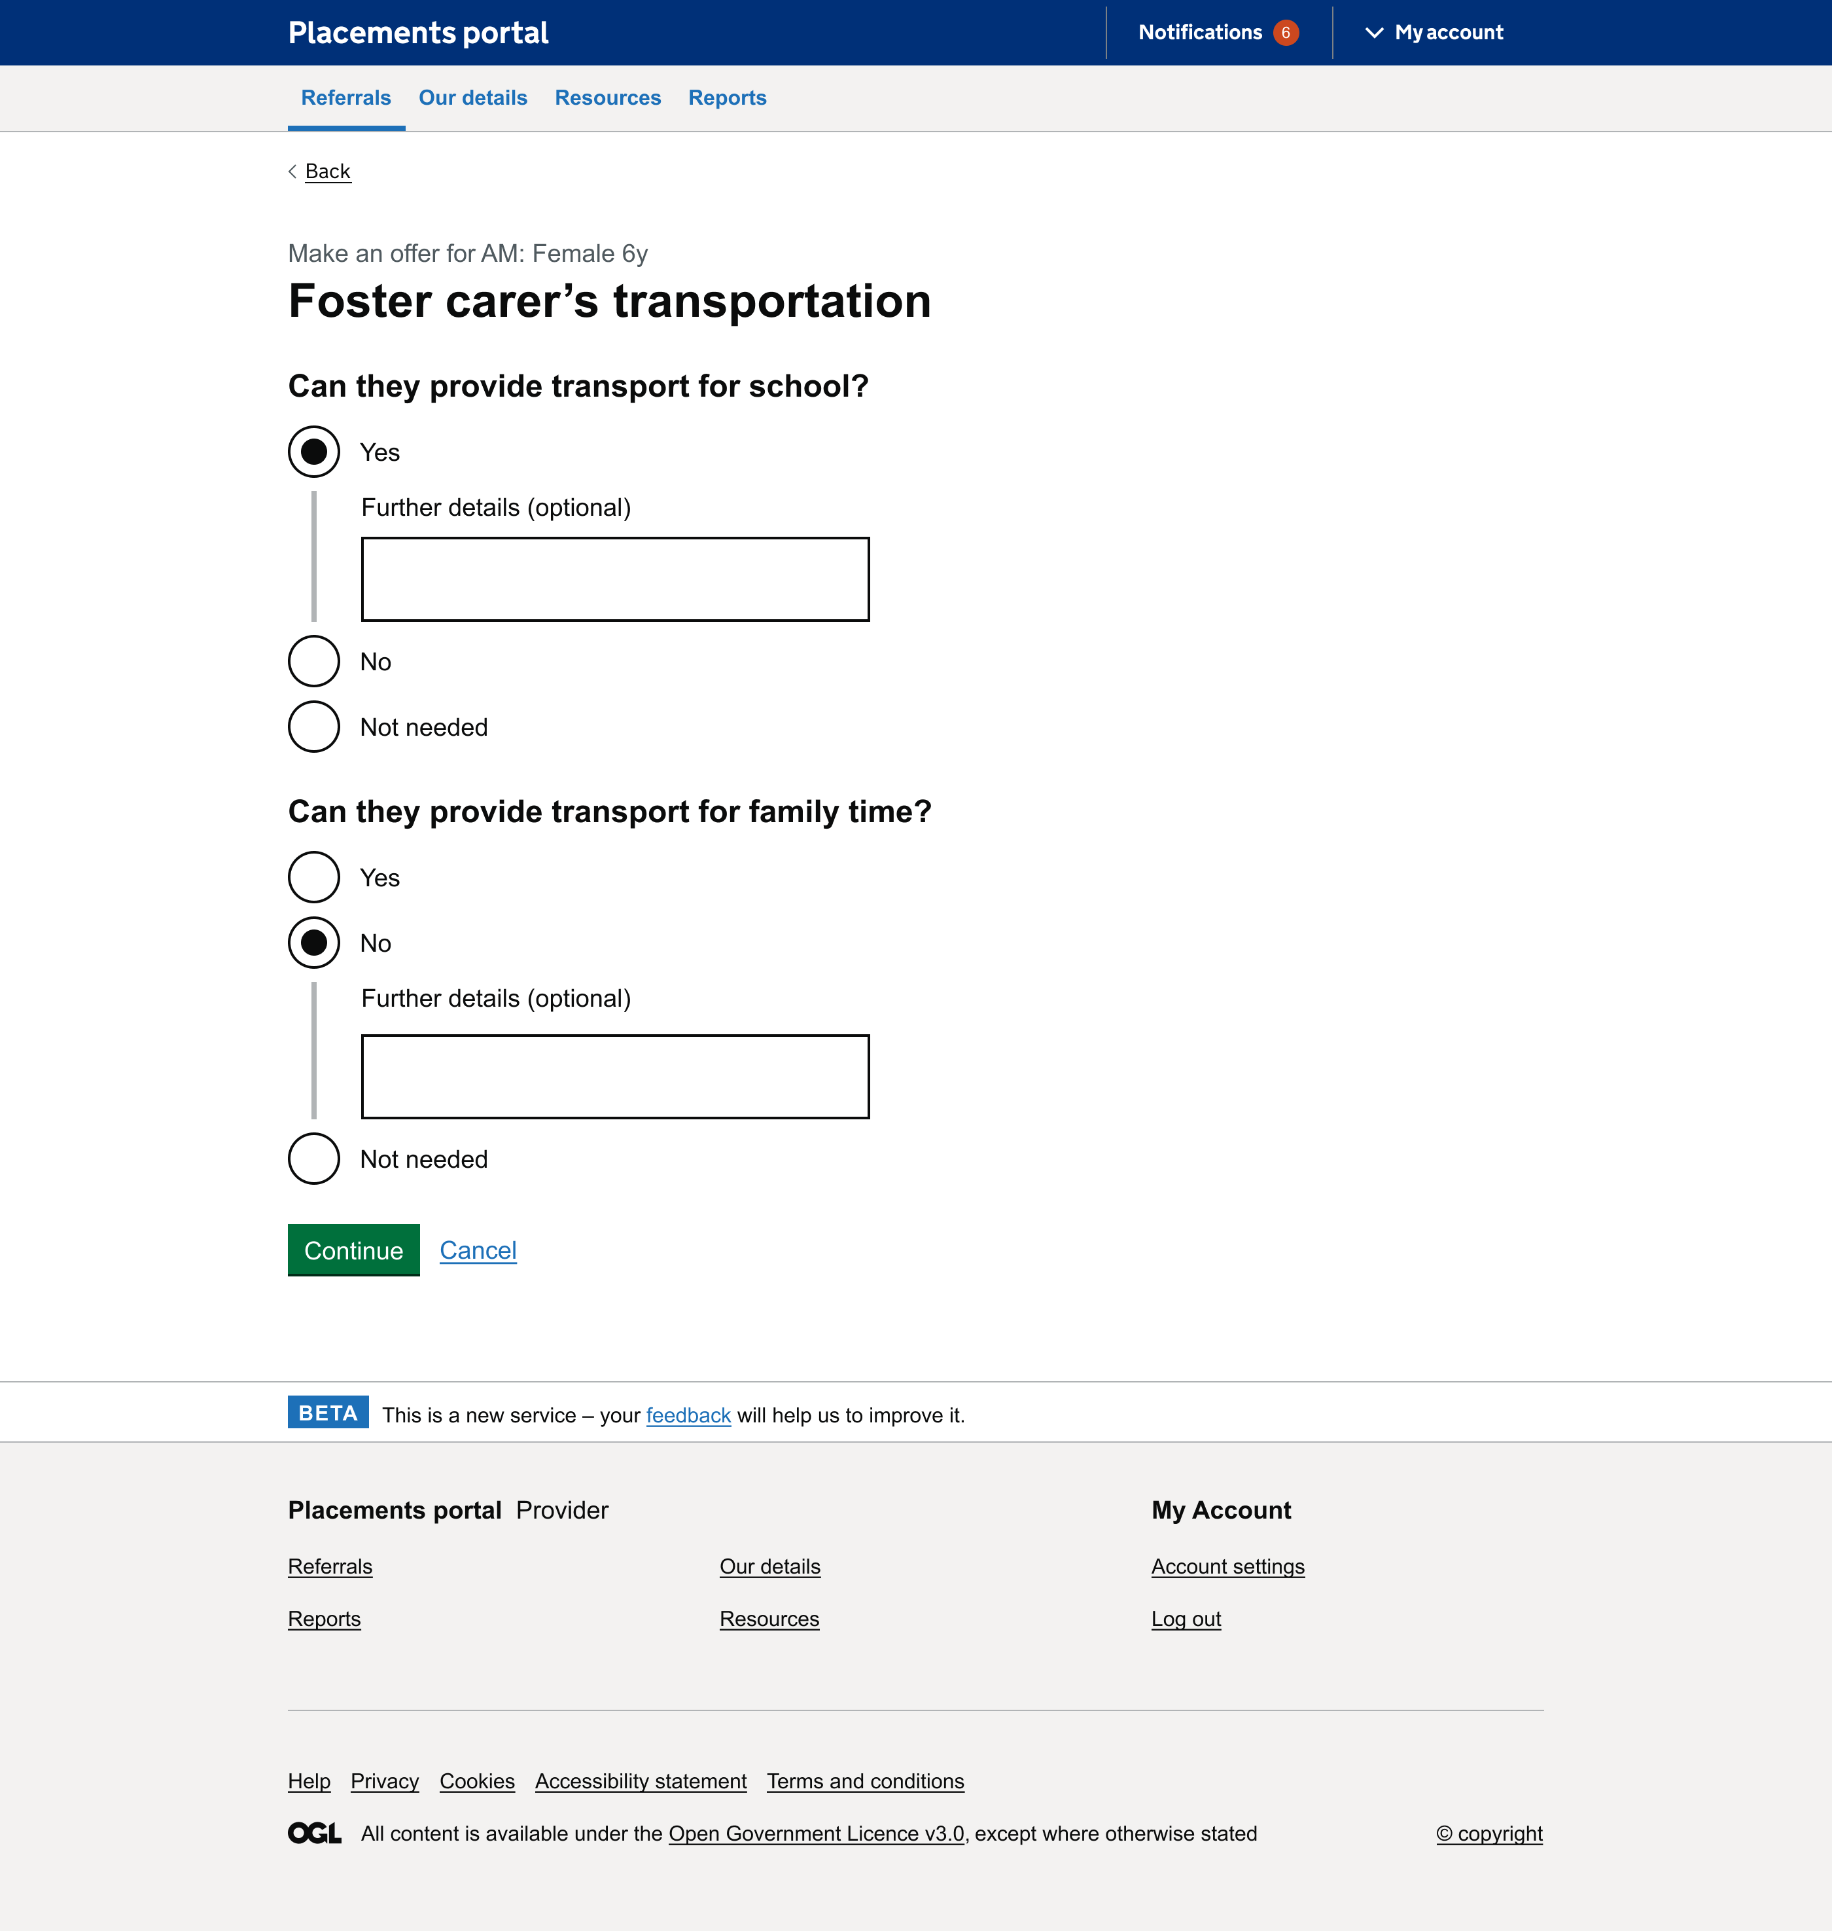
Ability to add context around transportation
In the interviews the need for context to be added around the transport was highlighted as a need. When selecting no and yes options the provider can now add text to add context in this response.
Notes:
It's also about relationships between providers and placement officers – some will call provders they know

Slide 10
User Research - Social Workers
Discover
Design
Develop
Test

Slide 11
Social Worker Interviews
During Sprint 12 we spoke to three team leads social workers all from Birmingham City. Each social worker dealt with a different phase of the referrals process: emergency placement, change in existing placement​ and new placements into care.
The findings are based on one local authority it would be good to understand in future if these process and views are universal across the West Midlands.
Understanding social workers needs
It is important to understand the portal in context of whole service of placing a child to ensure that the portal meets the needs of those who receive and use information that portal provides.
Social workers though not using the portal directly receive information from the portal. They select a provider from the offers placement officers send them, so it is important to understand what they need from these offers.
They also submit referrals that are uploaded to the portal which the placement officer uses to create the referral so understanding this process from their perspective is also important.
3

Slide 12
Lack of transparency
Social workers are unsure how the information they provide is shared on the portal by the Placements Officer. As the new portal is developed we can showcase how this will be done which could help transparency.
In some cases social workers would like to follow up with a phone call to talk through the referral with the placement officer.
In emergency placements there can be significant hold up as approval is needed from Head of Service before a referral is placed on the portal
Social workers understood the need to create a balanced referral that provided context to risks that child posed. However, felt sometime that placement officers were pushing them to 'dampen down risks' to get the child placed. They appreciated when placement officers offered advice on how they may frame things in positive light but wanted recognition this was not always possible. As would leave them feeling like there was a lack of transparency for providers.
"It's helpful having verbal conversation about a referral – you can’t capture it in a form, that form isn’t what is put on the portal – it’s lifted and translated. So conversations are key."
- P304, Social Worker
Notes:
It's also about relationships between providers and placement officers – some will call provders they know

Slide 13
Representing children's views and voices
There wasn't always a clear way to incorporate the child's view into the referral.
Social workers were unsure how this would be shared with the providers.
One social worker team lead shared how having a referral written from the child view for example writing 'I need' when filling out the referral questions. In an earlier interview, at the start of the project, one local authority changed the way they created referral documents to being written from the child's perspective. This could be something to consider within the documents or summaries going forward.
"One of the key things we need to be better at is doing the referral more positively."
"One social worker used the child’s words to create a summary, written from the child’s perspective. It was really powerful, very emotive."
- P306, Social Worker
Notes:
It's also about relationships between providers and placement officers – some will call provders they know

Slide 14
Changing from fostering to residential
It takes time to get approval to move a referral from fostering to residential. This is due to internal approval processes. This can be frustrating for social workers.
There is little that gets updated on the referral word document itself. In some instances if there has been incident that has happened with the child in between the referral this will be added.
These frustrations will be reduced in the new portal as the portal will be able to use information from the fostering referral to widen the search to residential with just few clicks making it is easier to do dual search.
"It is nightmare we have to redo the whole things – it's really frustrating – if we have close the referral and we have close it down and we have to do it all over again"
(what do you need to change) "not much really – normally very level – if there has been incident on the referral."
- P304, Social Worker
Notes:
It's also about relationships between providers and placement officers – some will call provders they know

Slide 15
Process of choosing type of provider
There is rarely multiple offers to choose from and social worker only has to review and speak to one provider.
The documents are emailed to the social worker for them to review quickly and then the social worker will always want to talk directly with the provider to get a more personal feel for the providers (home manager, supervising social worker and then foster carer) ability to meet the child needs. They will then update the placement officer via email.
The conversations are around the child's needs such as matching around transport arrangements, family time, arrangements, education arrangements and talk to the planning of the move. One social worker team lead highlighting that they would want to understand the level experience the home manager has to feel confident to place a child in that home.
The social worker trust that all diligence checks are done by the placement officers before they are sent over to them
"Do we think that what they are saying will broadly meet the child's needs, then we want to get into the detail and have conversations.
We take what we can get more often. It’s unlikely we get more than one offer."
- P304, Social Worker Team Lead
Notes:
It's also about relationships between providers and placement officers – some will call provders they know

Slide 16
Causes for delays in choosing a provider
The time it takes to choose a provider varies depending how emergency or urgent it is. With emergency placements choosing a provider within the hour and with non-emergency taking a few days.
The delay in placements being made is often due to the approval process not being signed off by senior managers or head of service in timely manner.
One social worker team lead explained that handovers from staff for instances when placement officers go on leave can cause delays. It is important to think how the new portal can facilitate these handover easily.
Sometimes getting hold of the provider and the right person in the provider team can be tricky.
Notes:
It's also about relationships between providers and placement officers – some will call provders they know

Slide 17
Key information looking for within the provider offer
"When we get residential we get all of those things through but when we get foster carers we just get one thing and I wouldn't want or need to see anything else."
- P304, Social Worker Team Lead
Fostering
carers profile with some also looking at the Form F briefly if sent. Within in there social workers focusing on what the child needs, e.g transport, therapy etc.
Residential and Support accommodation
Statement of purpose is important, Ofsted report and their category would help the social worker determine whether they could meet the young person needs
Notes:
It's also about relationships between providers and placement officers – some will call provders they know

Slide 18
Summary for the Social Worker
In the new portal there is a free text field for providers to summaries how they will meet the child's needs.
Currently this summary isn't provided to social worker however there are some details that are pulled out into body of email by the placement officer when sending the documents though. This is not standardised across referrals.
When the summary was explained this was particularly appreciated by the team lead who dealt with emergency placements felt there were many documents that were sent over and they would appreciate a clear summary
Suggestions for the summary
Transport - to education and family time
Education
What the provider offers
How many people are currently in the placement
Phone number
How they will meet the child's needs to ensure they have read and understood the referral
Personalising the summary to the child and reflecting on their needs as an individual.
Location and specific things about that location like how rural it is
When mentioned list of possible options such as model of care, placement breakdowns and staffing these also considered useful
"If it’s going to be free text that they write each time I’d want it to relate specifically to that child going forward. There would be no value in putting blanket text that just talks about the provider themselves.." - P304, Social Worker Team Lead
Notes:
It's also about relationships between providers and placement officers – some will call provders they know

Slide 19
Negotiations
The social worker is involved in the negotiations. How well the social worker knows the child helps with the referral process and the child's needs being met.
The social worker is not involved in agreeing costs that is senior managers. The nature of the costs for instance how much additional resources the placement needs determines how much approval is needed.
Getting senior manager approval can delay the process participially if requests have to go through the head of service and above.
"Main thing is the Social Worker knowing that child well, and the foster carer being honest about what they can do or there’s more costs and instability of the placement."
- P304, Social Worker Team Lead
Notes:
It's also about relationships between providers and placement officers – some will call provders they know

Slide 20
Ending a placement
A pain point highlighted, early on in the project, by commissioners was the lack of knowledge when a placement ends. This can lead to over paying for placements.
Understand how social workers tell placement officers that the provider gives notice can help us understand why this information sometimes does not get passed on.
Social workers will tell the placement officer when the provider gives notice. With emergency placement, this ending sometimes gets forgotten due to the emergency nature of their role.
Placement officers get told this is via email usually.
"there's not always time to tell the placement officer but they try to remember"
- P304, Social Worker
Notes:
It's also about relationships between providers and placement officers – some will call provders they know

Slide 21
Impact on project
Keeping social workers needs in mind during this project is important as they are key to negotiations and when they have been working with the child a long time they often are best placed to offer the childs views.
Ensuring more child centred language is used throughout the portal and referral documents. Consider times where child's perspective could be included. Ensuring the child is represented fairly with their individuals needs responded too and their voice heard.
Sharing with the social workers what is summarised to providers and how the process works after they sent the referral in could help with transparency in the process going forward.
Ensuring placement officers and providers are kept up to date that the internal process that are holding the process (e.g. getting approval from senior managers) as this will help with transparency and ease frustrations.
Notes:
It's also about relationships between providers and placement officers – some will call provders they know

Slide 22
Impact on project
There are lot documents that get sent to social workers. Although these are important it is good to understand the social worker will have quick glance key documents like carers profile and statement purpose and then ring the providers from confirmation and to understand the child's needs.
Ensuring that provider contact information is shared in timely manner so that social workers can make these calls is important.
A summary from the providers shared with social workers could be useful to help speed this process up however they currently look for this information in the carers profile and statement of purpose.
Key to notifying placement officers that placements have ended comes from social workers remembering to inform the placement officers. A solution could be to consider the providers contacting the placement officers at the same time as contacting the social workers to ensure this message gets shared across departments.
Notes:
It's also about relationships between providers and placement officers – some will call provders they know

Slide 23
Registration & Profile Management
Discover
Design
Develop
Test

Slide 24
Project Update – Registration & profile management
 | Requirements Discovered | Designs Agreed | Development complete | SW Testing Complete
Provider Registration
Home management
Provider Profile & Account management
Provider Directory
LA and LA User registration

Slide 25
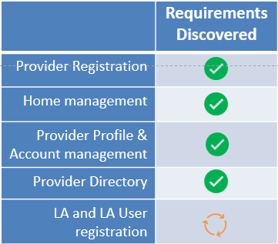
Discovery Progress
OFSTED April Changes
Supported Accommodation
Home ID
OFSTED Reports (Quality of Support)
Category Update
Discovery for Fostering Framework changes started
Provider Discovery Completed
Provider Holding Company Details
Started Local Authority Discovery
Continue into New Year

Slide 26
Next steps
Discover
Design
Develop
Test
Continue testing delivered functionality – Provider listings / manage workstack
Return to developing LA side of portal – Manage workstack
Document designs and functionality required to Make an Offer on a referral
Start designing Provider registration side of Portal

