Slide 1
Show & Tell
West Midlands Placement Portal
Sprint 10 – 22nd November 2023

Slide 2
Agenda
Discover
Design
Develop
Test
11:00 Project Update
11.10 Manage Referral workstack - Provider
11:20 Discovery: make an offer – Frameworks
11:25 Make an Offer – user research findings
11.55 Roundup and Next steps

Slide 3
Project Update
 | Requirements Discovered | Designs Agreed | Development complete | SW Testing Complete
Create New Referral
View referral
Manage Workstack
Respond & Action
Provider
Provider
LA

Slide 4
Project Update
 | Requirements Discovered | Designs Agreed | Development complete | SW Testing Complete
Create New Referral
View referral
Manage Workstack
Respond & Action
Provider
Provider
LA

Slide 5
Manage Referral workstack - Provider
Discover
Design
Test
Develop

Slide 6
Frameworks and how they impact Make an Offer
Discover
Design
Develop
Test

Slide 7
Framework & SPOT Pricing
SPOT Pricing – should be in the system to provide better visibility and control of pricing
Process and technical feasibility to be determined
Providers will be one of either SPOT or Framework
We recognise real world may vary – where this breaks down a provider will have to register their services separately between the two
For Frameworks and SPOT the system will help show how the final price has been arrived at and where applicable how much it varies from the original framework/SPOT cost agreed
Discovery completed for
Supported Accommodation
Residential
Fostering

Slide 8
Respond and action referrals - Make an offer
Discover
Design
Develop
Test

Slide 9
User Research Sessions Overview
Over the last 10 sprints we have spoken to all 14 Local Authorities (LAs).
During Sprint 10 we spoke to four placement officers from 4 LAs: Dudley, Warwickshire, Sandwell and Birmingham.
We also spoke to 5 providers. Three provided Supported accommodation, one residential and one fostering provider.
Each user research prototype testing session took place over Teams and lasted approx. 60 minutes.
During these sessions we asked both placement officers and providers to complete various scenarios to test making an offer, responding and actioning referrals within our prototype portal.
These scenarios helped us to understand how easy they find these tasks and how the prototype designs support or conflict their current processes.
4
5

Slide 10
Scenarios: Making and Accepting an offer
{SCENARIO 1}
{SCENARIO 3}
Provider makes a provisional offer
PROVIDER ACTIONS
Provider makes a final offer
Fig. Simplified Action Structure
Review provisional offers
Request final offer
Accept final offer
LA ACTIONS
{SCENARIO 2}
{SCENARIO 4}

Slide 11
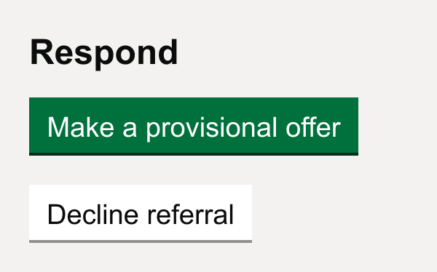
Providers
Scenario 1 – Making a provisional offer
The first scenario providers imagined that they had seen referral AM: Female 16y and that they would like to make provisional offer
Successfully navigated though this scenario
During this scenario, the supported accommodation and residential providers successfully completed the task and could navigate easily though the prototype. This did not suit fostering providers we will outline this further at the end of this presentation.

Slide 12
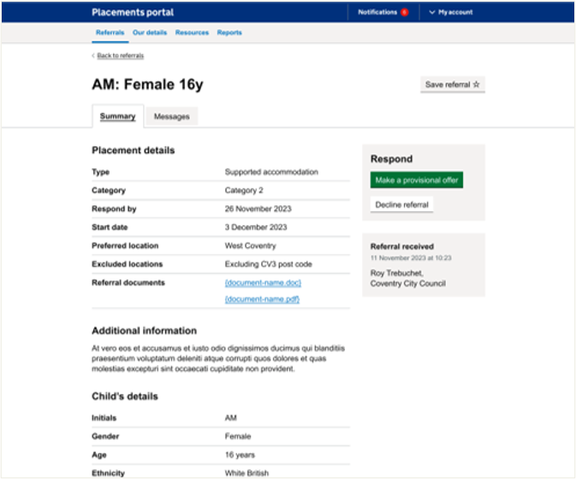
Page: Listing + Referral details
Listing Page is understood
Most users managed to quickly navigate to referral. One user tried to click the first referral in the listings. (test case referral was second in the list)
Referral details page is understood
Most users clicked on 'make a provisional offer' button. One user wanted to click into the summary first and explore the documents etc.
One user commented that they liked the additional info summary and stated this would save time when viewing multiple referrals a day
“’summary of additional information would
save (someone who looks at 30 referrals a day) time”
- P196 residential and support accommodation provider
Notes:
It's also about relationships between providers and placement officers – some will call provders they know

Slide 13
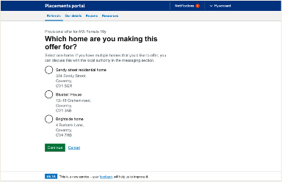
Page: Selecting one home
Selecting one home is understood
Most users managed to select home. Most understood that could only select one home and that they could discuss other homes via the messages functionality.
“'it's very dependant whether we offer multiple times - generally you are making one offer for one home - if I was to make an offer for multiple homes I wouldn't know how to do it - but in the past I would’ve used the message box”
- P196 residential and support accommodation provider
Notes:
It's also about relationships between providers and placement officers – some will call provders they know

Slide 14
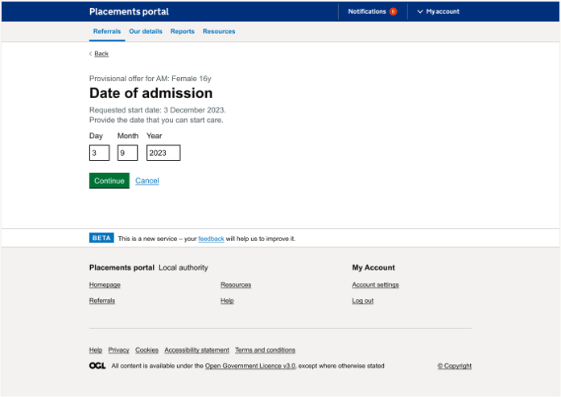
Page: Date of admission
Date of admission is understood
Date of admission was understood by all users and most completed the task. Most users mentioned that this is likely to change though and may not remain consistent throughout the process.
One user felt it was very early in the process to be confirming dates as the placement hasn't been agreed however when viewing the whole journey had better understanding. One provider also mentioned that would reserve the child a room if they were making a provisional offer.
“'What I tend to do – I would put in my blurb
that it is available sooner”
- P185 support accommodation provider
Notes:
It's also about relationships between providers and placement officers – some will call provders they know

Slide 15
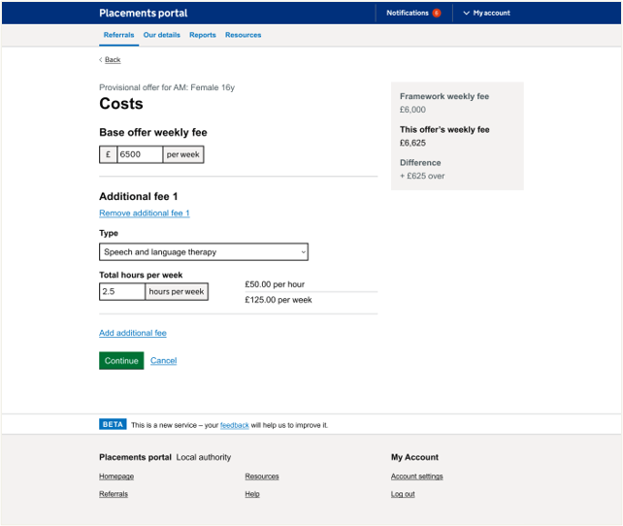
Page: Costing
Costings are understood
Most users understood the fees but there were lots of variants that differed per provider, either because of framework or spot costs but also additional fees.
Some added additional fees for childs personal costs (gym membership etc.) and some would operate on an all-inclusive rate. Fees for external providers that they used could also vary. Staff fees could also vary across their organisation.
Costs were not always in hours some were in staffing days. They may only need costs for short time such as waking nights for week
Most users understood this right hand summary but were relatively ambivalent to it though some found it useful. Some were confused by it as they weren't on framework
“staffing costs are over a day rather than set amount of hours”
- P185 support accommodation provider
Notes:
It's also about relationships between providers and placement officers – some will call provders they know

Slide 16
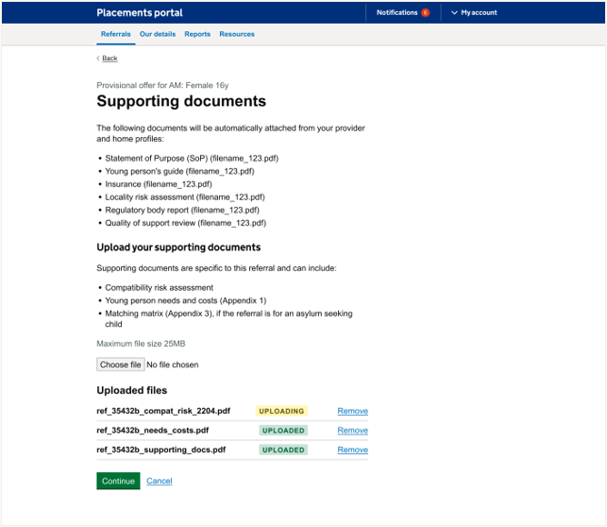
Page: Documents
Provider documents understood
Most users understood documentation required and that some came from their provider profile and some they would need to upload that are unique to that referral.
All users referred to appendices 1, 2 and 3 and that they would need to be included.
Two providers also mentioned that they would want to include their gas certificates and electrical reports.
“Reads out automatically - we would have to keep our profile regularly updated - I'm assuming, and each home would have their own file”
- P196 residential and support accommodation provider
Notes:
It's also about relationships between providers and placement officers – some will call provders they know

Slide 17
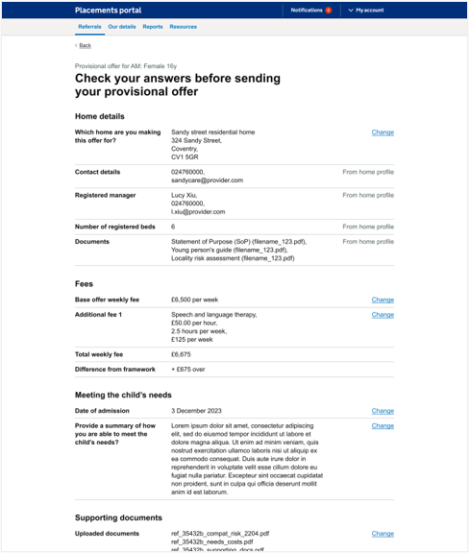
Page: Check your answers
Difference in provider profile and offer details understood
Most user understood that they could change the referrals via the change link and to change the other information they would navigate to provider or home profile.
“'provider profile - this will be edited at home page earlier on ”
- P196 residential and support accommodation provider
Notes:
It's also about relationships between providers and placement officers – some will call provders they know

Slide 18
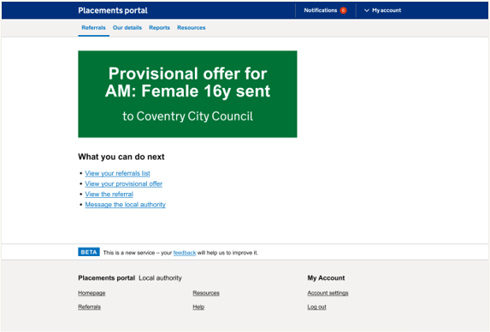
Page: Final Page
Difference in provider profile and offer details understood
All users managed to submit the offer. Most users wanted either a reference number for the offer or an email confirmation to follow up with LA this is due to lack of trust in the current portal. In their current ways of working they would follow this up with message to LA to ensure it had been received.
Most providers used their own internal systems to log offers, the majority of these seemed to be manual processes such as spreadsheets rather than any specific software.
One user (when navigating back to their referrals) didn't understand what 'Active' referrals meant and another user couldn't easily navigate their way back to the offer they had made.
“'I would want a reference number for submitting the provisional offer. I would put the referral into my placements so I can find them again. I need to know the ID so I can find the exact referral for that child. ”
- P187 support accommodation provider
Notes:
It's also about relationships between providers and placement officers – some will call provders they know

Slide 19
Discovery Questions
Why are homes different prices across organisation?
The homes differ in prices due to the category or provision they offer. This provision and category could differ across organisation. These could include things like offering therapeutic home.
“'Each category has a fee - the fees are determined by the category.”
- P187 support accommodation provider
“'time frames... transitions - the plans really .”
- P196 residential and support accommodation provider
What is ‘normally’ discussed as part of the negotiations? (price, hours, homes)
If on framework costs are not normally negotiated as providers saw these as set. The negotiations would instead be around transition plans and matching with the social worker.
Notes:
It's also about relationships between providers and placement officers – some will call provders they know

Slide 20
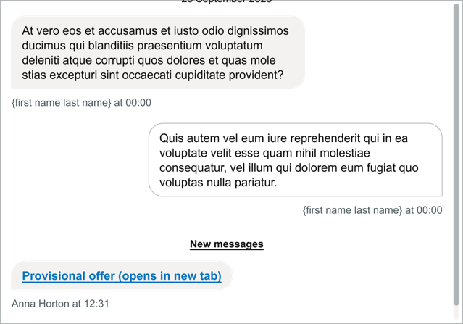
Placement officers
Scenario 2 – Reviewing the provisional offer
The second scenario was tested by the Placement Officer. They were asked to imagine they logged in to the portal and they wanted to review a provisional offer on referral AM:12345678.
We asked Placement Officers to navigate to the right referral and talk us through the offer. What information would they like to be summarised about the offer – whether any information was missing and the key things that they look for?
We also asked how this information was normally shared with the social worker?
All placement officers managed to navigate to the right referral and review the provisional offer from the outlined provider.

Slide 21
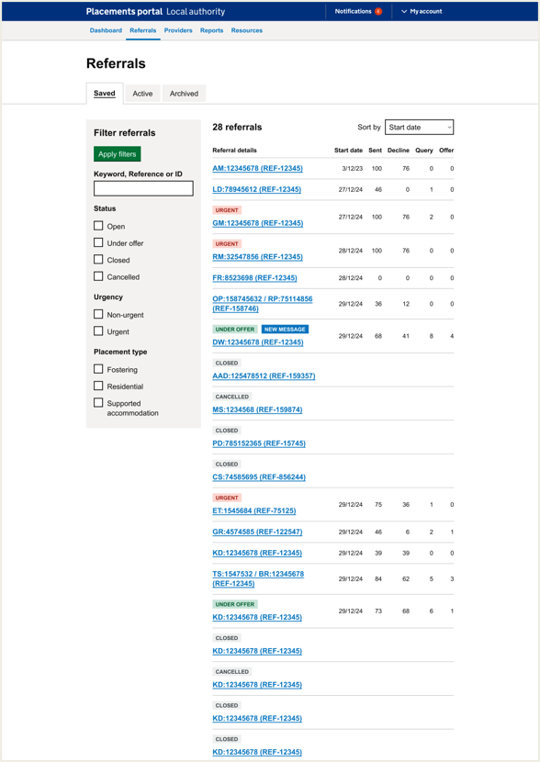
Page: Listings Page
Listing Page is understood by all users
One Placement Officer needed to see the type in the listing view due to often having to complete a dual search for both fostering and residential at the same time. Later they saw the filtering and expressed they would use these to distinguish the type.
Other filters weren't understood. For instance, one PO didn't understand Under Offer thinking it should show all referrals that were under offer in the whole system.
There is a need to understand requested by deadline with PO requesting the colour coding they are used to (red, amber, green for how near to the requested deadline a referral is) or deadline date on listing page so they are aware of when they need to chase providers for a response if they haven't had one.
Notes:
It's also about relationships between providers and placement officers – some will call provders they know

Slide 22
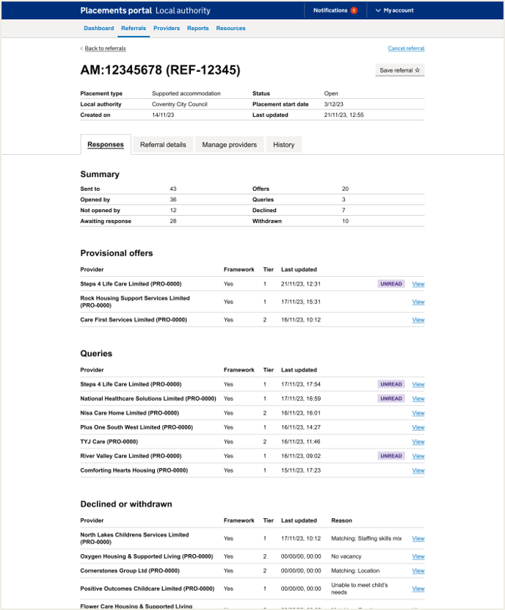
Page: Referral details + Responses
Referral details
The top summary was useful to users.
The unread label was clear. One user wanted to see a preview of the message as currently the portal is so slow they rely on this.
The provisional offers and queries were clear. Currently the notifications aren't working for queries (in current portal) so this greatly appreciated.
Responses
Key information and ‘snapshot’ about the provider is appreciated and users understood that they could navigate to the provider profile to find out more.
All users understood the message feature.
“Oh this looks good! The information for placement approval are all here, all documents are on site”
- P37 (Placement Officer)
Notes:
It's also about relationships between providers and placement officers – some will call provders they know

Slide 23
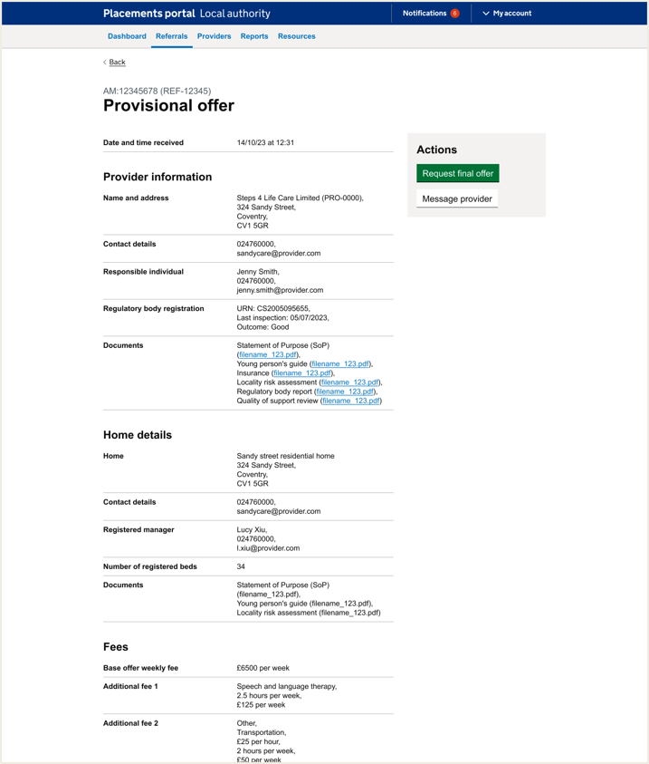
Page: Provisional Offer
Did it have all the information you would expect?
Most users said it had all the information they would need. One user who worked across all 3 types said the ‘form F’ was missing.
One residential user highlighted costs for education and milage for transportation would be important.
How do users need to share with SW?
Many users expected to be able to download this page and share the relevant information to the SW via email. The main information the SW would need tended to be; Appendices 1, 2 and 3; Contact details for the provider; how the provider meets the child's needs; Home profile; Costings; insurances and Ofsted reports
“I'm hoping these files you can click on and download them? I'd send all the info in an email to the social worker”
- P11 (Placement Officer)
Notes:
It's also about relationships between providers and placement officers – some will call provders they know

Slide 24
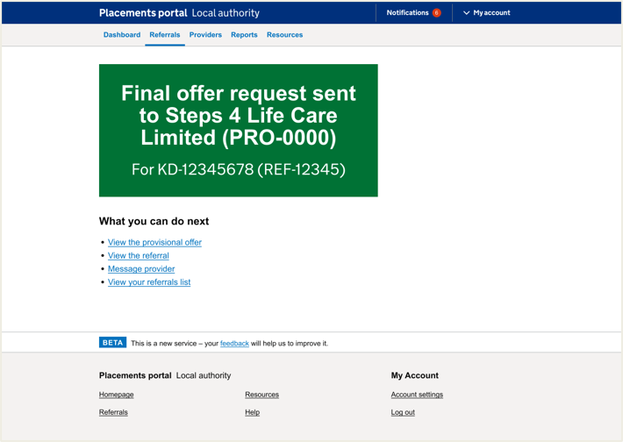
Page: Request final offer + Final page
All POs navigated to request final offer
One PO said they would send a courtesy message first
Final page:
One user wanted to message provider to say that they need the offer by a certain date (to avoid chasing and waiting for final offer).
One user also commented that they would log this step in internal log and the child's file. We have heard in previous interviews that logging on internal systems is common for Placement Officers.
“It'd be useful to be able to download the whole chat to add to the child’s file. if there is an issue later, we can see what was agreed. We would also have the providers contact details for any further conversations, before requesting final offer”
- P11 (Placement Officer)
Notes:
It's also about relationships between providers and placement officers – some will call provders they know

Slide 25
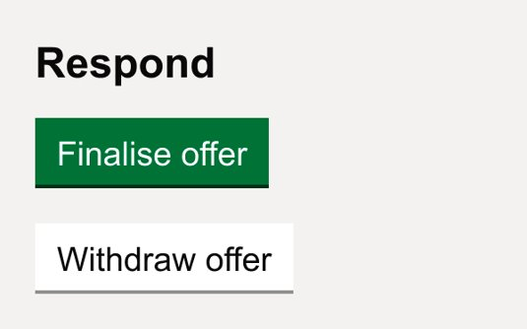
Provider
Scenario 3 – Reviewing and finalising the offer
Once the placement officer has requested the finalised offer from the provider then provider needs to give this one last check over before agreeing to that placement.
Successfully navigated though this scenario
During this scenario, the support accommodation and residential providers successfully completed the task and could navigate easily though the prototype. This did not suit fostering providers we will outline this further at the end of this presentation.

Slide 26
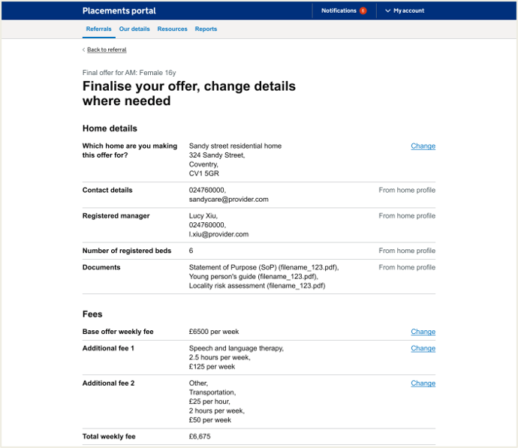
Page: Finalising the offer
Finalising the offer
Most users were able to finalise offer and complete scenario. It did however feel that this process felt contrary to their normal procedure.
Changes that are common
Changes that might occur between provisional offer and finalising an offer are things around the level of care once speaking to the social worker and new things come to light.
“'Following meeting social worker, we might need waking night for a week to settle them or transport that is out of county this would be a transport charge ”
- P196 residential and support accommodation provider
Notes:
It's also about relationships between providers and placement officers – some will call provders they know

Slide 27
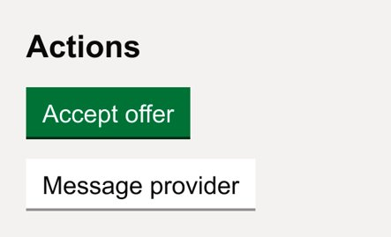
Placement officers
Scenario 4 – Accepting the final offer
In scenario 4 Placement Officers were asked to imagine that the Provider has agreed the provisional offer and finalised all the details and now the Placement Officer could accept the final offer and agree the placement.
We asked what is ‘normally’ discussed at negotiation stage and how do these negotiations occur? How do they share information back and forth with the social worker and was is discussed.
Placement Officers were asked to navigate to the right referral on the prototype and talk us through the offer. What information would they like to be summarised about the offer – was any information was missing and the key things that they look for?
All placement officers managed to negotiate to the right referral and review the provisional offer from the outlined provider.

Slide 28
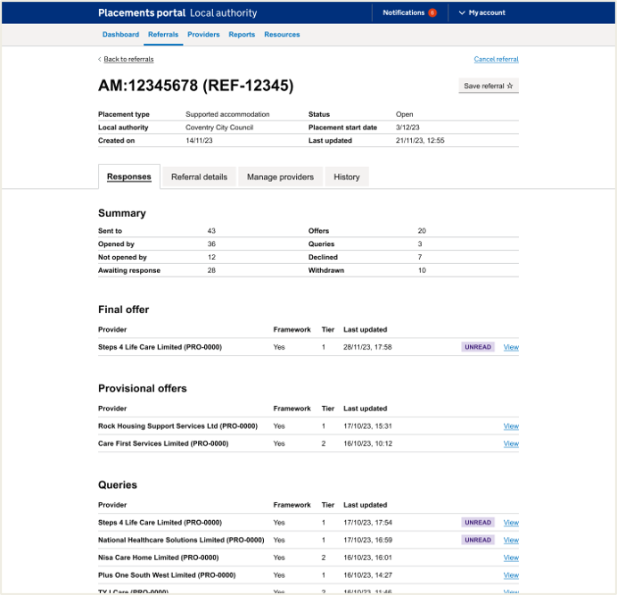
Page: Referrals details + Responses final offer
All POs navigated to the final offer:
Users understood they would need to seek the various internal permissions and approvals before clicking to finalise the offer. These approvals are recorded on internal systems
It was mentioned by users that there is mistrust in the portal which means throughout testing, users want to follow up with emails in case the portal goes down. As well as download conversations or offers.
Final offer page: What would you do if something wasn't right?
Call the provider to get update information. Often they need to know how the costs need to be broken down before going to approval. If there as concern, they would talk to the QA officer.
“if something’s not right I’d call the provider to check with them”
- P11 (Placement Officer)
Notes:
It's also about relationships between providers and placement officers – some will call provders they know

Slide 29
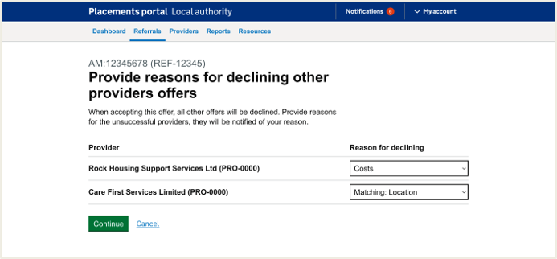
Page: Decline other offers
Some placement officers would want to send curiosity-personal messages to providers to help continue relationships. It wasn't always clear in this point of the journey how they might do this.
One placement officer explained that they wouldn’t want share certain reasons for declining with the provider (for instance if they under ongoing investigation) they might mark it as placement no longer required.
The list is appropriate with a comprehensive list of reasons. The main reasons being cost, matching and staffing.
One placement officers felt like this stage was what they might do later in the journey when the child has been physically placed (this being the final stage of the journey).
“This would feel too finalised - anything can happen - rather than restart whole new portal search - there might be reasons when YP get to the place and say they aren't staying there - yeah we need physical confirmation that they are physically placed there - anything can happen”
- P30 (Placement Officer)
Notes:
It's also about relationships between providers and placement officers – some will call providers they know

Slide 30
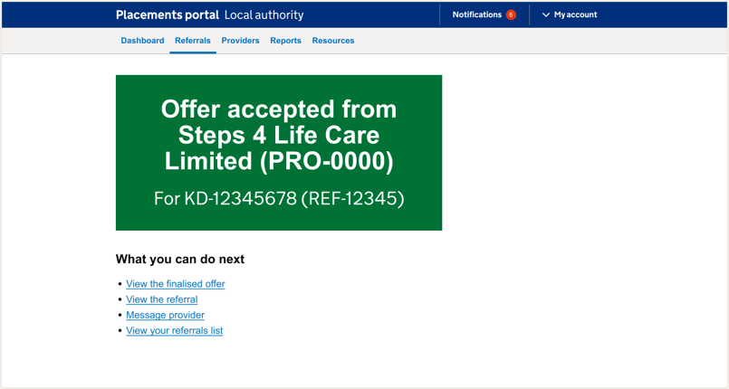
Page: Offer accepted page
Once accepted offer the next stage would be to complete the IPA and send details to finance team. POs would also log on their own internal systems.
One user wasn't clear on this part of the finalise offer part of the journey however they missed the requesting finalised offer part of the journey in testing so this could have been why. They felt that this part of the journey felt too quick.
“I don't know what I would do next - would it come up it would have been placed? I don't know - at the moment we would say they have been placed - doesn't that let all the providers know we have accepted the offer - check that it had happened – it still says open’
- P33 (Placement Officer)
Notes:
It's also about relationships between providers and placement officers – some will call providers they know

Slide 31
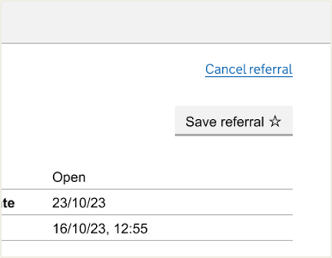
Placement officers
Scenario: Cancelling the referral
We asked Placement Officers to imagine that at something has come to light with another referral KD-12345678, and the child needs to stay where they are and there is no longer a need for the referral.
We asked them how they would you cancel the referral? And the reasons as to why this would happen?
We also asked them how they tracked the history of a referral and what they need to know and track for future reference.

Slide 32
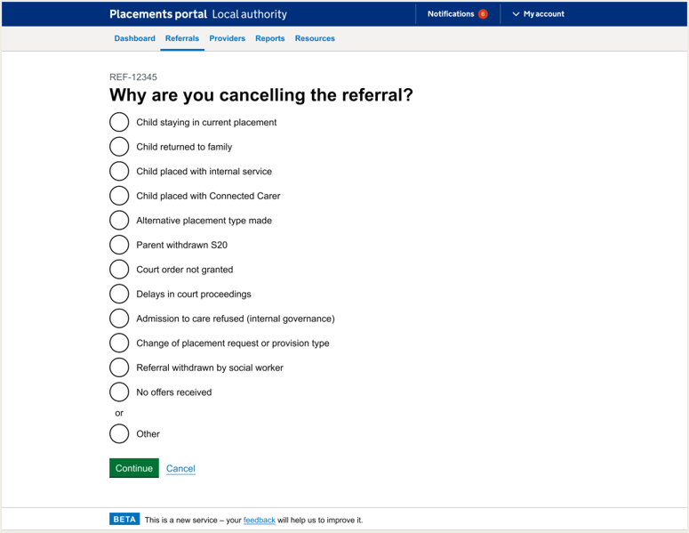
Page: Listings page + Cancel referral listing and returning to the referral
One user highlighted they would want to message providers before cancelling (if they had made an offer)
Most commented that the list of reasons were comprehensive and liked having increased list of reasons
One user commented that it was unclear that the message has gone out to providers that it has cancelled - would need this for those that have made a provisional offer
“How do you know have cancelled referral?
It happened so fast!”
- P37 (Placement Officer)
Notes:
It's also about relationships between providers and placement officers – some will call providers they know

Slide 33
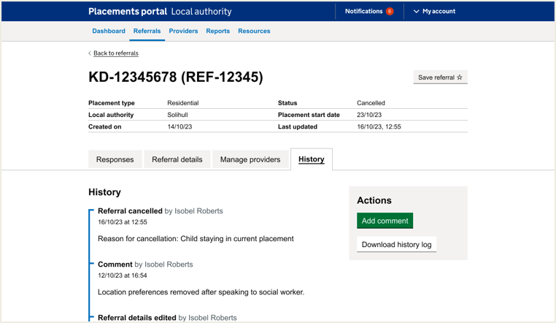
Placement officers: History page
Most POs would not need to add comments to cancelled referrals as once it's cancelled this is it. They may record things on their own internal systems.
Most users found the download history useful and would want to share this with relevant parties such as social workers. They may add comments if the referral was active.
“I would use this chronology if we are struggling to find placement - we know that the providers have seen this child loads of times before - we usually cancel and put fresh search - as it’s better that way… it just supports us in a way - search the referral and how many times it went out - it helps work with the market a bit more if we are struggling - court even ask us to report - and we be accurate as we can
- P33 (Placement Officer)
Notes:
It's also about relationships between providers and placement officers – some will call providers they know

Slide 34
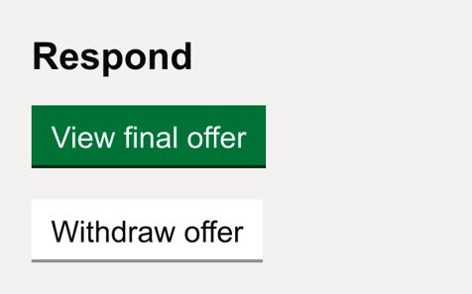
Providers
Scenario: Withdrawing a referral
Other scenarios that were tested was whether a provider could withdraw an offer if they needed to
Successfully withdrew an offer
During this scenario, the support accommodation, residential providers and fostering carers successfully completed the task and could navigate easily though the prototype.
All users successful realised that the offer had been withdrawn and noticed the change in status

Slide 35
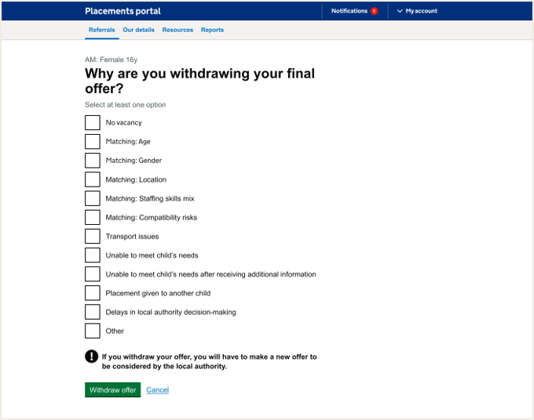
Providers: Withdraw offer page
Residential and support accommodation providers felt the withdraw list was comprehensive
Most common reason is 'unable to meet child’s needs' after receiving additional information. There was a feeling across the users that the list was comprehensive.
There was one suggestion that 'financially not viable' if LA is proposing lower costs and the provider can not offer this.
Fostering providers felt the list did not suit their needs as they would rarely withdraw over matching criteria
“'The reason [to withdraw an offer] was that for us to meet the young person's needs we'd have to charge more, and they weren't prepared to pay for it. 'Financially not viable”
- P208 support accommodation provider
Notes:
It's also about relationships between providers and placement officers – some will call provders they know

Slide 36
Fostering
During this round testing we spoke to one foster agency we are looking to validate these findings with further foster carers next sprint.
User profile: Fostering provider that worked across 4 different services, 3 of which were framework and one was a spot provider. They ran one inbox but oversaw all four of the different fostering services. They also ran the out of hours service and had themselves been a foster carer

Slide 37
Fostering
High level findings (from one user)
Unusual process for them to follow
While the user was able to navigate through the referral and further forms they reflected it would be very unusual for them to provide this level of detail for a provisional offer.
They also noted that it most fostering profiles would be 2-parent families and the process asked for one person's details. They also wouldn't include DOB or surname.
The user noted that this process would put-off a lot of providers. A lot of conversations will happen before a provider would make an offer. Conversations between social workers/foster parents, providers and placement officers.
They get over 100 referrals a day, so they only go back to the referrals they know they can support. The level of detail required in the provisional offer feels like a final offer to the user.

Slide 38
Fostering
High level findings (from one user)
Form F would cover what is being asked in this form
The user would use the term 'Expression of Interest' for referrals that they felt they could accommodate, but wouldn't normally submit the level of detail requested at provisional offer stage. The user felt most of this would be covered by a 'form F'
For date of admission they reflected that this changes so frequently and it would be too early to provide this information with any level of accuracy. - "there's so many people involved, and information is never at our fingertips".
Observation: User felt uncomfortable with the level of detail involved and stated - "There's not one set thing because we're dealing with human beings. Even local authorities within your portal do things differently."

Slide 39
Fostering
High level findings (from one user)
Summary isn't appropriate
User stated that they don't have the capacity nor the insight to provide summary detail on how to support the child. They match skills and behaviours and it would be up to the foster family and social worker to describe this in more detail (but again, not at a provisional stage)
Fostering is nuanced process
Fostering process is so nuanced and different everytime it simply doesn't fit into a neat set of boxes. Information often comes to light last minutes or get's agreed and collated over a series of off-portal communications with various involved parties. The portal felt like a one-way transaction, whereas there is often a lot of back and forth.

Slide 40
Fostering
We will validate these findings in next sprint. It is good that we have picked up the different between fostering and support accommodation and residential when it comes to making an offer.
This shows the benefits of user research testing with prototypes so that processes that are not suitable for all user are not coded into the portal.
Once we have further insight, we can look at how this might be reflected in our prototype designs.

Slide 41
Outcomes for Sprint 10
A Provider can view a summary of a referral on the portal (including standard, sibling and parent & child variations)
Provider can see and navigate through Portal screens organising views of Referrals sent to them. (NB: Back-end functionality will be progressed in this sprint but will not complete)
The development team can plan their technical approach to deliver the following functionality:
Provider manage referral actions (stories, attributes, design doc)
Email notifications
Frameworks and how they inform make an offer are fully understood and requirements handed over to design and tech
Make an offer journeys for Fostering, Residential & spot designed
LA Referral details tabs designs documented
Provider and Placement Officer views on prototype designs are captured so that the Make / receive an offer process maximises Portal engagement STRETCH goal - findings analysed

Slide 42
Next steps
Create new Referral
View new Referral
Manage referral workstack
Respond & action referrals
Continue Provider manage workstack development – integration with back-end
Manual software test Create & View Referral functionality
Further user research for Fostering process to Make and Offer
Iterate Designs for Make an Offer within action referrals
Kick off Provider registration discovery

