Slide 1
Show & Tell
West Midlands Placement Portal
Sprint 11 – 6th Dec 2023

Slide 2
Agenda
Discover
Design
Develop
Test
11:00 Project Update
11.10 Portal development - Demo
11:15 Make an Offer – Fostering research
11.35 Make an Offer – Design changes
11:50 Provider registration – Discovery
11.55 Roundup and Next steps

Slide 3
Project Update – Core Placement process
 | Requirements Discovered | Designs Agreed | Development complete | SW Testing Complete
Create New Referral
View referral
Manage Workstack
Respond & Action
Provider
Provider
LA

Slide 4
Manage Referral - Provider actions
Discover
Design
Test
Develop

Slide 5
Fostering Research - Make an Offer
Discover
Design
Develop
Test

Slide 6
User Research Sessions Overview
During Sprint 11 we spoke to four fostering providers. One large provider (managing over 450 homes), one medium (managing 100+) and two smaller providers managing less than 40 each. We also included the feedback of the fostering provider we spoke to in sprint 10, in our findings.
Collectively we have spoken to 24 providers and 20 local authority placement officers across all 14 local authorities over the last 11 sprints
Each user research prototype testing session took place over Teams and lasted approx. 60 minutes.
During these sessions we asked fostering providers to complete various scenarios to test making a provisional offer, then finalising the offer on referrals that they had matched.
The fostering providers are given a web link to a prototype which they then operate themselves, giving a realistic feel to what it will be like to use the portal.
These scenarios helped us to understand how easy they find these tasks and how the prototype designs support or conflict their current processes.
4(+1)
44
thank you!

Slide 7
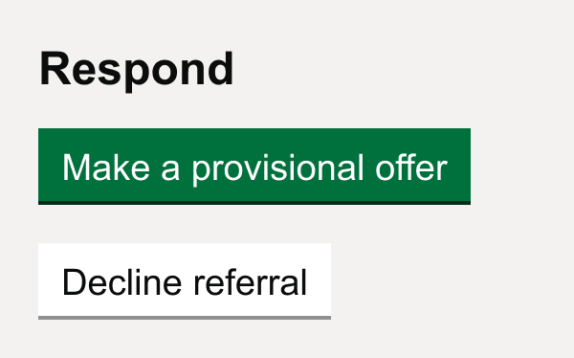
Fostering Providers
Scenario 1 – Making a provisional offer
In the first scenario fostering providers were asked to imagine that they had seen referral AM: Female 16y and that they would like to make provisional offer.
All users were able to quickly navigate to the correct referral and make a provisional offer.
However, in their current processes most providers would get to provisional offer stage by having off portal exchanges, a mix of phone calls, meetings online and in-person before they felt comfortable making an offer (of any sort).
Because there was no existing process that matched our ‘provisional offer’ scenario most fostering providers felt it wasn’t aligned to their existing process and felt uncomfortable providing such a high level of information at that stage.
“From what I'm aware of, on the portal you would ask the questions and get a reply back - I'm not sure where the reply goes. I would email over to set up a meeting over Teams to discuss the child and whether we think it would be a good match. If the meeting's positive, we would usually set up a meeting between the carers and the child.”
- P217, Fostering provider
Notes:
I’m not going to go through the prototype page by page as I’ve done before because we quite quickly found that this scenario wasn’t

Slide 8
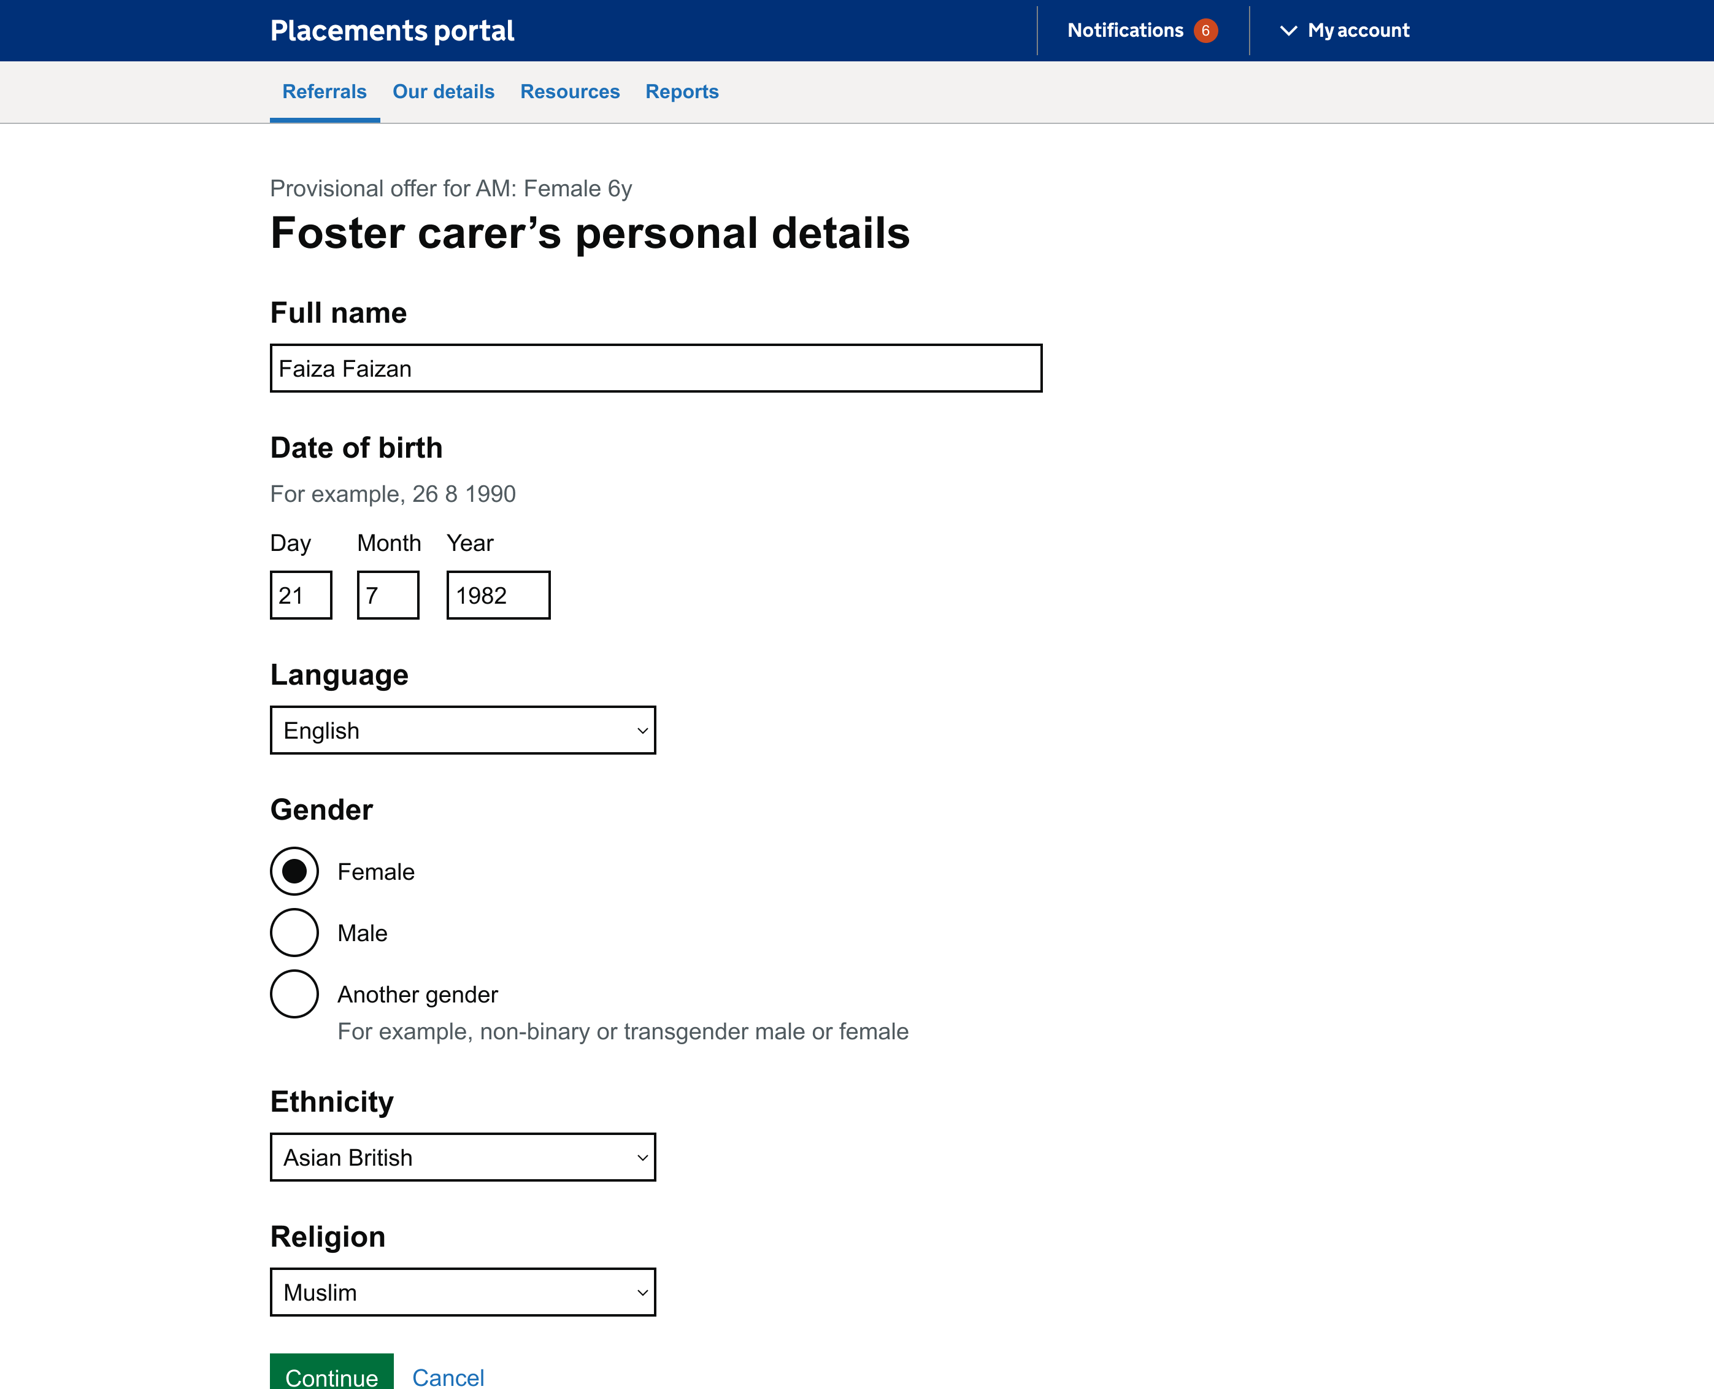
Page: Foster carer personal details
Most providers mentioned sending a carer profile that would contain the detail needed at this stage
Two users highlighted that typically carers would be a couple rather than an individual, they questioned where they would add the information for a second carer. Another user commented that many households in the West Midlands speak more than one language, and questioned where they would be able to add a second language to the carer details.
Two users commented that the information requested was more detail than they would usually provide at this stage for a provisional offer. They mentioned that they would only provide this level of detail in the form of a carer profile or a 'Form F', which they would send over if requested by the social worker.
“If they match, we will send a couple [of carer profiles] across and then the LA would make the decision themselves.”
- P166, Fostering provider
Notes:
It's also about relationships between providers and placement officers – some will call providers they know

Slide 9
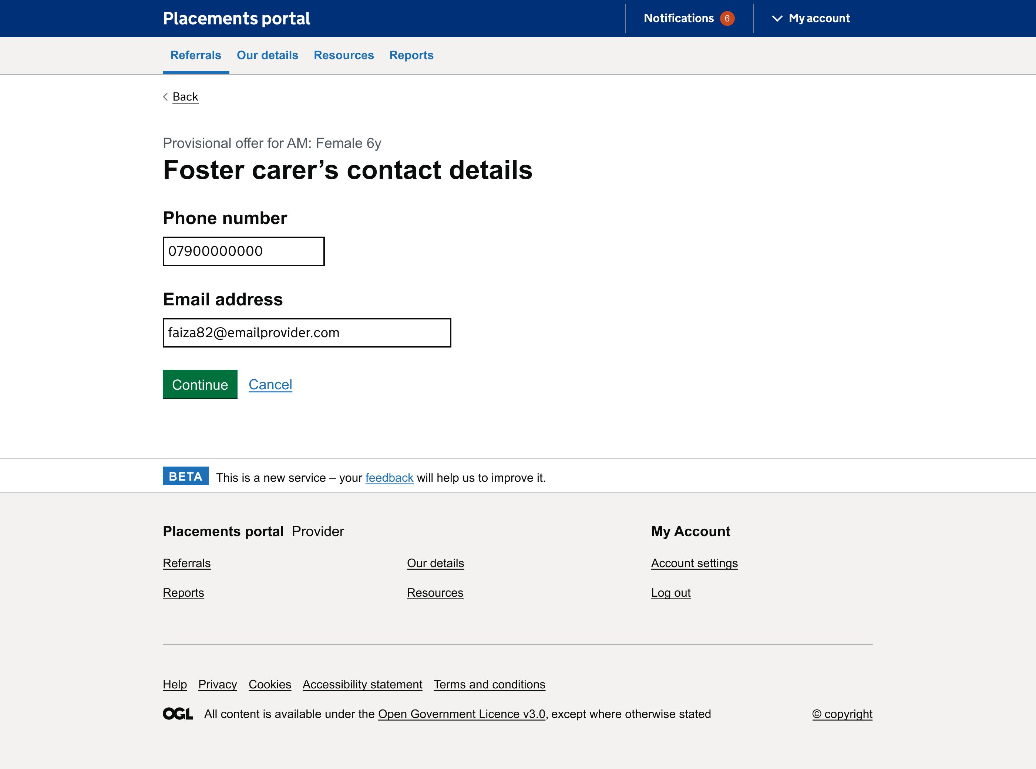
Page: Contact details
Providing full contact information would not happen at this stage
All users were able to easily navigate to the carer details page.
Three users highlighted that they would not provide the carer's contact information without first getting their consent.
Two users also said they they would not usually provide a foster carer's contact details, as this could lead to the agency being left out of the loop in direct conversations between a foster carer and the Local Authority.
“We probably wouldn't put the foster carers details, because sometimes our LA's will miss the agencies out of the loop. If there's direct contact between the carer and the LA. We'd probably only provide the carers contact details once we know the placement is going ahead, or if it's an emergency placement outside of office hours.”
- P166 fostering provider
Notes:
It's also about relationships between providers and placement officers – some will call provders they know

Slide 10
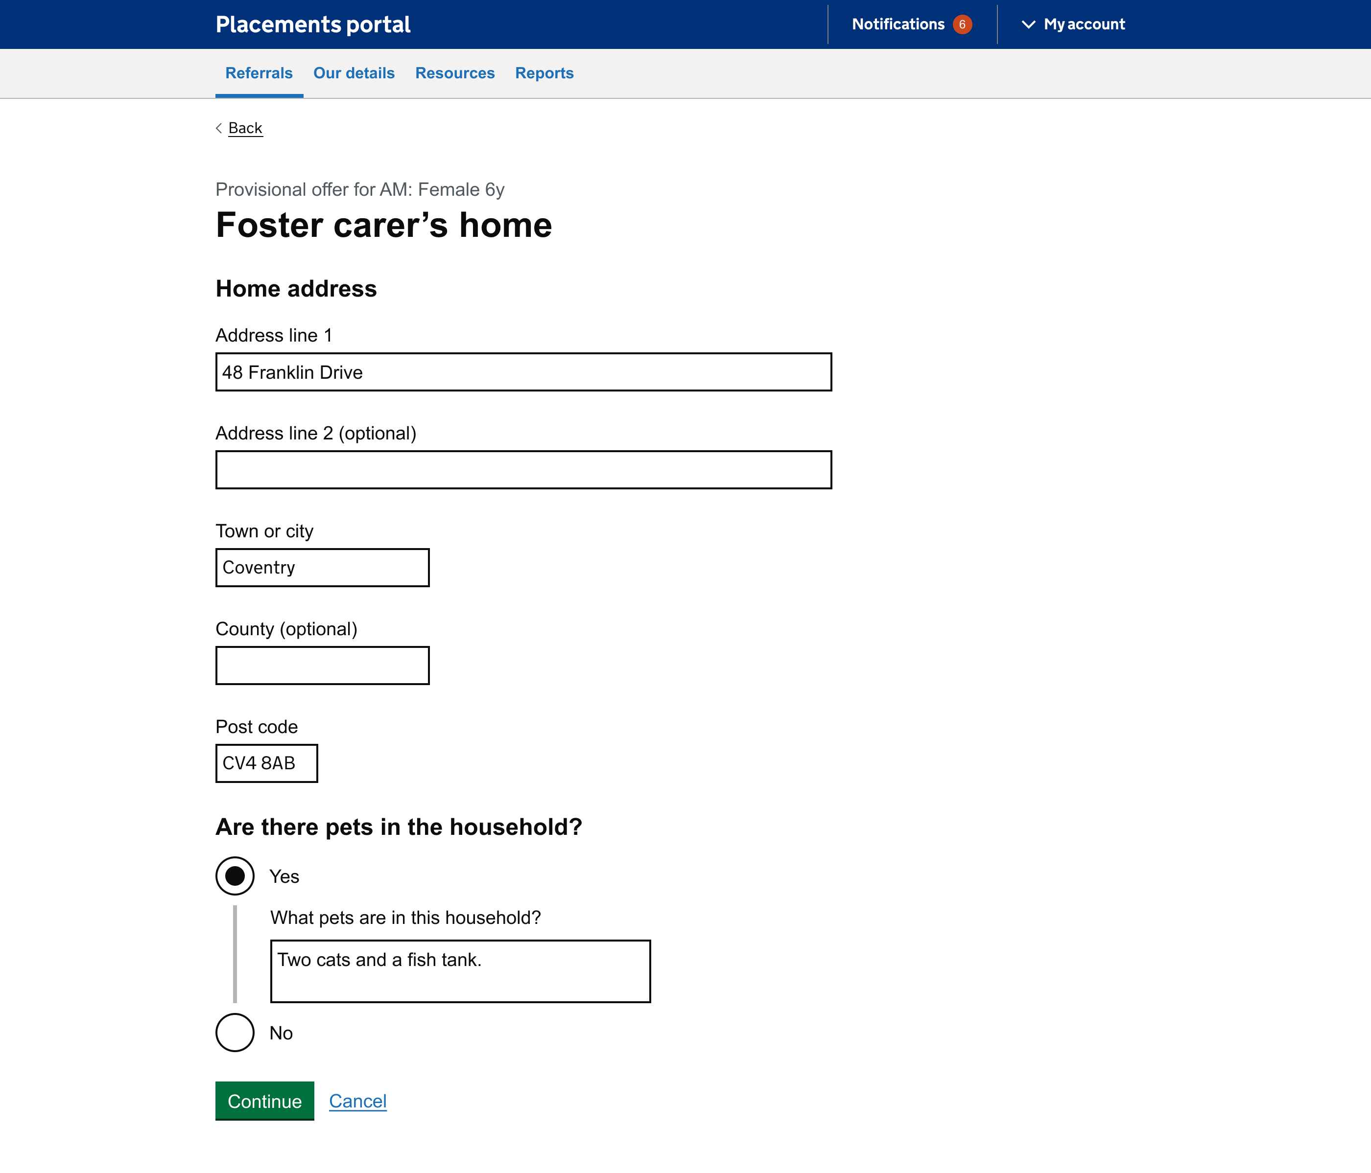
Page: Carer's home
Exact address isn't always shared at this stage
Two users commented that they wouldn't provide foster carer's exact address at this stage. To still give an idea of their location, both said they would usually provide a post code.
Pets, transport and other children in home is important at this stage
Three users felt the information requested on the page was useful, particularly around pets, transport, and other children in the home.
“We would probably put the post code, just to give a general idea of the location. But sometimes if we put the address we can again end up out of the loop so we only do it if it's confirmed.”
- P166 fostering provider
Notes:
It's also about relationships between providers and placement officers – some will call provders they know

Slide 11
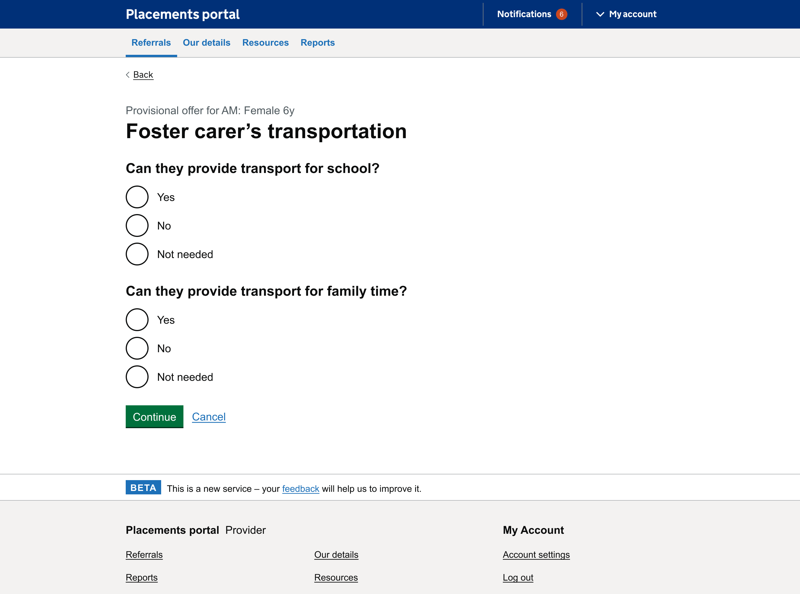
Page: Transportation
Transportation would need greater discussion
Most users (4) commented that transportation is an area that usually requires greater discussion or 'negotiation' between carers, Placement Officers, social workers, and the Local Authority.
For this reason several suggested that a 'yes/no' question was too limited to be able communicate what transport a carer would be able to offer.
“Again, we would normally put that information in the discussion box in the current portal.”
- P166 fostering provider
Notes:
It's also about relationships between providers and placement officers – some will call provders they know

Slide 12
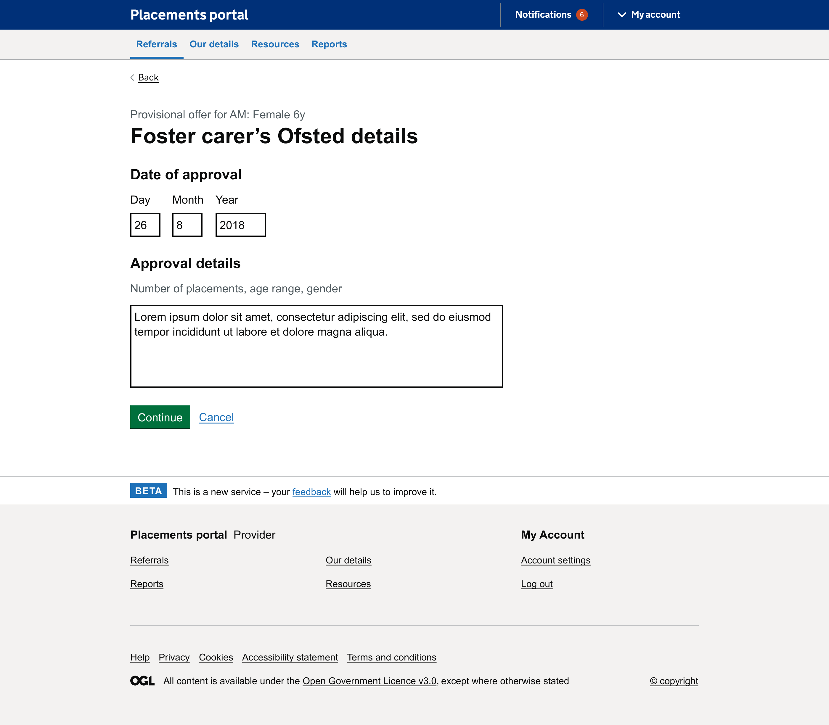
Page: Ofsted details
Sharing Ofsted details is new to fostering process
Two users commented that providing Ofsted details was a new step in their process, and one suggested that this was something they would only provide if they needed to.
Two users highlighted that this information would already be available, either through the provider profile on the portal, or as part of the foster carer profile which they send out.
“This isn't something I've had to do before, not sure if it would usually happen.”
- P217 fostering provider
Notes:
It's also about relationships between providers and placement officers – some will call provders they know

Slide 13
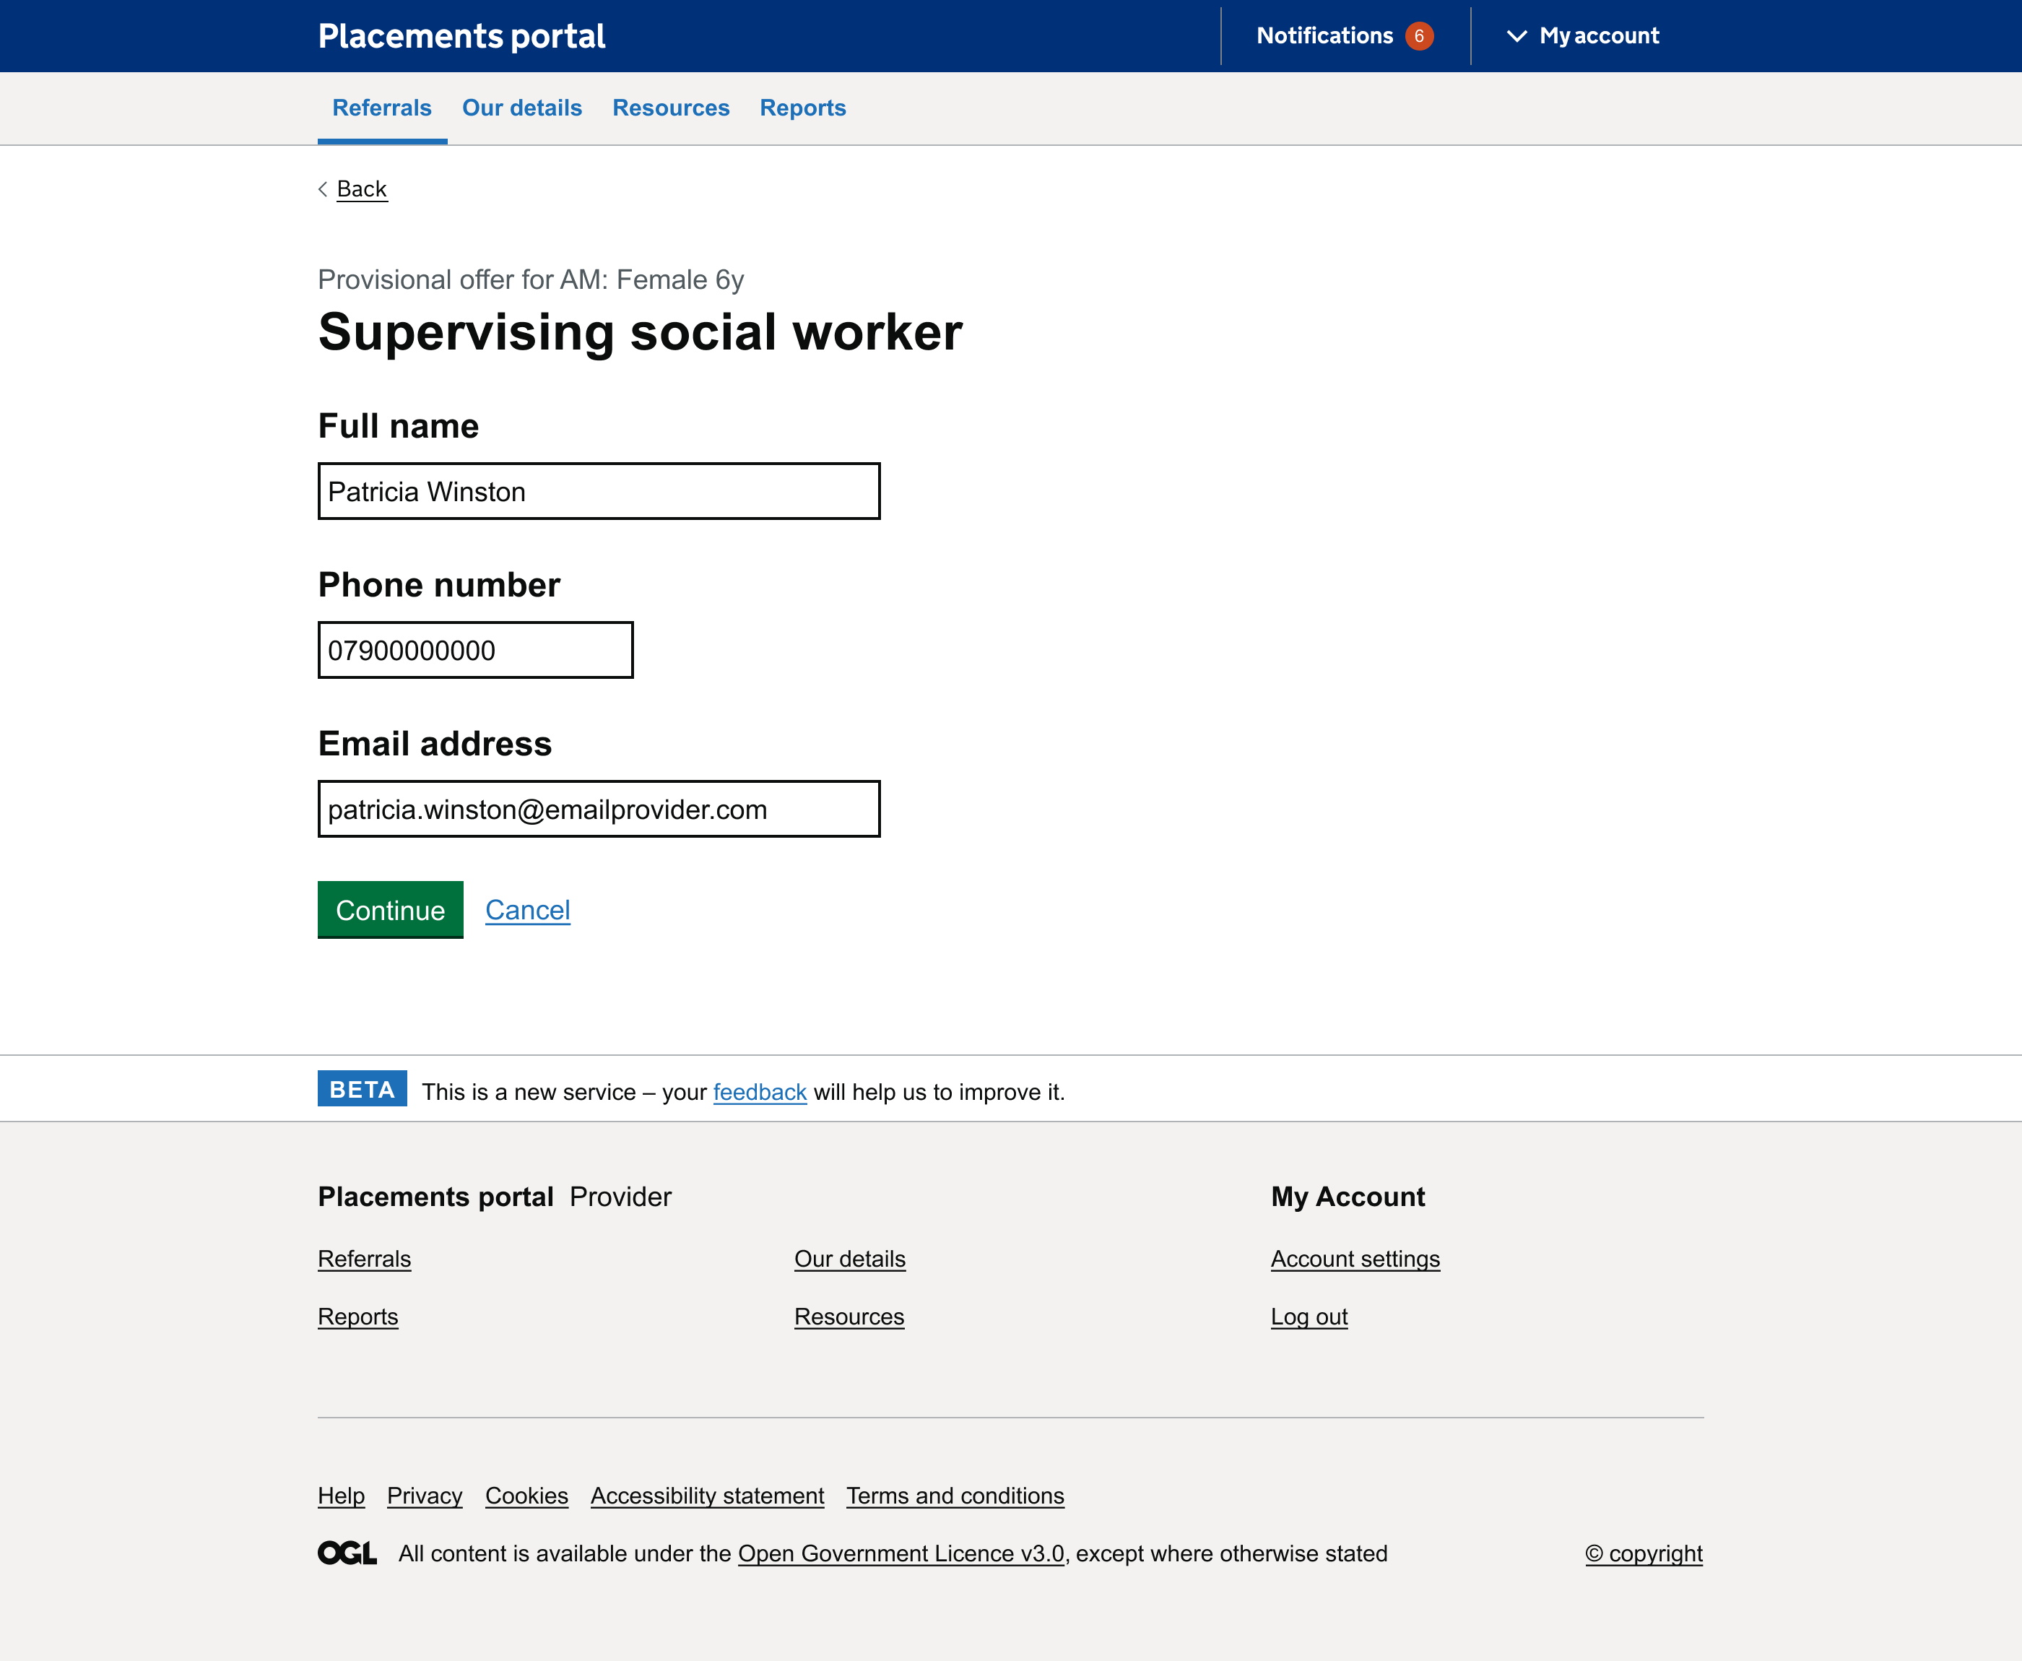
Page: Supervising social worker
The social worker information would be known
One user commented that the SW would be involved from the start.
Another user said that they have a supervising SW allocated to every carer family.
It seemed that all users would know this information at this stage.
“Every carer is linked to a supervising SW, if we were looking at placing a child it would be the SW that would pick it up.”
- P166 fostering provider
Notes:
It's also about relationships between providers and placement officers – some will call provders they know

Slide 14
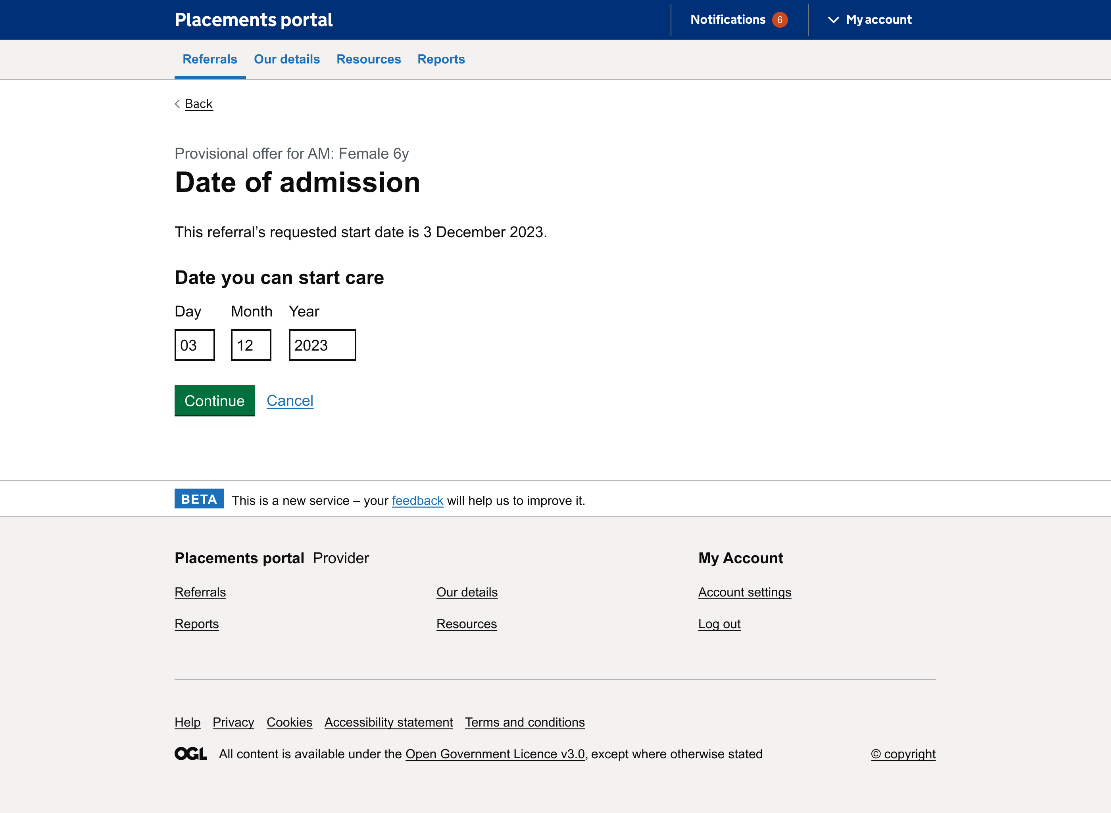
Page: Date of admission
Dates are very subject to change
Most users (3/5) stated that dates are always subject to change and it would be pointless to try and provide it at this stage.
Two users also commented on the language used, one stating it was clinical (date of admission) and one commenting it wasn't very child centred.
One user pointed out that care leavers get access to their file and existing research states that language where the child is referred to as an object or impersonally it can be traumatic and dehumanising.
“The date we can start is quite vague, it's not a set date. So we can't always fill this in.”
- P217 fostering provider
Notes:
It's also about relationships between providers and placement officers – some will call provders they know

Slide 15
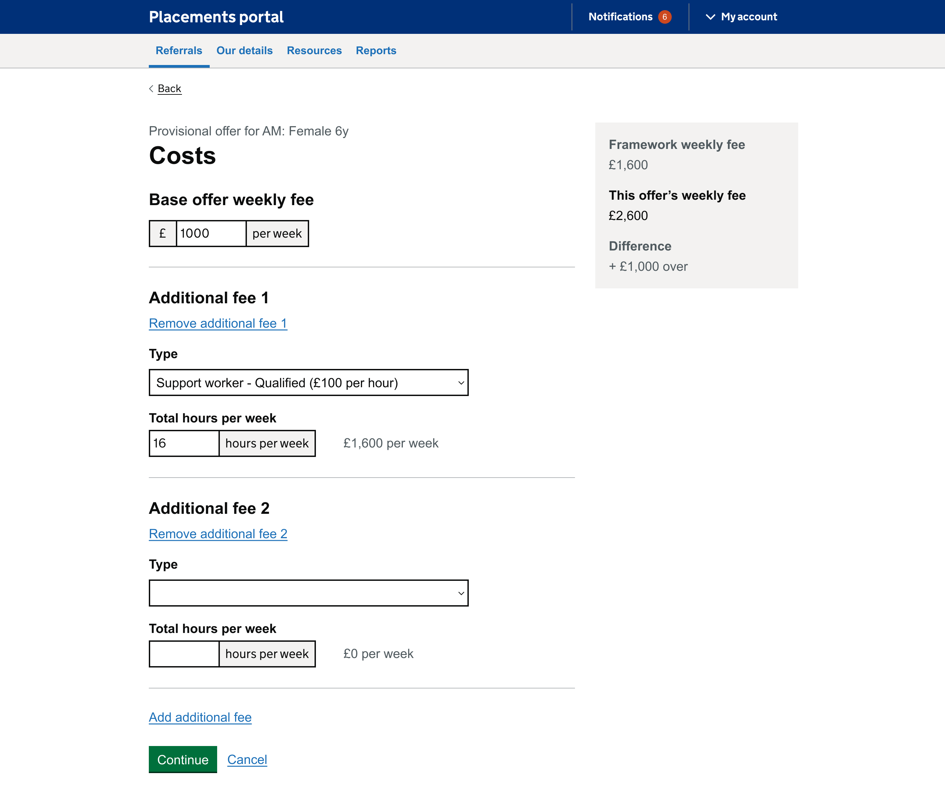
Page: Costs
Some users explained how provisional costing would be difficult to provider
One user commented that it would be difficult to provide an accurate provisional costing when so many things are subject to change.
Another mentioned the breakdown would cause issues as invoicing is all done monthly in retrospect, placement fee it's all weekly. LA's pay a weekly amount, and some costs are worked out pro-rata for other elements. You also have to consider term-time and holidays for any school transport or educational support.
Difficult to provide additional costs at this stage
About half of users commented that it would be difficult to assess any additional needs that would need to be costed at early offer stage. With one stating in particular that it would be rare to add respite at this stage.
One provider had respite included their base offer cost (one night a week) or included a standard number per year. One user said costs associated with a child's additional needs might not become apparent until a child is placed.
"Additional fees would come in the future, at this point the LA would question it."
- P129 fostering provider
Notes:
It's also about relationships between providers and placement officers – some will call provders they know

Slide 16
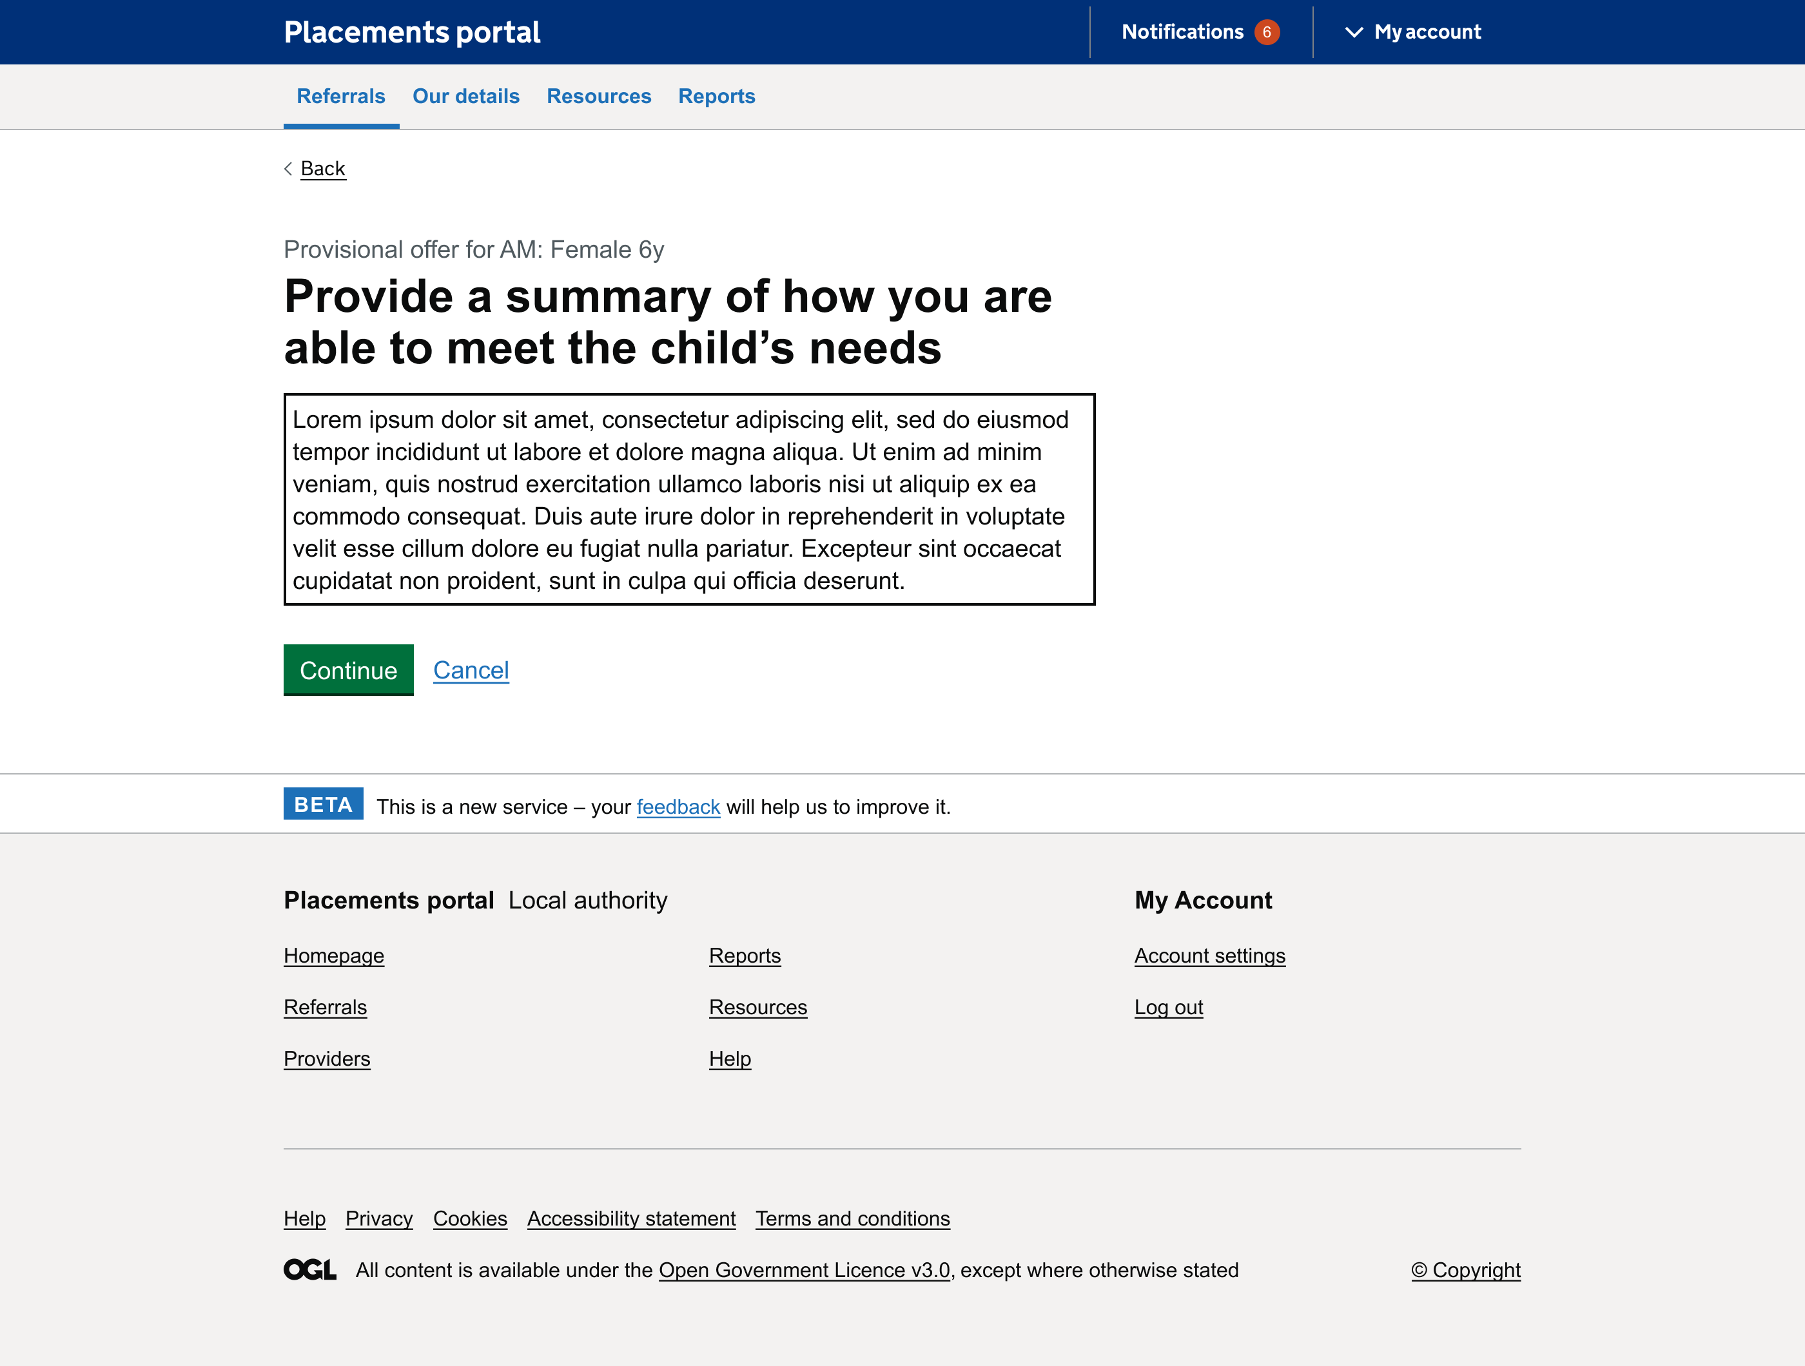
Page: Summary
Difficult to fill summary as this would need to come from the social worker
Two users stated that it would be difficult for them to provide a summary as this would need to come from the SW and isn't their remit with one commenting that it would cause delays in the process (as they wouldn't be able to process beyond this part of the offer without waiting for input from other parties).
One user also mentioned that this is something that happens as part of a back and forth discussion with carer family, SW and Placement Officer and not something that is necessarily known off the bat.
One user commented that they could provide generic information based on the carers profile but wouldn't be able to provide much insight at this stage and these are figured out in exchanges off portal through conversations and meetings further down the line.
“We don't have the capacity to do this. We know why they are being matched. We match skills/behaviours. But this is something the SW would do.”
- P216 fostering provider
Notes:
It's also about relationships between providers and placement officers – some will call provders they know

Slide 17
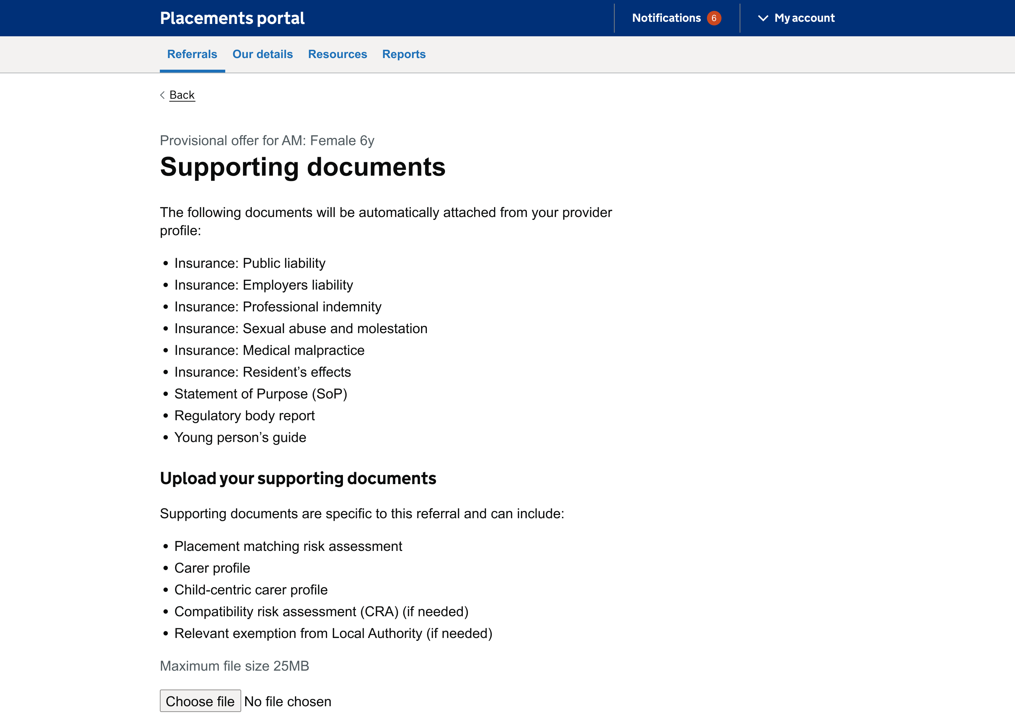
Page: Documents
Quantity documents to excessive
Most users felt the quantity of documentation was excessive for a provisional offer. Most would only share the appropriate carer profile when submitting an initial offer or EOI.
Receiving alerts when documents have expired
One user mentioned it would be useful to receive alerts when your standard/annual documentation on your provider profile was about to expire.
Risk assessments would be hard to complete at this stage
Two users also commented that you couldn't complete a risk assessment at this stage, and one said it was more of a working document and subject to change with some amends occurring after the child was actually placed.
“’All the providers will have a profile with all of documents, every year these documents are renewed. The LA will already have access to them..... I don't have access to a lot of these [documents]. The placement manager would have these.”
- P129 fostering provider

Slide 18
Page: Check Answers
All users understood the summary
All users understood the summary page and most understood that you could edit information if needed. One commented that it would be useful to have the finance team contact details there too as part of the offer.
“That is good, because you can go through and check if you've missed anything.” – P217 fostering provider

Slide 19
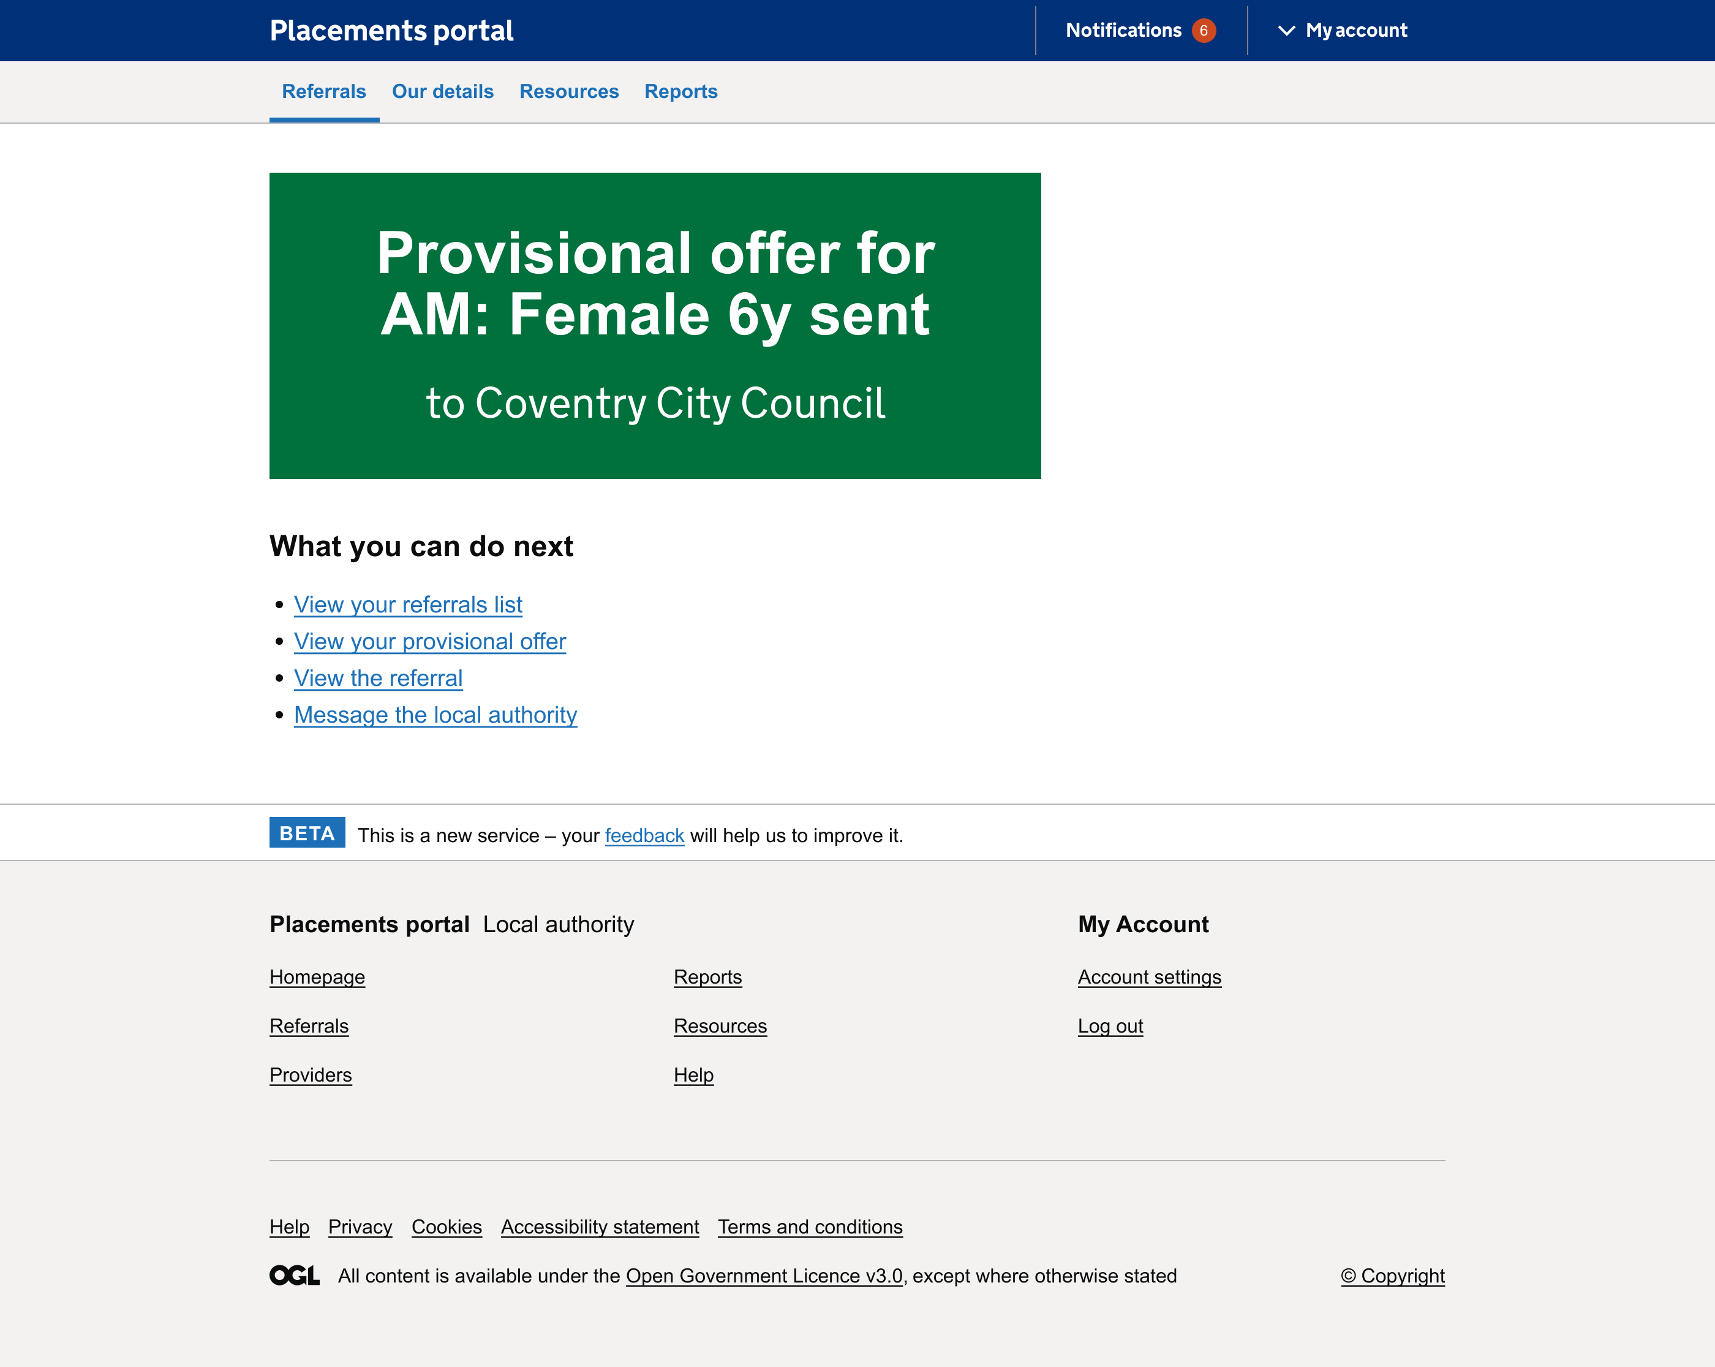
Page: Final page
Completed all tasks but wanted confirmation
Most users managed to complete all of the tasks easily leading up to the final offer page. 2 users stated that they would like an email confirmation of the offer.
A lot of information for this stage and some subject to change
All users commented throughout the process of making the provisional offer that it was a lot of work and not the type or level of information they are used to sharing at provisional offer stage.
It was also clear that some of the information submitted as part of the provisional offer process was subject to change as more information comes to light through meetings with SW and carer family (at least half of users mentioned this)
“’That's a LOT of work for a provisional offer. We would read the referrals and check our vacancy list. ”
- P216 fostering provider

Slide 20
Summary: Observations/Final Thoughts
There are lot of off-portal discussions
As I mentioned at the start to caveat the findings almost all providers interviewed currently get to provisional offer stage by having off portal exchanges, a mix of phone calls, meetings online and in-person before they felt comfortable making an offer (of any sort).
Fostering providers did not see the distinction between provisional and final offer
It seemed that most providers would either submit an EOI, perhaps just submitting a carer profile or making initial contact with the PO - through the portal or otherwise rather than submitting any documentation for an 'offer’. Fostering providers didn't see the distinction between provision/final offer to the fostering providers.
Foster providers had no problem operating the prototype the usability of the prototype worked well. The process and the amount of information for provisional offer was different to them which lead them to push back on the design.
Due to this we have altered the journey, which will be explained in the design section of this presentation. Whilst this isn’t a big change, we hope this will solve the discomfort and unfamiliarity with the on-portal process felt by foster carers.

Slide 21
Respond and action referrals - Make an offer
Discover
Design
Develop
Test

Slide 22
Provider Registration & Profile
Discover
Design
Develop
Test

Slide 23
Project Update – Provider Profile
 | Requirements Discovered | Designs Agreed | Development complete | SW Testing Complete
Provider Registration
Home management
Provider Profile & Account management
Provider Directory

Slide 24
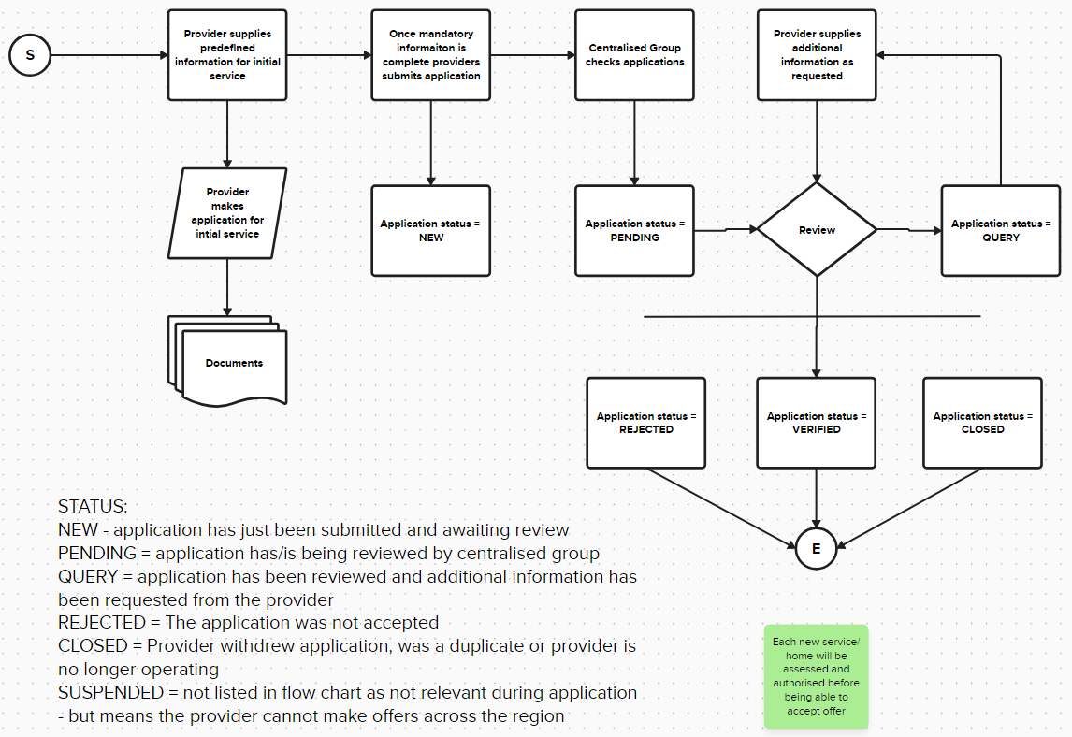
Provider Registration

Slide 25
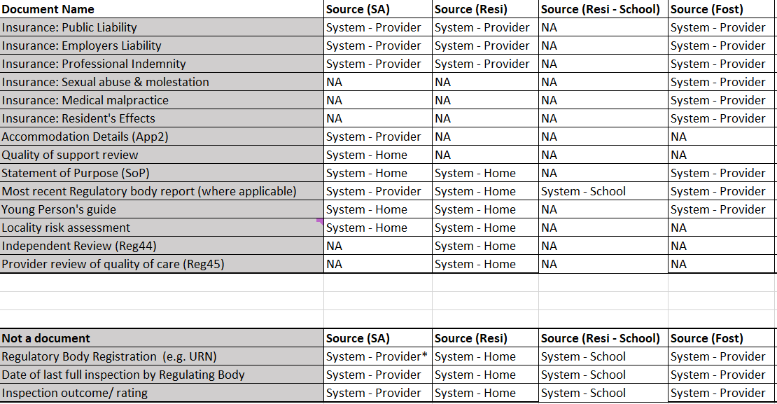
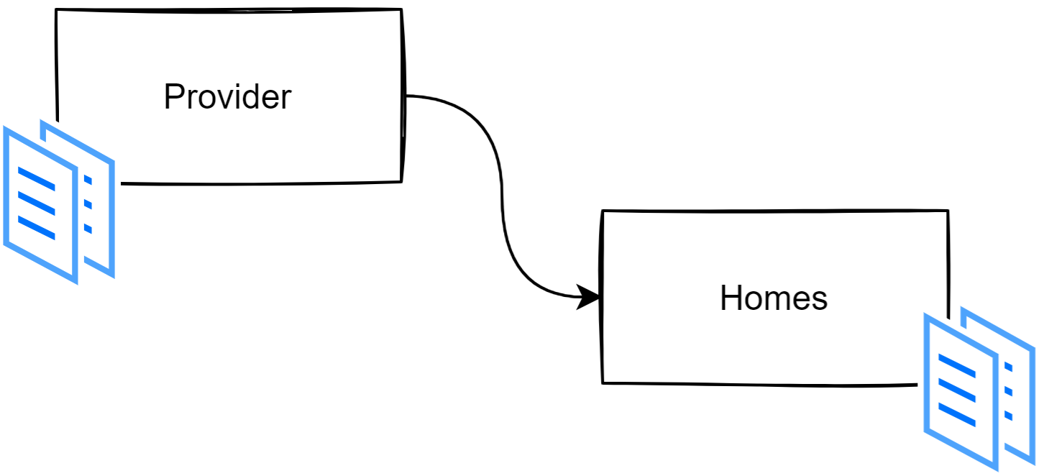
Provider Multiple Service Types

Slide 26
Next steps
Discover
Design
Develop
Test
Continue testing delivered functionality – Provider listings / manage workstack
Complete development for Provider listings, progress Provider actions to manage referrals
Finalise, document and handover LA elements to managing referrals
User research with Social Workers – what do they need?
Discover Provider account management processes and requirements
Understand the impact of upcoming Fostering framework changes

