Slide 1
Scenarios: Making and Accepting an offer
{SCENARIO 1}
{SCENARIO 3}
Provider makes a provisional offer
PROVIDER ACTIONS
Provider makes a final offer
Fig. Simplified Action Structure
Review provisional offers
Request final offer
Accept final offer
LA ACTIONS
{SCENARIO 2}
{SCENARIO 4}

Slide 2
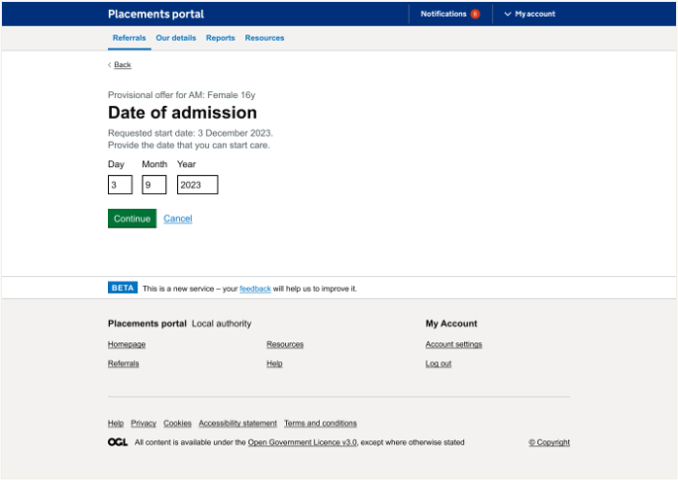
Providers - Page: Date of admission
Date of admission is understood
Date of admission was understood by all users and most completed the task. Most users mentioned that this is likely to change though and may not remain consistent throughout the process.
One user felt it was very early in the process to be confirming dates as the placement hasn't been agreed however when viewing the whole journey had better understanding. One provider also mentioned that would reserve the child a room if they were making a provisional offer.
Confidence in date is low
Design Decision:
Amend wording or add sub text e.g ‘proposed date of admission’
“'What I tend to do – I would put in my blurb
that it is available sooner”
- P185 support accommodation provider
Notes:
It's also about relationships between providers and placement officers – some will call provders they know

Slide 3
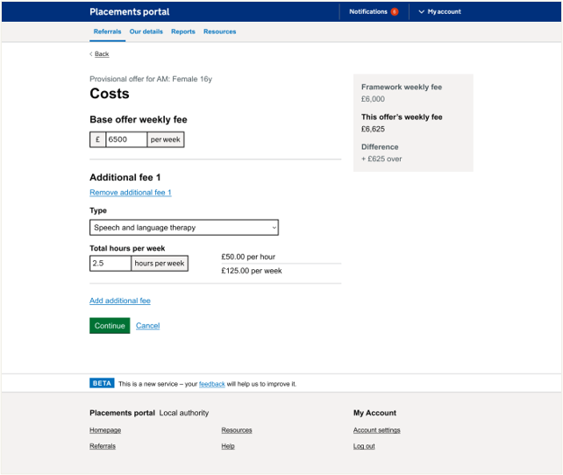
Providers - Page: Costing
Costings are understood
Most users understood the fees but there were lots of variants that differed per provider, either because of framework or spot costs but also additional fees.
Some added additional fees for childs personal costs (gym membership etc.) and some would operate on an all-inclusive rate. Fees for external providers that they used could also vary. Staff fees could also vary across their organisation.
Costs were not always in hours some were in staffing days. They may only need costs for short time such as waking nights for week
Most users understood this right hand summary but were relatively ambivalent to it though some found it useful. Some were confused by it as they weren't on framework
Wide variation of fees per provider – couldn’t always be broken down into hours
Design Decision:
Not half hours. Full days, overnight and hours
“staffing costs are over a day rather than set amount of hours”
- P185 support accommodation provider
Notes:
It's also about relationships between providers and placement officers – some will call provders they know

Slide 4
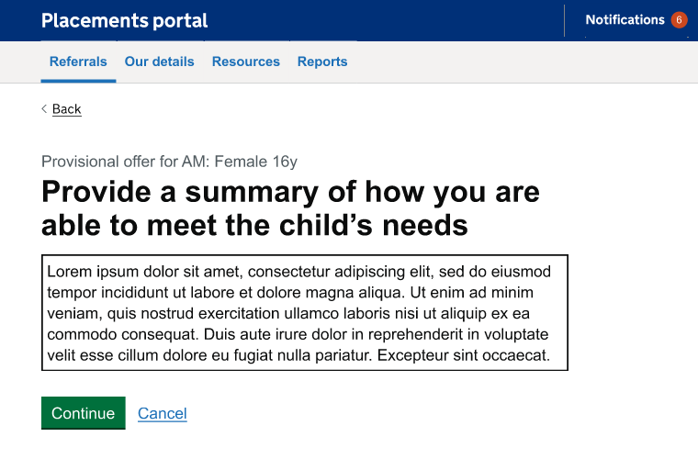
Providers - Summary
Difference in provider profile and offer details understood
All users understood what to include in this section and appreciated this being separated out. One mentioned they would like this reflected in the IPA.
Another mentioned that these details are likely to be discussed further down the line with home manager and SW and not necessarily at provisional offer stage.
The summary was interpreted differently by different providers
Design Decision:
Provide more guidance and/or word count to guide user on expectations
I have idea of what's going on, but the in-depth conversation would be next stage process
- P197
Notes:
It's also about relationships between providers and placement officers – some will call provders they know

Slide 5
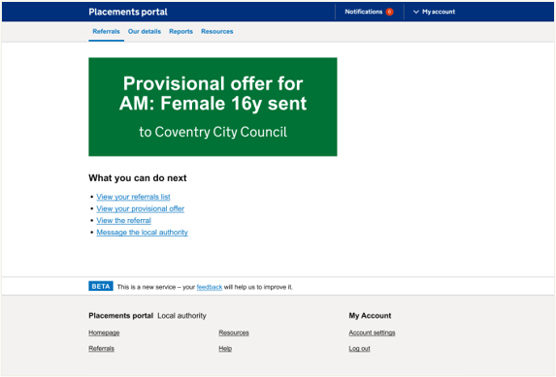
Provider - Final Page
Difference in provider profile and offer details understood
All users managed to submit the offer. Most users wanted either a reference number for the offer or an email confirmation to follow up with LA this is due to lack of trust in the current portal. In their current ways of working they would follow this up with message to LA to ensure it had been received.
Most providers used their own internal systems to log offers, the majority of these seemed to be manual processes such as spreadsheets rather than any specific software.
One user (when navigating back to their referrals) didn't understand what 'Active' referrals meant and another user couldn't easily navigate their way back to the offer they had made.
Most users wanted a ref no. or email to follow up with LA (re. their submitted provisional offer)
Design Decision:
Check email notifications with BA, add specific ref no. or ID?
“'I would want a reference number for submitting the provisional offer. I would put the referral into my placements so I can find them again. I need to know the ID so I can find the exact referral for that child. ”
- P187 support accommodation provider
Notes:
It's also about relationships between providers and placement officers – some will call provders they know

Slide 6
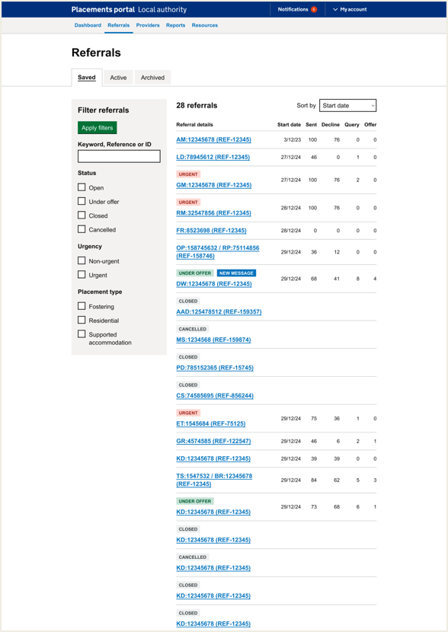
Placement Officers: Listings Page
Listing Page is understood by all users
One Placement Officer needed to see the type in the listing view due to often having to complete a dual search for both fostering and residential at the same time. Later they saw the filtering and expressed they would use these to distinguish the type.
Other filters weren't understood. For instance, one PO didn't understand Under Offer thinking it should show all referrals that were under offer in the whole system.
There is a need to understand requested by deadline with PO requesting the colour coding they are used to (red, amber, green for how near to the requested deadline a referral is) or deadline date on listing page so they are aware of when they need to chase providers for a response if they haven't had one.
Confusion around ‘Under Offer’ status
Design Decision:
Consider wording ‘Under Offer’ Also need a solution of how to deal with referrals that are past start date
Notes:
It's also about relationships between providers and placement officers – some will call provders they know

Slide 7
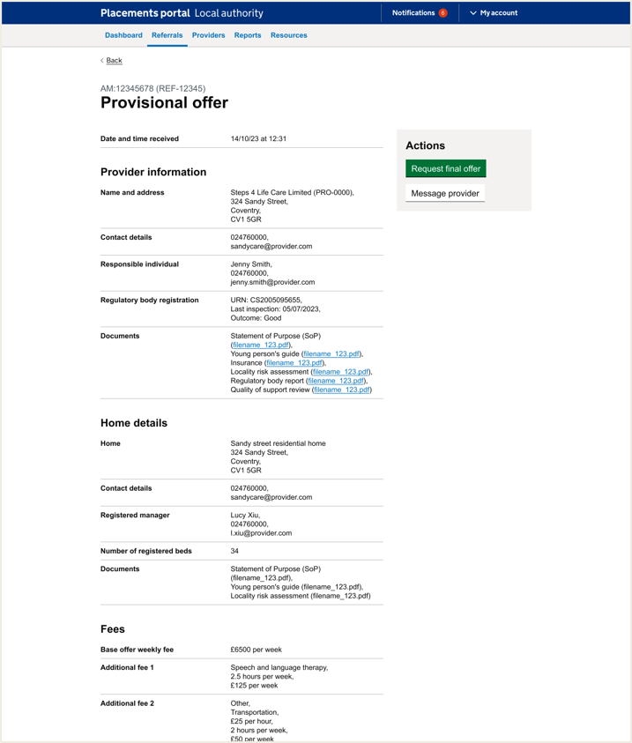
Page: Provisional Offer
Placement Offer wanted to share provisional offers with SW
Design Decision:
Consider allowing an export of offers, is this MVP? Does it set a precedent for other export capability e.g Referral History?
Did it have all the information you would expect?
Most users said it had all the information they would need. One user who worked across all 3 types said the ‘form F’ was missing.
One residential user highlighted costs for education and milage for transportation would be important.
How do users need to share with SW?
Many users expected to be able to download this page and share the relevant information to the SW via email. The main information the SW would need tended to be; Appendices 1, 2 and 3; Contact details for the provider; how the provider meets the child's needs; Home profile; Costings; insurances and Ofsted reports
Variation of costings by different categories (SA/Residential)
Design Decision:
Which framework cost would override the other when a referral is across two different categories?
“I'm hoping these files you can click on and download them? I'd send all the info in an email to the social worker”
- P11 (Placement Officer)
Notes:
It's also about relationships between providers and placement officers – some will call provders they know

Slide 8
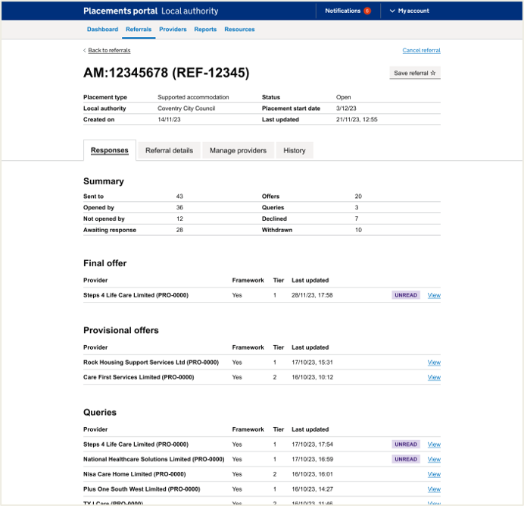
Placement Officer: Referrals details + Responses final offer
All POs navigated to the final offer:
Users understood they would need to seek the various internal permissions and approvals before clicking to finalise the offer. These approvals are recorded on internal systems
It was mentioned by users that there is mistrust in the portal which means throughout testing, users want to follow up with emails in case the portal goes down. As well as download conversations or offers.
Final offer page: What would you do if something wasn't right?
Call the provider to get update information. Often they need to know how the costs need to be broken down before going to approval. If there as concern, they would talk to the QA officer.
Placement Officers were asked about making edits if something wasn’t right
Design Decision:
Discuss unhappy path – does the final offer ‘lock’
“if something’s not right I’d call the provider to check with them”
- P11 (Placement Officer)
Notes:
It's also about relationships between providers and placement officers – some will call provders they know

Slide 9
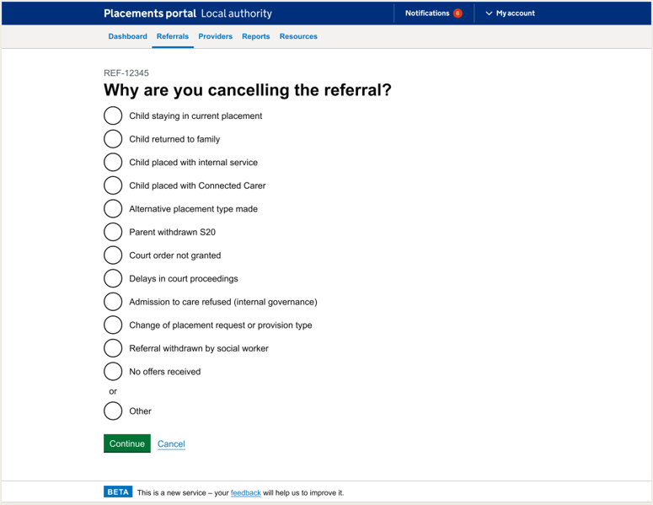
Placement Officers: Listings page + Cancel referral listing and returning to the referral
One user highlighted they would want to message providers before cancelling (if they had made an offer)
Most commented that the list of reasons were comprehensive and liked having increased list of reasons
One user commented that it was unclear that the message has gone out to providers that it has cancelled - would need this for those that have made a provisional offer
Some confusion from users around whether the referral had been cancelled and providers notified
Design Decision:
Consider creation of confirmation page (need content design)
“How do you know have cancelled referral?
It happened so fast!”
- P37 (Placement Officer)
Notes:
It's also about relationships between providers and placement officers – some will call providers they know

Slide 10
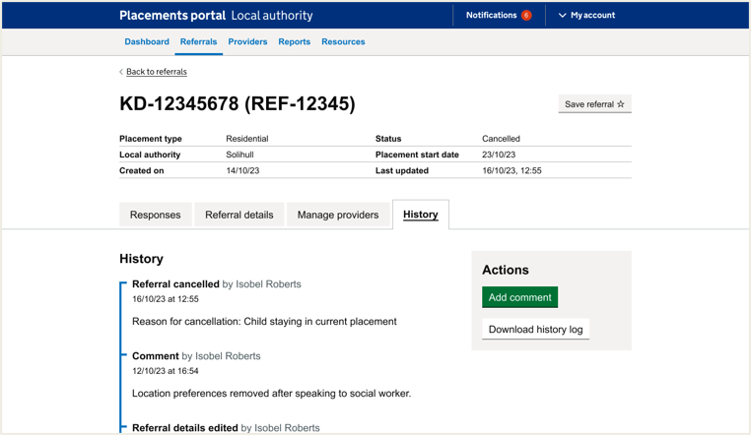
Placement officers: History page
Most POs would not need to add comments to cancelled referrals as once it's cancelled this is it. They may record things on their own internal systems.
Most users found the download history useful and would want to share this with relevant parties such as social workers. They may add comments if the referral was active.
Users said it would be useful to be able to export History (e.g for court)
Design Decision:
Again, consider allowing export, but is this MVP?
“I would use this chronology if we are struggling to find placement - we know that the providers have seen this child loads of times before - we usually cancel and put fresh search - as it’s better that way… it just supports us in a way - search the referral and how many times it went out - it helps work with the market a bit more if we are struggling - court even ask us to report - and we be accurate as we can
- P33 (Placement Officer)
Notes:
It's also about relationships between providers and placement officers – some will call providers they know

Slide 11
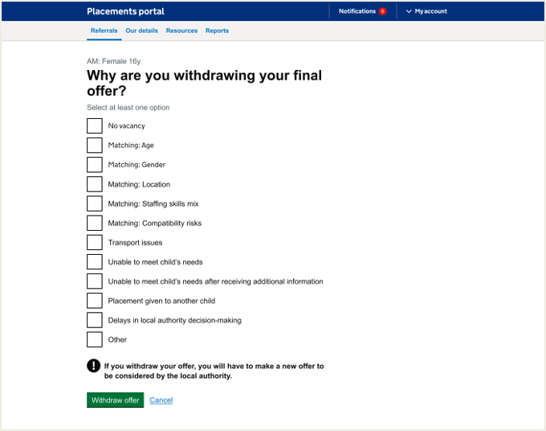
Providers: Withdraw offer page
Residential and support accommodation providers felt the withdraw list was comprehensive
Most common reason is 'unable to meet child’s needs' after receiving additional information. There was a feeling across the users that the list was comprehensive.
There was one suggestion that 'financially not viable' if LA is proposing lower costs and the provider can not offer this.
Fostering providers felt the list did not suit their needs as they would rarely withdraw over matching criteria
Some users wanted to cite costs as a reason for withdrawing
Design Decision:
Add costs reason option
“'The reason [to withdraw an offer] was that for us to meet the young person's needs we'd have to charge more, and they weren't prepared to pay for it. 'Financially not viable”
- P208 support accommodation provider
Notes:
It's also about relationships between providers and placement officers – some will call provders they know

