Slide 1
Show & Tell
West Midlands Placement Portal
Sprint 14 – 17th Jan 2024

Slide 2
Agenda
Discover
Design
Develop
Test
11:00 Project Update
11.10 Portal development – Demo
11:20 Approach for portal access & profiles
11.25 User roles and permission
11.30 Next steps

Slide 3
Project Update – Core Placement process
 | Requirements Discovered | Designs Agreed | Development complete | SW Testing Complete
Create New Referral
View referral
Manage Workstack
Respond & Action referrals
Provider
LA
Provider
LA
Provider
Provider

Slide 4
Manage Referral - LA Listings / manage workstack
Discover
Design
Test
Develop

Slide 5
Portal access (LA & Provider)
Discover
Design
Develop
Test

Slide 6
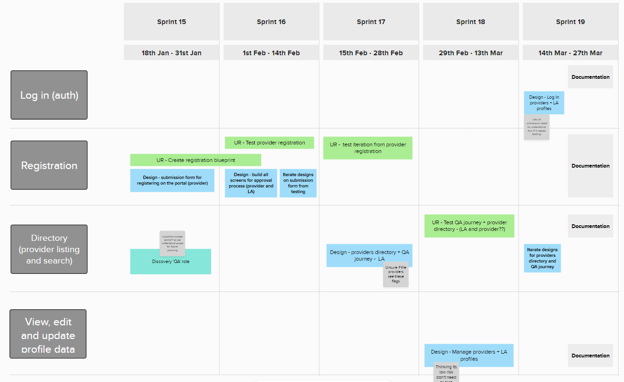
Portal registration & profiles - approach

Slide 7
Portal registration & profiles – design features
A submission form providers fill out to register with the portal
A directory that lists all the provider profiles. Local authorities will have the ability to narrow their search by applying certain filters
Profile pages for each provider, with the ability for the provider to edit or add certain information about their service
Understanding of the Quality Assurance role needs on the platform

Slide 8
User Roles & RBAC
Discovery Completed on user roles for Local Authorities and Providers
RBAC – role-based access controls
Essentially who can do what and where
Validation with providers will be conducted to confirm what is being suggested will work for them
NOTE – Shared email inboxes
The portal will cater to these where used. A user will need a unique email for their profile but can define the shared email address for which correspondence about referrals will be sent
If there is no shared email defined notification emails will default to the unique email
The LA entity discovery was also completed along with some initial findings about what is needed in the IPA
IPA discovery has yet to be done – but useful context to have prior

Slide 9
Next steps
Discover
Design
Develop
Test
Continue developing LA side of portal – Manage / organise workstack
Functionality to attach documents to messages and be able to view (poc)
Continue testing the delivered software
Start designing Provider registration side of Portal
Discover the QA role and requirements relating to authorising new Providers

