Slide 1
Show & Tell
West Midlands Placement Portal
Sprint 16 – 14th February 2024

Slide 2
Agenda
Discover
Design
Develop
Test
11:00 Intro
11.05 LA Manage Referral - data and stats
11:15 Provider registration – user research findings
11:40 QA journey – requirements discovered
11.50 Next steps

Slide 3
Manage Referral - LA referral data
Discover
Design
Test
Develop

Slide 4
Portal Registration - User research findings
Discover
Design
Develop
Test

Slide 5
User Research Sessions Overview
This sprint we were researching how providers fill in the registration form when applying as new provider on the system.
Each user research prototype testing session took place over Teams and lasted approx. 60 minutes.
During these sessions we asked providers to imagine they were registering on the portal for the first time and to complete the registration form.
We spoke to 7 users from 4 providers. There were a mix of providers with at least 3 offering multiple services such as supported accommodation, residential and /or fostering provider.
7

Slide 6
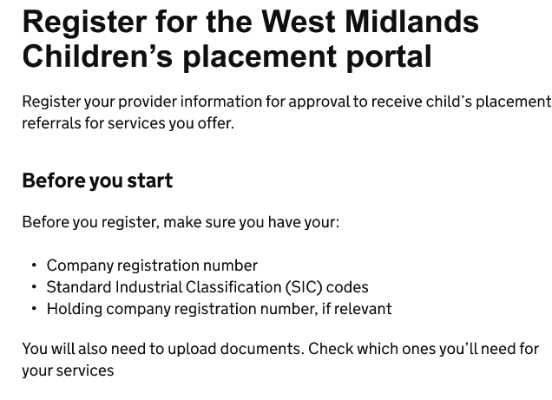
Page: Start Page
Reaching out to other team members
Most users felt they would need to reach out to another team member to find all the information that is requested on the start page. However, all users knew who this would be in their organisation and felt they could quickly contact them.
Most users had not seen SIC code before but would know who to ask to find this information out.
"SIC codes wouldn’t have a clue – I would highlight these questions and email the directors to get them to help"
P135 Fostering Provider
Notes:
It's also about relationships between providers and placement officers – some will call provders they know

Slide 7
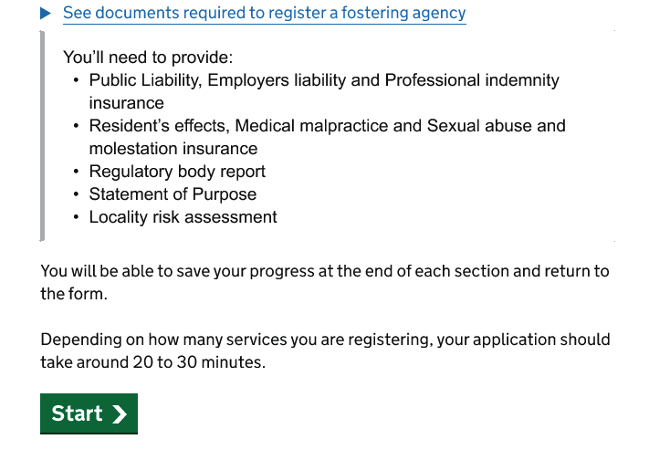
Page: Start Page Timings + Save and return
Change the content around time
The time it takes to complete the application would depend on the size of your organisation; with larger providers taking a lot longer to add all the homes.
Design decision: update estimated times for the registration at provider level and separately the time it would take per home
Save and return
Throughout testing users mentioned the need for saving and returning.
Design decision: Save and return will be incorporated into the next design.
"There is no way this would take 20-30 minutes. It would take much much longer. Can I save and come back. Perhaps an indication of time per home."
P118 Residential and Fostering Provider
Notes:
It's also about relationships between providers and placement officers – some will call provders they know

Slide 8
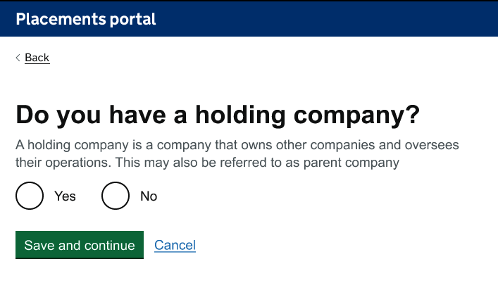
Page: Holding company
Providers knew where to find this information
3 users weren't sure of holding company but would know who to contact to find out what it means and what the number is.
Those users where holding company was relevant for appreciated the automatic look-up and understood this. This user also mentioned that they are used to this being called the parent company.
Design decision: Keep as is, do not change question to say 'parent company'.
"I'm not very good at the business stuff but I think that's a yes. I'd have to quickly call someone to ask. When I think about it, if I'd gone and got the documents, I'd have this information to hand. That would be easy. "
P118 Residential and Fostering Provider

Slide 9
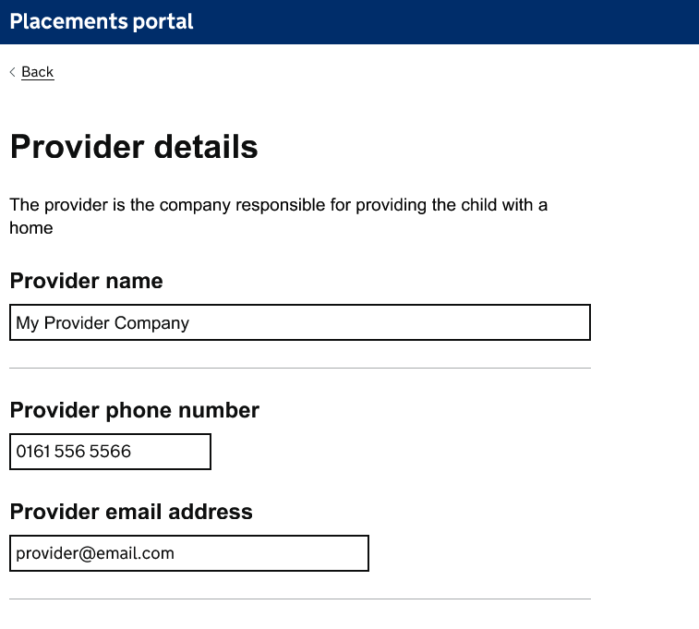
Page: Provider details
Unclear on the exact email to put in the provider details
Some users weren't always clear about the contact address to put into the provider details. With one explanation they put their own details in as it was them completing the form while others sharing they would put the referral email as that's who they want the referral to go to.
Design decision: To add additional information to the page description that outlines what the contact information will be used for.
“This would be (provider name) depending whether its fostering or residential. but this all commercial so our email address."
P172 Residential and Fostering Provider

Slide 10
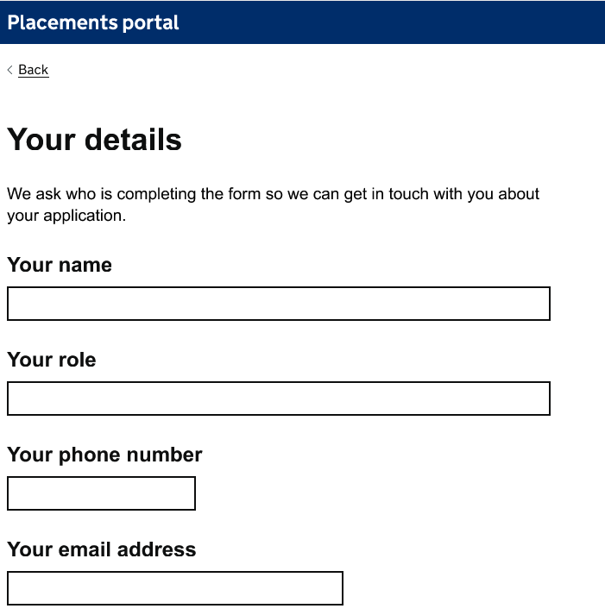
Page: Applicant Details + RI
Unclear on the email they should put in your details
Most users were not clear on which email to put in the ‘your details’ section as providers were unsure what the email address was being used for. Users weren't sure whether to put their individual emails or that of the general referral team and missed the page description.
Responsible individual
The ‘Responsible Individual’ was not always known by users as this is a terminology they had not come across. However, most users knew who to contact in their organisation to find out.
Design decision: Move ‘your details’ page to the first page in the journey to help give more context to the name and contact wanted. Also add additional information in the page description to explain what these details will be used for.
“I would just put ‘commercial’ in the ‘Name’ box as there are a few of us who would need access.”
P219 Residential and Fostering Provider

Slide 11
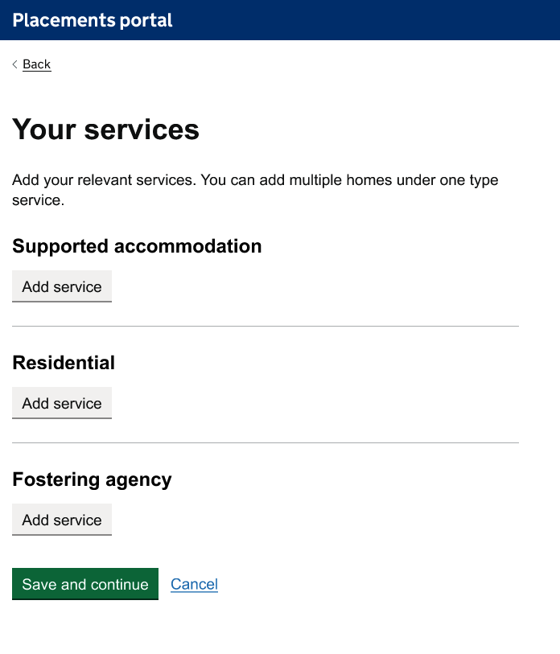
Page: Your services
Users understood what to do on this screen.
Multiple users need to access and fill this in registration
However, it was raised for instance in a larger provider that someone is responsible for residential and someone else is responsible for support accommodation so there would need to be a mechanism to save and return and for multiple users to fill out the registration form.
Large providers would take longer than
Some providers have 100s homes to add to the portal so consideration on how much time this will take needs to be factored into the start screen content.
Design decision: Add extra information to the page description to remind users that you can save and
continue if needed.

Slide 12
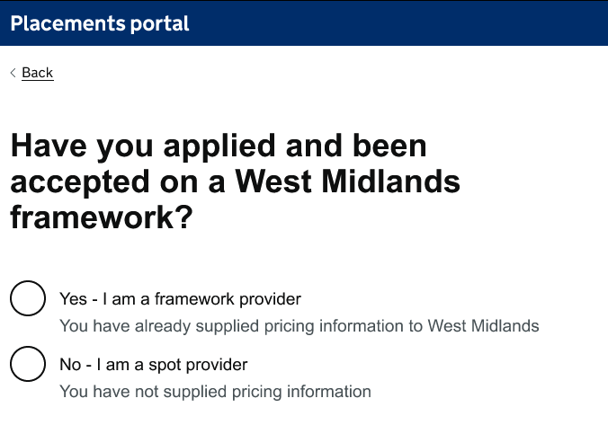
Page: Framework and spot
Users understood framework and spot
All users understood framework and spot however one provider highlighted that as they had homes of both spot and framework, yes and no questions would not work for them. The spot homes were outside of the West Midlands.
Business decision: Ambition is going forward a provider will only be able to be framework or spot provider
Design decision: Add secondary information underneath the question to explain why we ask for either framework or spot, and add contact details in case the provider has follow up questions
“We need to contact WM to add home onto the framework….Whether the home is going on the framework or not. Why not?...Some of the homes are on the framework and some are not”
P219 Residential and Fostering Provider

Slide 13
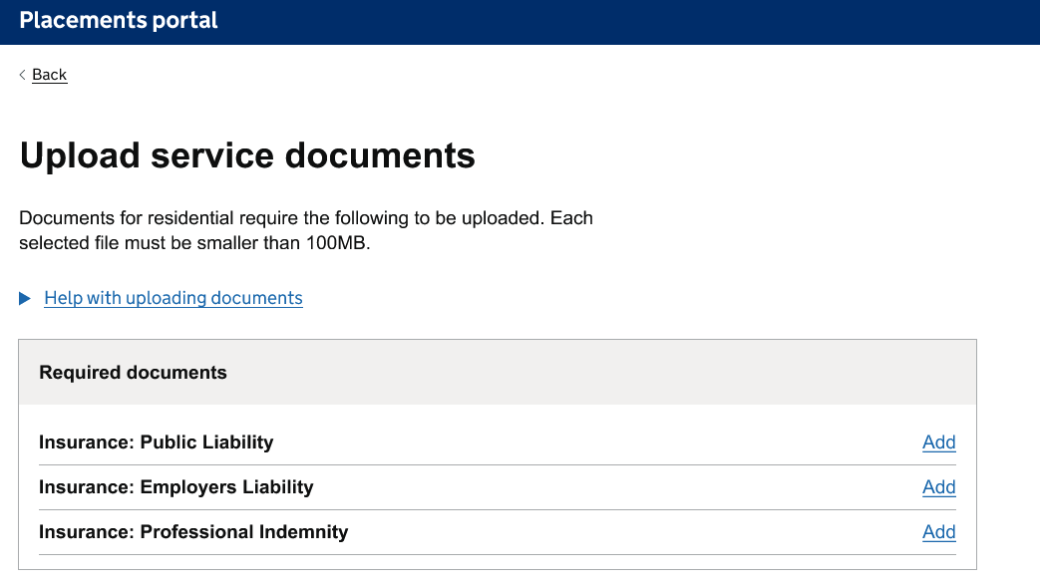
Page: Uploading documents
All providers understood the documents being asked of them during the testing
Insurance can be in one document
The two providers that dealt with residential highlighted the insurance would be in one document rather than multiple. However, they didn't see a problem with uploading it twice. This is something that one provider mentioned they do on other portals.
Design decision: to keep all three types of insurance to cover all ways of working as there is potential for the insurances to have different dates. It will also help the approvers to see all insurances have been covered.
Fostering often stored in other locations
One provider was off put by the amount of documents that they needed to fill in. Explaining that they would shut it down and come back to it later. This was due to them all being stored in different places. Having save and return will help mitigate this.
“Maybe we would upload twice? Would only take a few seconds to do this”
P219 Residential and Fostering Provider

Slide 14
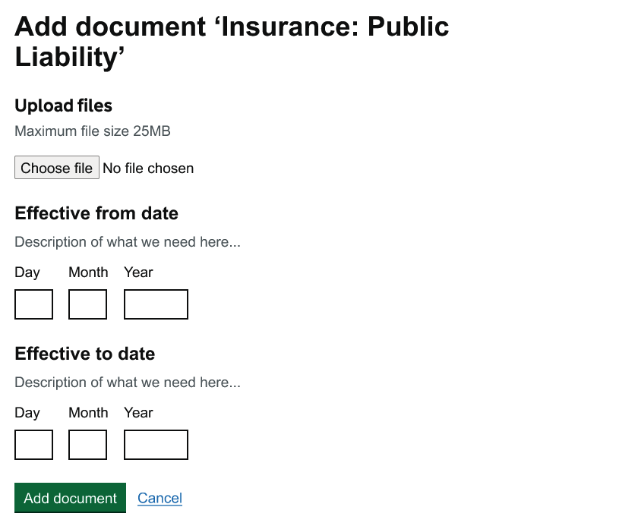
Page: Start and end dates in documents
Depending on the documents, start and end dates may not be relevant
Not all documents are able to have start and end date. For Ofsted for instance “you might be inspected in the December 2022, and your inspection then is technically due in the December of 2023, but you might not be inspected until the March of 2024.."
Statement of purpose is regularly updated when new staff members. This is reviewed by some providers yearly.
Locality risk assessment is also regularly updated throughout the year.
Design decision: to have start date, last updated and review date on documents that do not have clear end date
“location risk assessment because that's another document that's sort of ongoing... it's something that you have to update and with a new child coming in, you have to update it if you're crime statistics in your area … that's constantly changing sort of with your environment and”
P219 Residential and Fostering Provider
Notes:
It's also about relationships between providers and placement officers – some will call provders they know

Slide 15
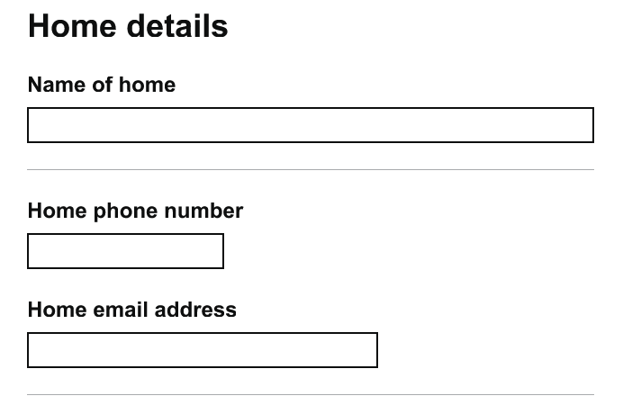
Page: Home Details
Concern on what the contact information was being used for
There were concerns from some providers about what the home details contact would be used for. Providers would not normally give these details out at this point in the process.
One provider was worried that they wanted their personal home address rather than that of residential homes.
Register manager
The same concerns were given to supplying the registered manager contact details
Design decision: add content into both page descriptions about what this data will be used for and how stored.
“What if it was a directory? Oh, well that would be fine, it depends who has access. there is sensitivities around childrens homes. So we need to know who has access. ”
P117 Residential and Fostering Provider
Notes:
It's also about relationships between providers and placement officers – some will call provders they know

Slide 16
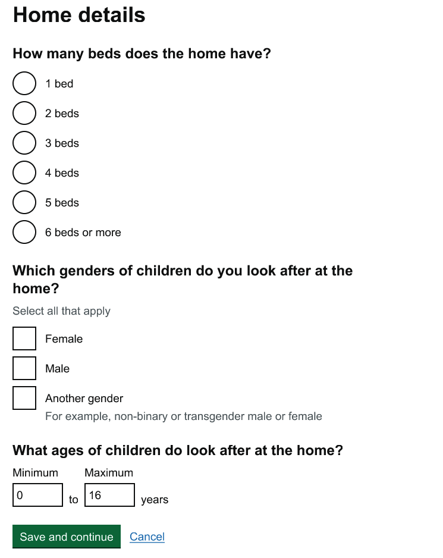
Page: Home Details
Page understood clearly
Ages, genders and number of beds easily understood and information easily accessible.
Users knew to tick all three genders when there was mix gendered home.
Notes:
It's also about relationships between providers and placement officers – some will call provders they know

Slide 17
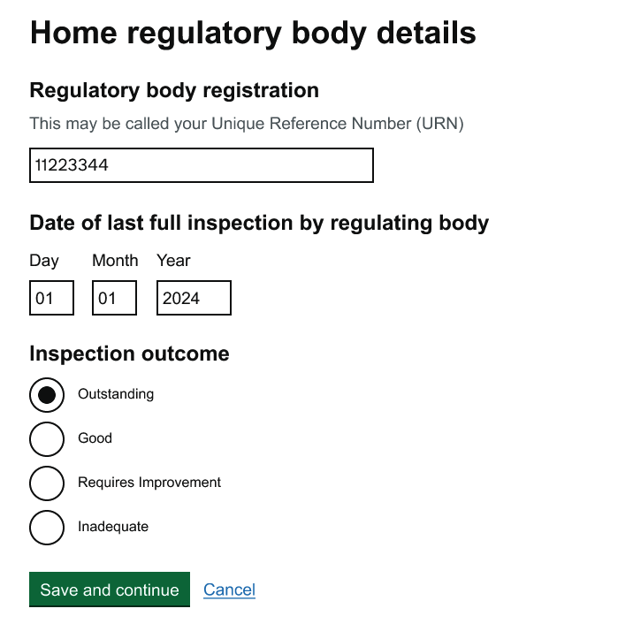
Page: Regulatory body details
Easy to find information
User explained how it was easy to find information about regulatory body and this was easily understood part of the journey.
This was also easy to find at the provider where applicable
Might not always have a date
One mentioned that there is a period of time when home is registered but hasn’t had an inspection
‘There is a period where they are not inspected in the first year. So you might not have last full inspection.’ P219
Design decision: create an additional design that will allow providers to tell us if they are new and waiting to be inspected
Notes:
It's also about relationships between providers and placement officers – some will call provders they know

Slide 18
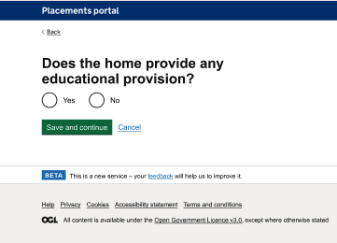
Page: Education provision
Core fee sometimes requested to be broken down
There was some confusion from one provider around education provision and whether it would apply to some of their homes that had education provision near by which they would sometimes offer as part of the package.
Suggestion of content from the user - 'Can education be included in the package?’, this would allow them to add both the homes that have education attached and their independent separate schools.
Finding the information for the school would be easy enough and users understood the rest of the questions about education provision
Design decision: Add a drop-down list of what types of education provisions are included so it is clearer to providers what is covered.
“Sometimes separate registered as Children’s Home, sometimes as a separate school. Not that all homes provide education, but we have schools nearby that can be included. ”
P219 Residential and Fostering Provider
Notes:
Design Decisions

Slide 19
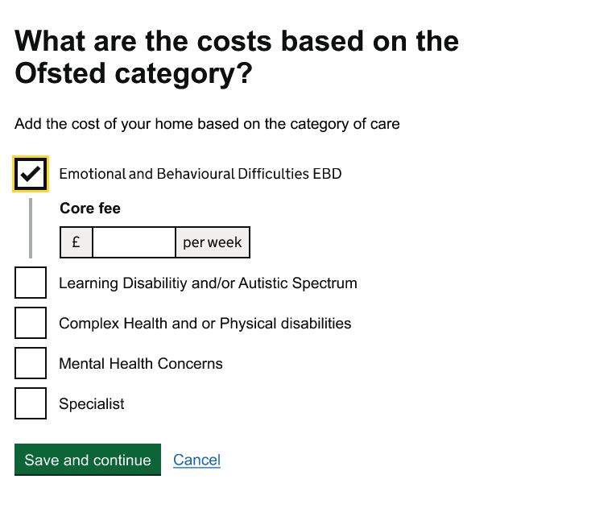
Page: Costs for spot providers
Core fee sometimes requested to be broken down
The core fee is sometimes requested to be broken down further by placement officers when providers apply.
Specialist fee was highlight as being slightly different to other. One provider explained that they have two types of specialist fee
Business decision: if the core fee is needed to be broken down this will be handled offline outside of the portal. There will be an option to explain costs in more detail through the chat function at make an offer stage.
Reassurance around uplift in costs
One spot provider wanted reassurance that they could update these costs when they do their yearly uplift.
Business decision: There will be mechanisms to request price lift
“Specialist fee - There would be a breakdown of the costs, sometimes the LA would request this. ”
P172 Residential and Fostering Provider
Notes:
It's also about relationships between providers and placement officers – some will call provders they know

Slide 20
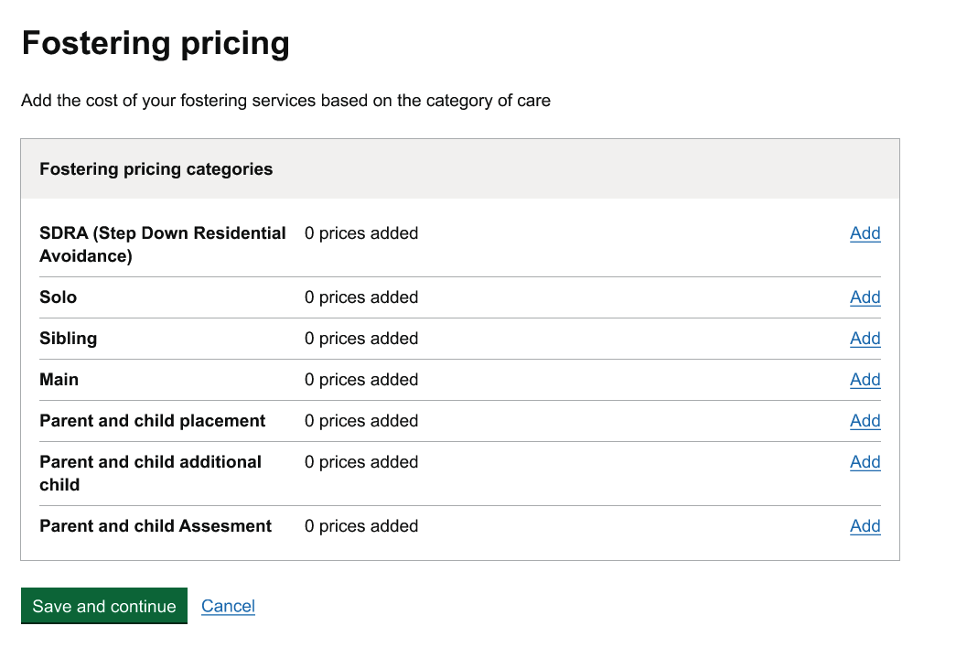
Page: Fostering costs for spot
Language of main not always understood
Providers referred to main as standard rather than main.
Sibling costs behave differently in the system
Sibling costs may be complex for one provider they offered 1% discount depending on the number of siblings that were in the group. So would need dynamic pricing.
Design decision: create a design that enables placement officers to add relevant information about their pricing structure, such as discounts per sibling.
“Sibling is a main cost minus the discount per sibling. 1%. It depends how many siblings, we take up to 4 and put pricing for each one. and thats dynamic depending on amount. ”
P171 Supported accommodation, Residential and Fostering Provider
Notes:
It's also about relationships between providers and placement officers – some will call provders they know

Slide 21
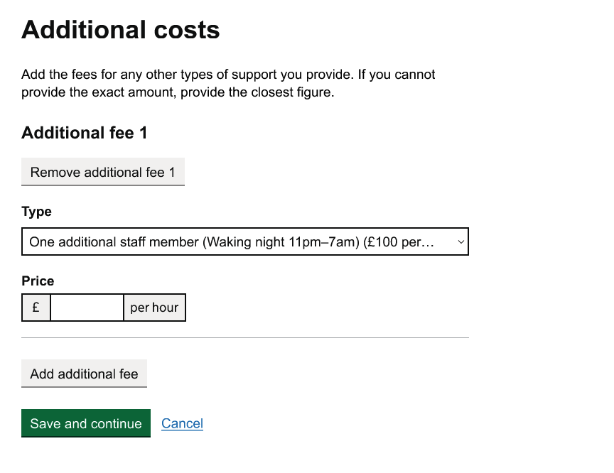
Page: Additional Costs for spot
Additional costs understood
Providers understood additional cost.
Highlighted that the fees would respond to the specific child referral when it came to making an offer
Per hour agreed to be the unit of cost
Additional costs were highlighted by one provider it wouldn't always be per hour and could sometimes be day rate. Others said this was an appropriate measurement.
Business decision: To keep amount as per hour due to the complexity of adding per day/ other amounts so per hour has been prioritised.
Additional costs will be added per home
Therapy, education, and transport highlighted as the additional costs. One provider mentioned that these were done per home. While others mentioned these costs would be per service.
Business decision: to keep additional costs at home level to enable services to be added
to an individual home
“Additional costs wouldn’t all be ‘per hour’ some would be different . ”
P219 Residential and Fostering Provider
Notes:
It's also about relationships between providers and placement officers – some will call provders they know

Slide 22
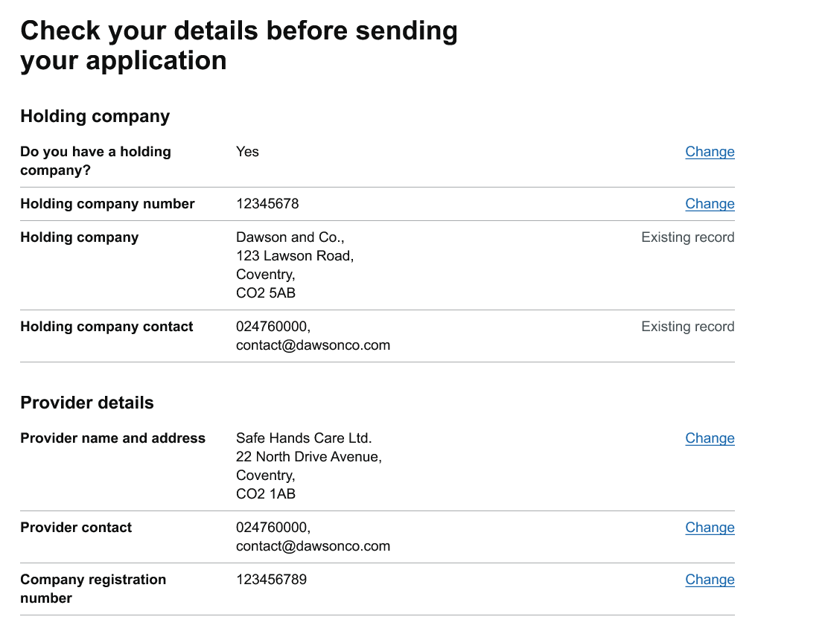
Page: Check answers + T&CS
Check answers page understood
Check answered understood by all providers but needs some thought into how information is displayed for those providers that have large number of homes.
Design decision: the team are working through how to make this accessible for large providers
Terms and conditions page understood but contact need to be added
All users were happy the link took them to somewhere external. One provider mentioned they would want a contact incase they had questions or queries about the terms and conditions or wanted to challenge them.
Design decision: contact details will be added to the terms and conditions link which will be hosted off the portal
“No place here to query the terms, if there’s something I’m not supportive of. Doesn’t detail what I can do with my application form ”
P135 Fostering Provider
Notes:
It's also about relationships between providers and placement officers – some will call provders they know

Slide 23
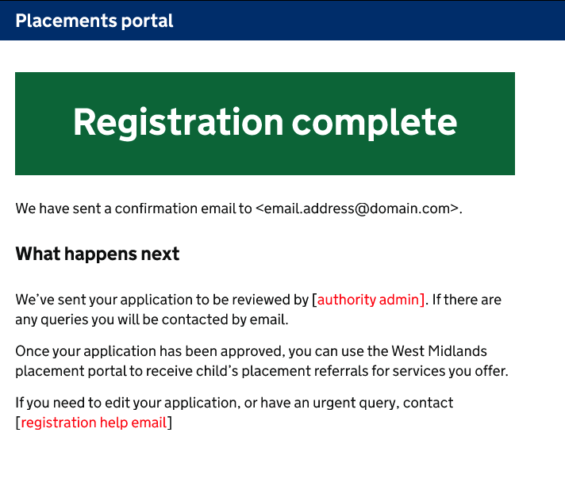
Page: Registration complete
Information clear would like a timeframe for response
Users understood that they would receive an email confirmation and that their application was being reviewed. There were varying expectation on how long this would take to be approved from couple of weeks to 24hours. With some users asking for this to be outlined in the information
Design decision: A automatic email notification will be made. The addition of content explaining it will take approximately 2 weeks for placement officers to make the first response about a referral. This was felt to be possible due to now having all documentation and information upfront.
Reference number
One provider explained how they would print the page for evidence it had been submitted. They would want a reference number to refer to incase they had query they wanted to speak to someone about.
Design decision: Not to include a reference number as this is out of scope and the providers name can be used to search for the registration
“I'd want to know when the application would be reviewed. I'd expect it in 10 working days, but don't know if that is unrealistic. ”
P135 Fostering Provider

Slide 24
Discovery - QA Requirements
Discover
Design
Develop
Test

Slide 25
QA Discovery
Provide POs information relating to the safety of placing a child in care when reviewing an offer
Enabled by:
Allowing QAs to record information about a provider and/or home(s)
To make that information visible for QAs, POs and Commissioners across all 14 LAs
To retain a visible history against the provider of all QA intelligence
Potentially use the same QA intelligence collection mechanism to show planned visits to prevent duplication of QA inspection effort

Slide 26
QA Discovery
Essential information to be recorded TBC:
A flag that will serve as a CTA (call to action) for users of the system at the relevant point
e.g. a LA user looking at the provider via the directory, or a PO viewing a referral offer from a provider
Intelligence Type (e.g. Young Person Allegation, Social Worker Concern, phone call, Unannounced Thematic Inspection)
The QA who created the intelligence and date
Date of intelligence creation trigger (e.g. incident)
Location details
QAs contact details - essential so others can request more information if needed
Which LA the inspector came from
Inspection Date
Inspection Outcome
Summary of Concerns & Recommendation
Review Date

Slide 27
Next steps
Discover
Design
Develop
Test
Continue developing LA side of portal – Data on referrals, document work
SW testing of LA Listings functionality
Finish designs for Provider registration approval and test with users
Finalise Provider registration designs
Initial designs for Provider Directory and QA journey

