Slide 1
Show & Tell
West Midlands Placement Portal
Sprint 18 – 13th March 2024

Slide 2
Agenda
Discover
Design
Develop
Test
11:00 Welcome & overview
11.05 Demo portal functionality – Referral Journey Variations
11:15 Provider approval process - update
11.45 Next steps

Slide 3
Manage Referral - LA journey variations
Discover
Design
Test
Develop

Slide 4
Manage Referral – LA referral journey variations
Actions a Placement Officer might take regarding an existing referral:
Cancel or withdraw the referral
See an overview of responses from Providers
Awaiting response
Declined
Sent message / raised query
Made an offer
Edit / update the referral details
Edit the Framework search
Extend to Spot providers

Slide 5
LA journey variations – today’s demo
A Placement Officer can search for a specific referral based on ID/ref or initials and can Cancel that referral
Within a specific referral, a Placement Officer can view details of Providers who have:
a) declined
b) messaged about it

Slide 6
Provider onboarding - Application & approval
Develop
Test
Design
Design

Slide 7
Intro
Over the last 2 sprints the designers and researchers have created the journey a provider takes to get their services and homes onto the portal.
We've looked at different design approaches to gather feedback on design approach as well as understand more about the context of use.

Slide 8
What
(Tested in Sprint 16/17)
Provider registers to the new WMPP
Provider reviews and amends registration queries
PROVIDER ACTIONS
APPROVAL LOOP
LA reviews and approves or queries Provider registration
LA reviews Provider responses and/or updates
LA ACTIONS
Service level query
(out of date PI)
Home level query
(out of date SoP)
Fig. Simplified Action Structure

Slide 9
Who
Who we tested with (Sprint 17 and 18)
4 local authority roles acting in the QA capacity. (Members of current RSU)
4 providers (2 Residential, 1 Supported Accomodation and one provider who delivered Residential, Supported Accomodation and Fostering services.
Notes:
It's also about relationships between providers and placement officers – some will call provders they know

Slide 10
How
We tested 3 different design iterations of the LA/Provider Approval Loop with various options for adding a query which we will share in a future show and tell, once the team have had chance to understand the design and development implications.
Today we will be sharing the insights from the start of the approval journey and if the referral has all the information and documentation to be approved.

Slide 11
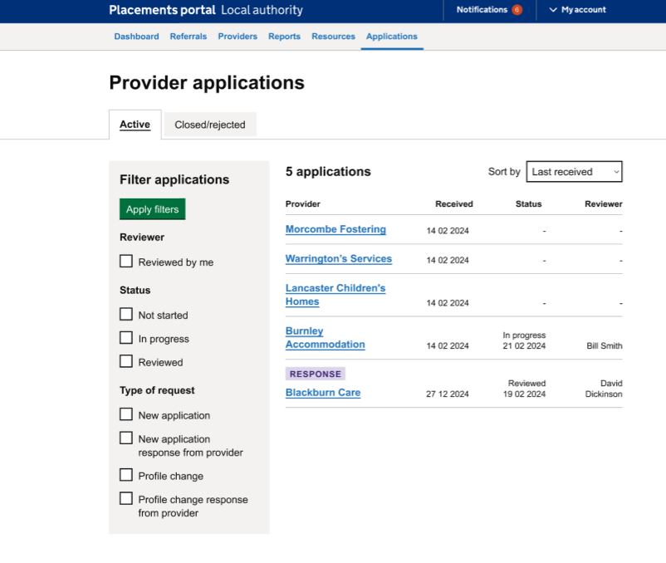
LA - Page: Listings
All LA users were easily able to select the correct provider application
It wasn’t clear however what the distinction was between ‘In progress and ‘Reviewed was and why that might be needed.
LA users requested to able to filter by service so they could triage applications by need.
One user queried how they would be notified if a new application came in.
Notes:
It's also about relationships between providers and placement officers – some will call provders they know

Slide 12
LA - Page: Listings
One provider didn't understand the distinction between the tabs and what the status of applications would be for each - and whether they were needed.
One provider asked what the filters would be for ordering (i.e a-z, oldest to newest etc.)
User commented that the filters didn't signify applications waiting for a response. They were also confused by profile change and type of request filters.
“’[you] don't need rejected / closed tab – unless you want to be specific – here are your active and rejected tab - If you reject a provider – can you un-reject them? – I wouldn’t want them to have to create everything again'
- P31, LA representative
Notes:
It's also about relationships between providers and placement officers – some will call provders they know

Slide 13
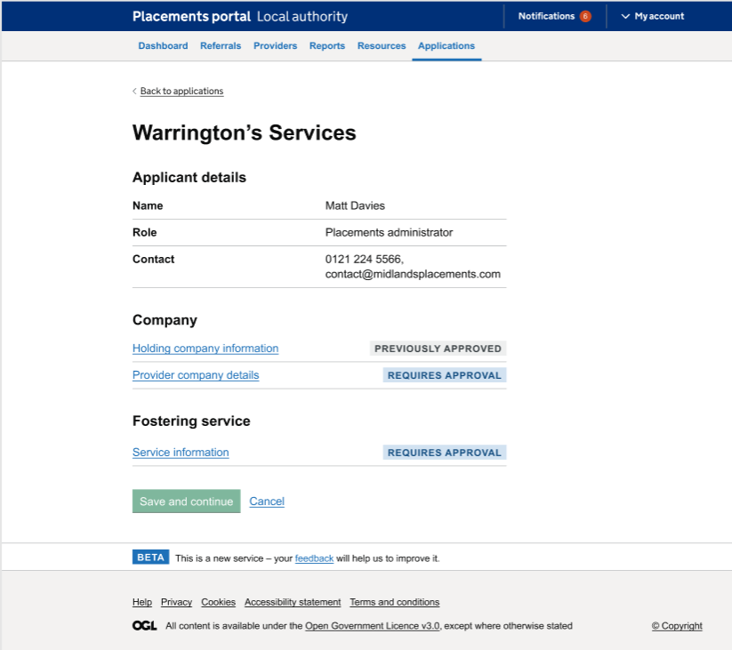
LA – Provider application/Holding company details
One user didn’t notice the previous approval and another user wasn't clear what the previous approval meant and how, and by who it had been previously approved by.
There was also some confusion from one user on the term holding company and suggested parent company is a term more familiar to them.

Slide 14
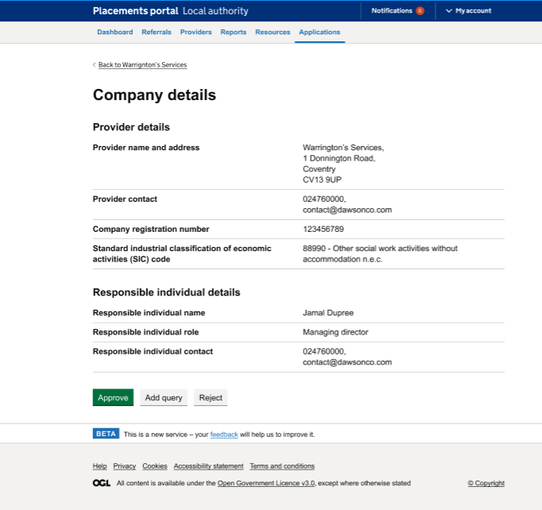
LA – Provider company details
Both users understood they could check company data by copying/pasting company no. in companies house (this is already part of their process.
One user requested contextual information for what the holding company number and company registration number within the provider details pertained to.

Slide 15
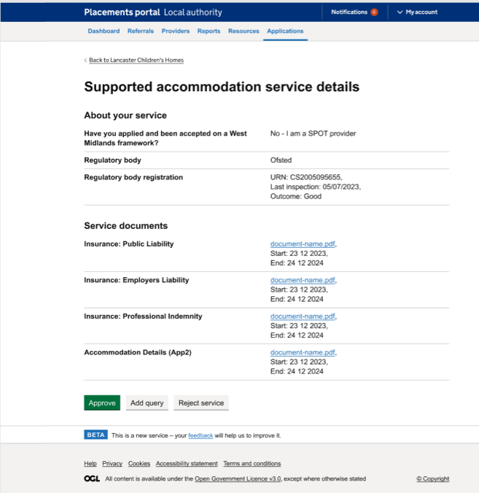
LA – Service details
One user commented that the Appendix 2 doc should be in the home details, not the service details.
One user commented that the category type (for accommodation type) was missing. (e.g ring-fenced etc.) PO's need this information to place appropriately.

Slide 16
Provider – Add documents
All users understood to click 'change' to amend a document
All users managed to add the insurance doc although one user needed support as they had not realised they had to remove the old document before adding a new one. Another user mentioned this had confused them.
One user was confused by the fields to enter document dates, and had not uploaded new document before trying to fill them in.

Slide 17
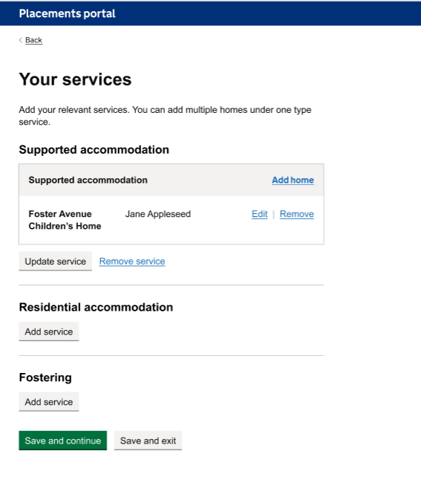
Provider – Save and Continue
Half of the users had to be prompted to save and continue after updating their profile query, one stated they would save and exit as they had updated the query already – meaning that this user did not complete the scenario and we should consider shortening this process.
One (residential) user queried the visible full addresses of their residential children’s homes. They would need to be reassured that this information was secure.
No users navigated back to their application (one submitted) or suggested that they needed to.

Slide 18
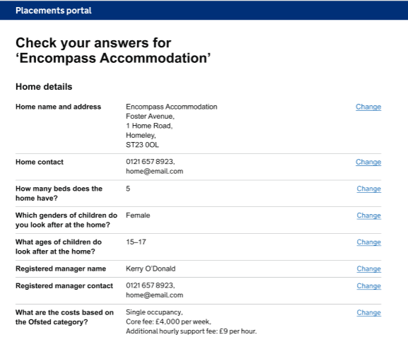
Provider – Home documents
All users managed to replace the out-of-date SoP.
One user mentioned that there should be descriptions or categories visible next to each home.
One mentioned that it was confusing whether their home would be suspended from taking referrals until their docs/queries were verified, as this could cause loss of income which is very concerning.
I would expect a description which is something like ‘x house is registered to take children with learning disabilities and the certificate would say type of children you’re allowed to support.
- P155 (Residential Provider)
“You’d want to make sure that the query was resolved and you’re back on [able to accept referrals]”
- P111 (Supported Accommodation Provider)
Notes:
It's also about relationships between providers and placement officers – some will call providers they know

Slide 19
Next steps
The upcoming design iteration will combine what we've learned from extensive usability testing, input from Subject Matter Experts (SMEs) in discovery working groups, and considerations of technical feasibility to optimize our approach to building the registration and approval process.
Today, we're holding a workshop to integrate these diverse elements into a cohesive solution that not only addresses user needs but also aligns with our technical constraints within the remaining timeframe.

Slide 20
Next steps
Discover
Design
Build
Test
Portal development – LA Referral journey variations
Continue test and bug fix of delivered code
Simple log-in functionality
Provider onboarding – review and revise the approach

