Slide 1
New West Midlands Placement Portal
Provider Training
5th March 2026, 10 – 11.30 am.
Claire Differ – BCT Change Lead
Jasvir Sandhu – BCC Change Lead
Andy Sjurseth– Product Owner, West Midlands Commissioning Hub
Sian Hickman – Commissioner, West Midlands Commissioning Hub
This session will be recorded

Slide 2
Agenda
Introduction
2. New WMPP timeline
3. Email notifications / Login Details
4. View Referral
5. Make an Offer
6. Sign an IPA

Slide 3
New West Midlands Placement Portal (WMPP)
A new WMPP will be launched on 28th April 2026, replacing the existing portal which is no longer adequate to meet the needs of its users.
The new portal will support our vision for the placement of children in the West Midlands:
“To deliver positive outcomes that meet the needs of our children in care by finding the right home, in the right place, at the right time.”

Slide 4
What this means for you
Enhanced Operating System
Mobile device access
Intuitive and Organised dashboard
Standardised referral form
Digitised IPA’s
Increased data collection
A Unified Regional Approach

Slide 5
2. New WMPP timeline
Go Live Date is 28th April 2026
Pilot Project runs from 23rd March – 17th April involving Birmingham and Coventry Local Authorities
Birmingham LA will test Supported Accommodation Referrals, Coventry will test Fostering Referrals. A small number of Residential referrals may be tested.
Account Login Details will be sent before Pilot Project
Training and guidance is available on BCT website
Weekly email updates

Slide 6
3. Email Notifications
E-mail Notifications will not be available till July 2026
Can remain logged into new portal and refreshes in real time
There are multiple in-portal notifications to notify of new actions

Slide 7
3. Log in details
Single Providers
Referrals received can be viewed by all
Referrals can be saved in individual’s list
Multiple Providers
Different logins for each organisation
Discussions taking place to agree process

Slide 8
4. Referrals
Viewing a Referral

Slide 9
4. Referrals
Filtering and sorting – identify suitable and new referrals quickly and easily
Urgent, Unread, Updated labels show referral activity
New, Active, Successful, Archived and Saved lists keep referrals organised
Summary of important referral information
Message function within referral

Slide 10
5. Making an Offer
How to make an offer on a referral for a supported accommodation placement

Slide 11
5. Making an offer
Manually entered by Provider | Pulled through from Profile
Date of Admission | Home and Provider Contact Details
Weekly / Additional Costs | Registered Manager
How Meet Childs Needs | Number of Registered Beds
Home Details | Responsible Individual
Education | Ofsted registration
Foster Carer details | Last Inspection Date
Non-compulsory documents | Inspection Outcomes

Slide 12
5. Making an offer
Notification on screen if documents are out of date
How Childs Needs will be Met is required field. No need to duplicate if information is included in other documents.
Additional Cost options
Only one home can be included in the offer, if multiple homes available, discuss directly with LA’s
Selecting Category of Care – can only chose one option
Can include Education in Offer
Once LA has accepted an offer, the information cannot be changed.

Slide 13
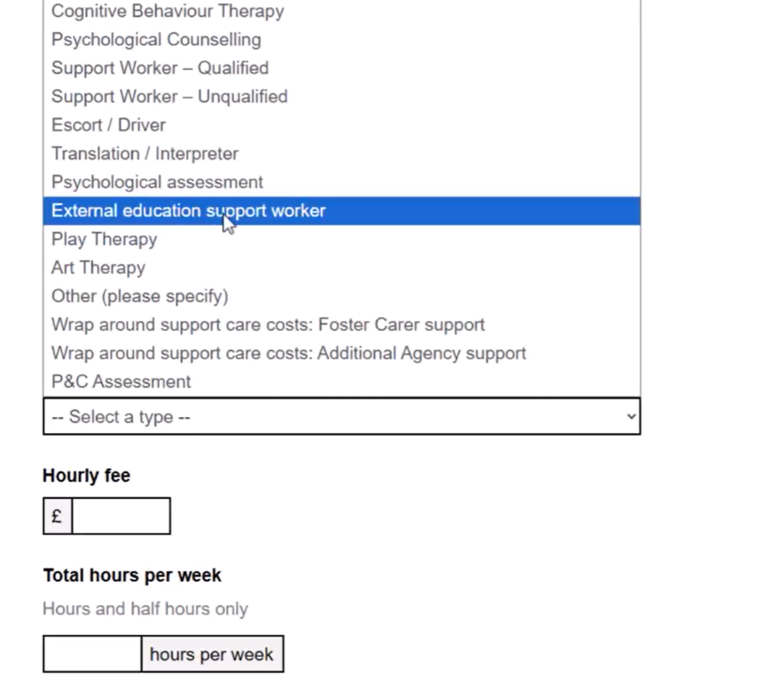
Additional Cost Options

Slide 14
6. Signing an Individual Placement Agreement
How to sign an individual placement agreement

Slide 15
6. Signing an IPA
When IPA is ready for signing, the details cannot be changed
The IPA can be signed by LA or Provider first, or by both at the same time
IPA can be exported as a pdf document
When IPA signed by Provider, referral has Completed status
When IPA signed by LA and Provider, referral has Closed status and moves to Archived list

Slide 16
Training videos and Guidance
westmidlandsplacementportalenquiries@birminghamchildrenstrust.co.uk
necdigitalsupport@necsws.com / 01429 558255

